Slide 1
Essential Steps to Creating a Formula for Academic Success of Foster Youth Students
Blueprint Conference 2017

Slide 2
Introductions
Flo Charlie Sierra College-Guardian Scholars Program
Britney Slates Sierra College-Guardian Scholars Program
Raquel Magadan-Sanchez Sierra College-Guardian Scholar Program
Sal De Leon Sacramento County Office of Education
Shane Libby Unity Care Group, Inc.

Slide 3
Learning Objectives
Program History
Blueprint of Sierra College Guardian Scholars Program
Step-by-Step enrollment process for an identified GS
Direct Student Services provided
Systems used to collect data
How community partners and County Office of Education add to the formula of success

Slide 4
SIERRA COLLEGE History
2007 FYSI Launched
2007 Created College Transition & Support Team formed
2014 College recognized Foster youth students as a disparate population
2015 (Spring semester) Student Equity Hired Full-Time Foster youth Program Coordinator and Counselor
2015 (Fall semester ) Launched Sierra College Guardian Scholars Program
2016 Spring Launched CAFYES program
2016 Mid-semester Spring hired Full-time Guardian Scholars & Financial Aid Technician

Slide 5
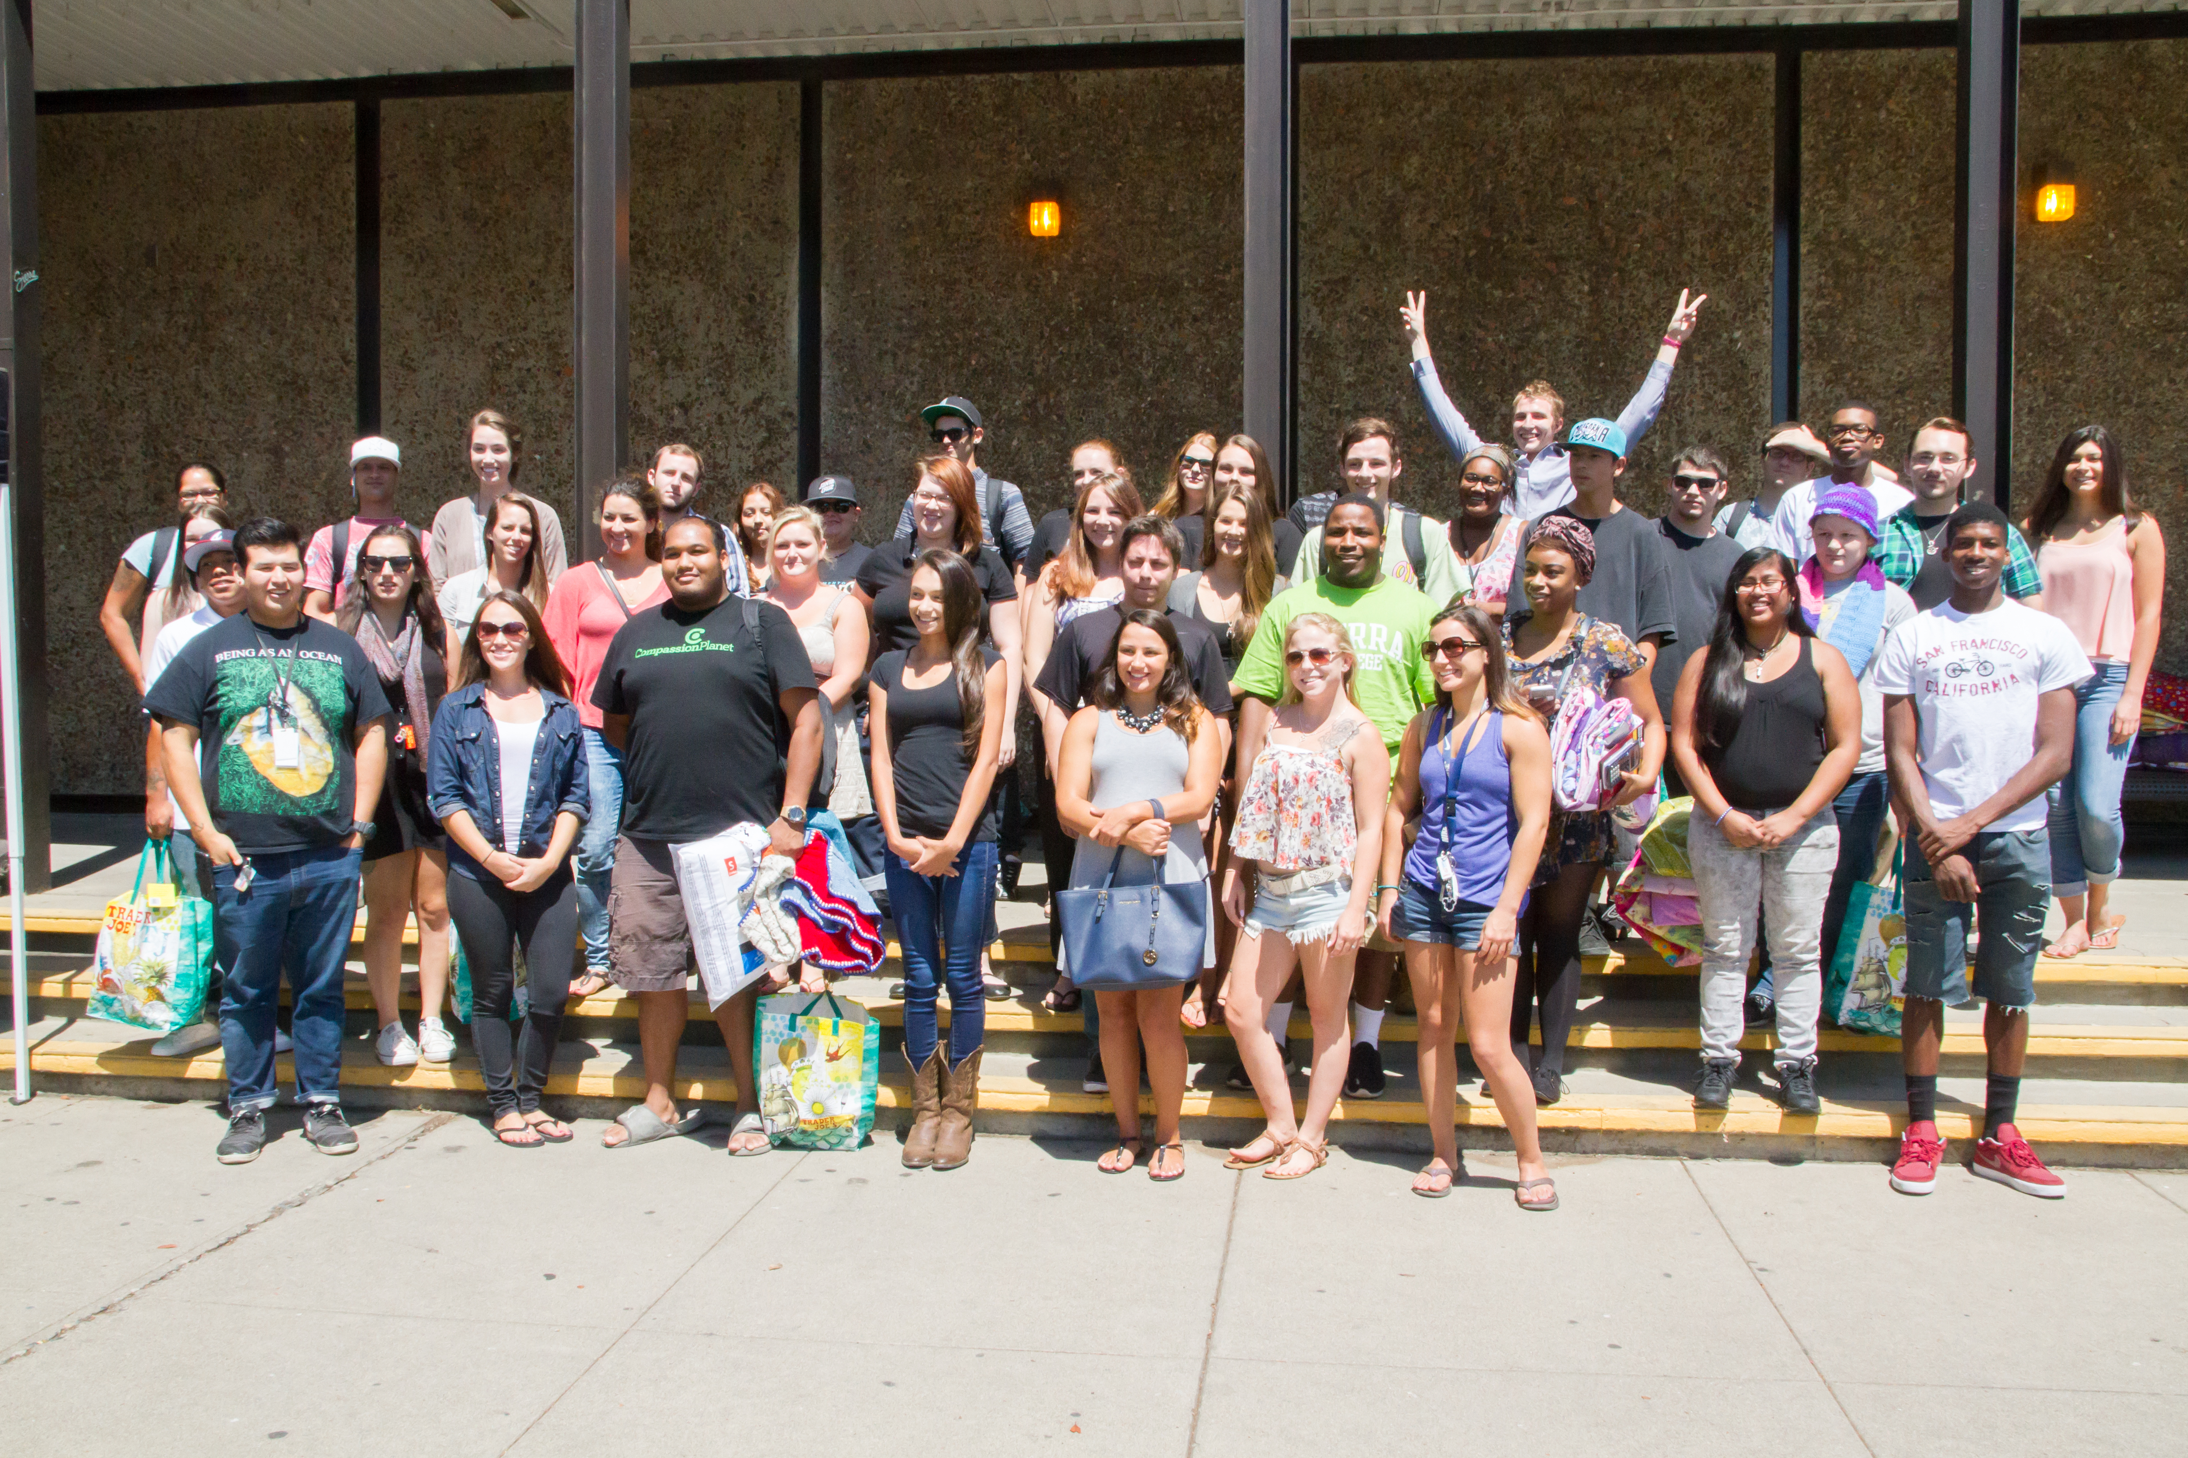
SIERRA COLLEGE History
Fall 2016
Fall 2015
Fall 2017

Slide 6
Organizational Structure

Slide 7
ONE Stop Shop
1 Counselor to Serve all FFY Students (GSP/EOPS/CAFYES/CARE/RISE)
1 Financial Aid Technician to verify and award all FFY students (GSP/EOPS/CAFYES/CARE/RISE)
1 CAFYES Counseling Assistant who collaborates with both Counselor & FA Technician

Slide 8
Steps of Enrollment for identified Foster Youth Student
Complete school app, FAFSA application and collect appropriate documents – Britney
Application is submitted and reviewed by program coordinator for selection – Ruth/Flo
Once selected, Intake appointment is scheduled with Flo
Once intake is done, student is routed to Britney for scheduling of counseling appointments and 1st check-in as well as check financial aid status
Student will be seen for 3 contacts with their counselor and 8 times with Allisha for check-ins per semester
Student schedules an academic appointment with Flo if semester hasn't begun yet,
Complete Program Application!

Slide 9
Direct Services Provided by Eligibility Status
Guardian Scholars
- Counseling
- Care-packs
- Financial Aid Assistance
- Transportation Assistance
- Book Voucher
-Meal Card Per Semester
-Gas Card Per Semester
- Transfer Assistance
- Resource connections
- Graduation pictures, cap and gown Assistance
- Campus visits to universities
-Lending Program
-End-of-Semester Success Grant
-Special Circumstance Emergency Fund
-Progress Celebration
-Social Events
EOPS/Guardian Scholars
- **everything in Guardian Scholars and...
- additional funds to buy text books
- additional funds to buy school supplies
-Priority Registration
-additional tutoring services
-waived CSU/UC applications
EOPS/CAFYES/ Guardian Scholars
- **everything in Guardian Scholars and EOPS and...
- additional funds to buy text books
-additional funds to buy school supplies
- monthly grants, vendor cards,
-lending laptop program
-special circumstance/Emergency fund
- Success coach and specialized counseling

Slide 11
Systems Used to collect Data
SARS - EOPS/CAFYES appointment data
Banner – FY indicators added upon verification
ARGOS – allows us to run reports based on information from Banner

Slide 12
Data Driven Decision
Student Exit Survey
Student Focus Group
Quick Survey Monkey
Asking Students Directly (informally)

Slide 13
Guardian Scholars Services based on 12 Elements
Designated Leadership
Internal & External Champions
Collaborations with community agencies
Data-Driven Decision Making
Staff peer support and professional development
Sustainability planning
Year-round housing and other basic needs
Financial Aid
Academic, career, personal counseling
Supplemental Support
Opportunities for student community engagement and leadership
Planned Transitions

Slide 14
2017 Blueprint for Success Conference
Sal De Leon
Sacramento County Office of Education

Slide 15
Higher Education Collaborative - Sacramento
Participation in neighboring counties’ transition efforts
Foster Youth Education Summit/Blueprint Conferences
Foster Youth Success Initiative (FYSI) 2007
CA Fostering Connections to Success Act (AB 12) 2012
Stuart Foundation
Request for Data
Individual education records/transcripts
Demographics for grants/program planning
Mutual agreement to meet on June 5, 2014

Slide 16
First meeting
Big question – did everyone agree there was a need for this collaboration?
What were the current efforts/services?
What were the barriers and challenges?
Consensus to begin Higher Education Collaborative (HEC) – Partnerships for Success: Case Studies in Successful Collaboration Between Child Welfare and Higher Education, September 2013, California College Pathways

Slide 17
Commitment
Surveyed potential partners
Quarterly meetings
2 hours
College foster youth liaisons would share program information and outreach opportunities.
Agendas would consist of relevant topics/speakers for both K-12 and colleges.

Slide 18
FYSCP will facilitate and host the Higher Education Collaborative (HEC)
Provide a space for community-based networking among professionals in Sacramento County
2) Provide information about the resources available in the community through brief presentations by district providers, child welfare agency, probation, local colleges/universities and other key partners

Slide 19
FYSCP will facilitate and host the Higher Education Collaborative (HEC)
3) Highlight college and career resources and outreach efforts in Sacramento County
4) Learn how HEC can support the priorities of the community as they work to increase access and success in post-secondary education for current and former foster youth

Slide 20
AB 854: Coordinating Education Services and Supports for Foster Youth
AB 854 aligns the former Foster Youth Services Coordinating Program (FYSCP) with Local Control Funding Formula (LCFF).
Enacted on October 11, 2015
Focus on collaboration among child welfare, probation, courts, Local Education Agency (LEA), and post-secondary partners to minimize school placement changes and improve education outcomes
Local cross-agency collaboration is a central component of FYSCP Plan.

Slide 21
Local Cross-Agency Collaboration is a Central Component of FYSCP Plan
Language states FYSCP plans need to include how FYSCP will collaborate with LEAs, child welfare and probation to determine proper educational placement of youth. EC 42921(e)(1)(A)
Collaboration includes:
Building capacity of county agencies, school districts and community organizations to support educational success of youth EC 42921(e)(1)(A)(i)
Facilitating collaboration amongst local agencies to ensure coordinated and non-duplicative service delivery and receipt of services.

Slide 22
Collaboration with Higher Ed
FYSCP plan shall describe how it will collaborate with higher education to ensure youth meet admission requirements and access programs that support their matriculation needs. EC 42921(e)(3)(B)
Emancipation and transition services are allowable FYSCP activities. EC 42921(e)(1)(A)(ii)

Slide 23
Local Control and Accountability Plans
What is the Local Control and Accountability Plan (LCAP)?
The LCAP is an important component of the LCFF. Under the LCFF all LEAs are required to prepare an LCAP, which describes how they intend to meet annual goals for all pupils, with specific activities to address state and local priorities identified pursuant to EC Section 52060(d).

Slide 25
Higher Education Collaborative Accomplishments
Partners reporting an increase of FY being identified and participating in college support programs
Partnership with ILP/EFC program and THP-Plus programs
Revamp of countywide College and Career Readiness conference
Average attendance 24 partners per meeting
Constant communication among partners

Slide 26
Unity Care Group, Inc.
Shane Libby

Slide 27
A community based, non-profit, multi-service youth and family development agency.
Mission Statement
“To Provide Quality Youth Programs for the Purpose of Creating Healthier Communities Through Life-long Partnerships”

Slide 28
ILP Services
Core Services to be Provided:
Career Development Housing Information
Education Interpersonal/Social Skills
Employment Life Skills/Daily Living
Financial Resources Mentorship
Health/Mental Health Money Management

Slide 29
Individualized Case Management
Meet with the youth in the community wherever they feel most comfortable.
Youth is in the drivers seat.
Using the TILP and results from the Ansell Casey Life Skills Assessment, develop 1-4 goals the youth can work on toward achieving independence.
Goals change as they are accomplished or if/when the youth changes his/her mind as to the direction they wish to take.
1:1 case management meetings occur as often as needed but at least once monthly.

Slide 30
2. Life Skills Workshops
Workshop facilitation may include bringing in guest speakers, taking fieldtrips and/or hosting workshop panels to communicate needed information for the youth.
Food, beverages, raffle prizes
$20 incentive per workshop
Workshops are currently offered 2-3 times per month, depending on the month.

Slide 31
3. Supportive Activities to be Provided
Advocacy
Ongoing Communication with Outside Entities
Information and Training
Incentives
Emancipated Youth Stipends Funds (EYS)
Information and Referral to Community Resources

Slide 32
4. Specialized Employment & Education
Services
For youth seeking employment or education assistance, referral is made by primary ILP Coordinator to the Education & Employment Specialist (EES) and an Employment & Education Plan is created.

Slide 33
EES provides:
1. Linkage to employment programs & liaises with employment programs to ensure services are working for the youth
2. Individualized 1:1 employment training & support
3. Linkage to school or education services to ensure youth education needs are being met
4. Provide 1:1 education support
5. Collaborates with ILP Coordinator

Slide 34
What makes us unique?
We were one of the original members of the TAY collaborative formerly known as College Transition Support Team (CTST) which was established to bring together college and community partners to work together to assist foster youth transitioning from high school to community college.

Slide 35
What makes us unique?
Our 1:1 individualized case management allows ILP staff to have a regular presence at Sierra College and work together with Sierra College staff and departments who provide support to foster youth to ensure there is a safety net so youth do not fall through the cracks.

Slide 36
What makes us unique?
As a community partner, we helped create the Guardian Scholars Program at Sierra College and were able to ensure the unique needs of our youth were adequately met by the program. Sierra College values our input and expertise.

Slide 37
What makes us unique?
We created the EES position to specifically address the educational needs of our high school and college age youth.

Slide 38
Education Specific Services: High School Age
Meet one on one with students to discuss academic challenges and plans for the future.
Advocate for youth to ensure their educational needs are met.
Coordinate with youth, caregivers and community supports to establish a plan for college enrollment.

Slide 39
Education Specific Services: High School Age
Coordinate youth workshops with community partners including Sierra College to provide information regarding Financial Aid, College enrollment and career/technical training opportunities.
Support youth in the application process for Career and Technical trainings including ROP/CTE Works and vocational training programs

Slide 40
Education Specific Services: College Age
Provide individualized support in conjunction with Sierra College counselors to develop youth academic plans and transfer goals.
Provide linkage to college campus supports including tutoring, EOPS, DSPS and Guardian Scholars Programs.
Assist youth with the financial aid application process.
Coordinate campus tours of local post-secondary education programs and career and technical training programs.

Slide 41
Education Specific Services: College Age
Advise and counsel youth on career and educational goals.
Explore learning challenges with youth and establish plans with youth to receive support on campus to meet their educational goals.
Coordinate with college campus staff to ensure that youth are enrolled in the appropriate support programs and meeting all program requirements in a timely manner.
Attend advisory committee meetings and provide support to college campus programs as needed.

Slide 42
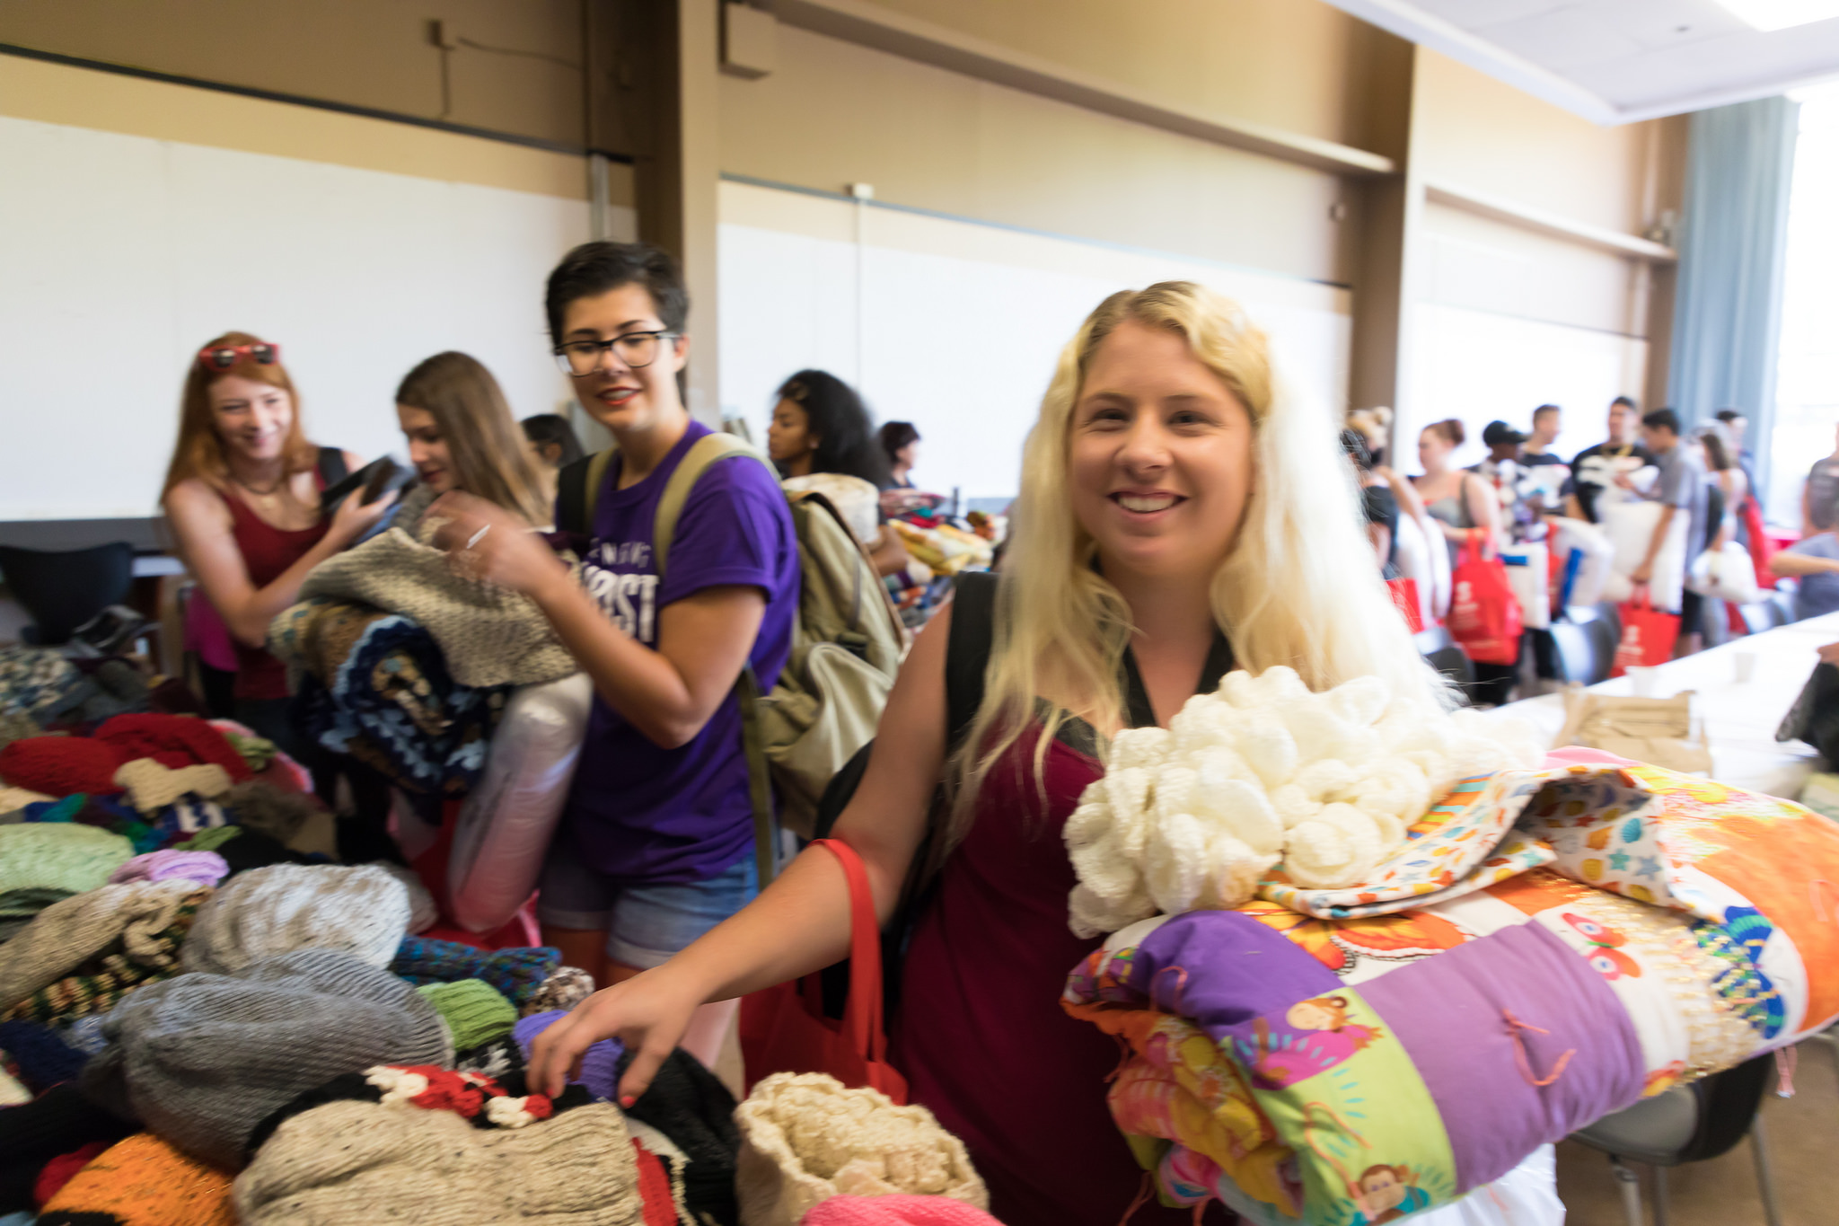
Helpful Tips
Give them something to smile about/Warm Welcome!
TIP #1

Slide 43
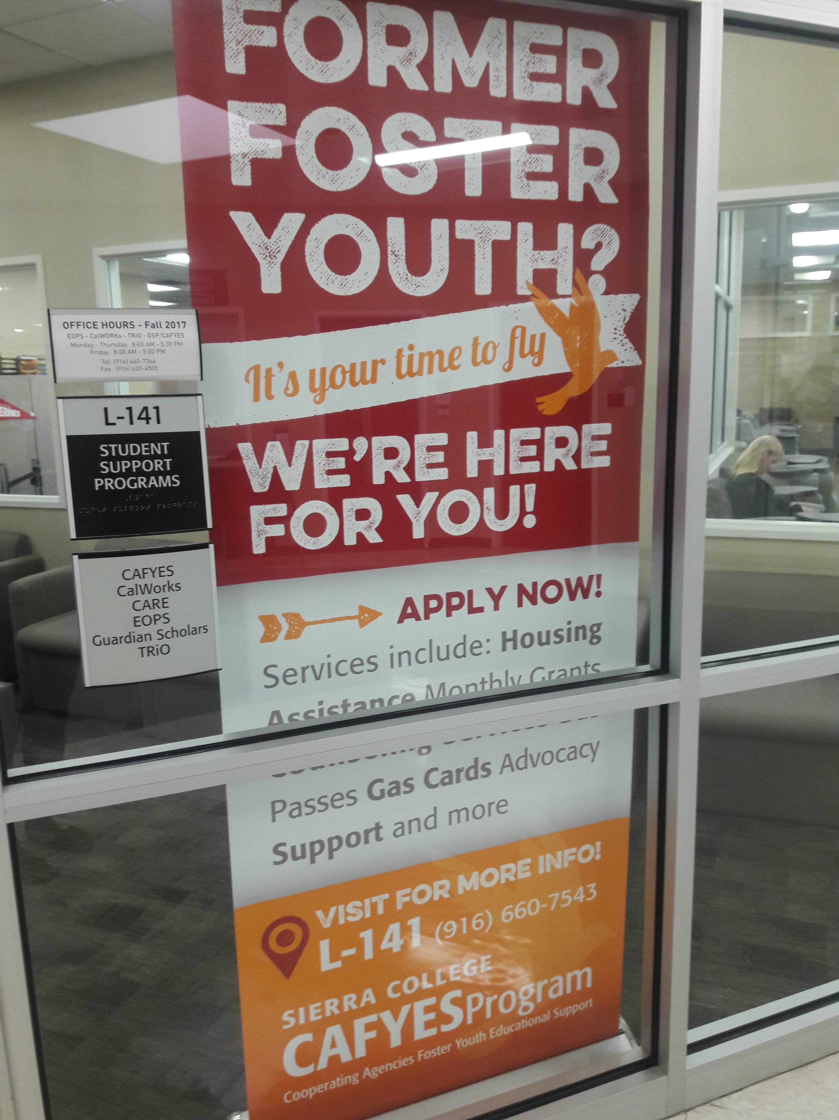
Tip #2
Make your space of service visible for students & try to co-locate with other student service programs

Slide 44
TIP #3
Provide your student with tools to stay organized and manage life

Slide 45
TIP #4
FEED THEM!!

Slide 46
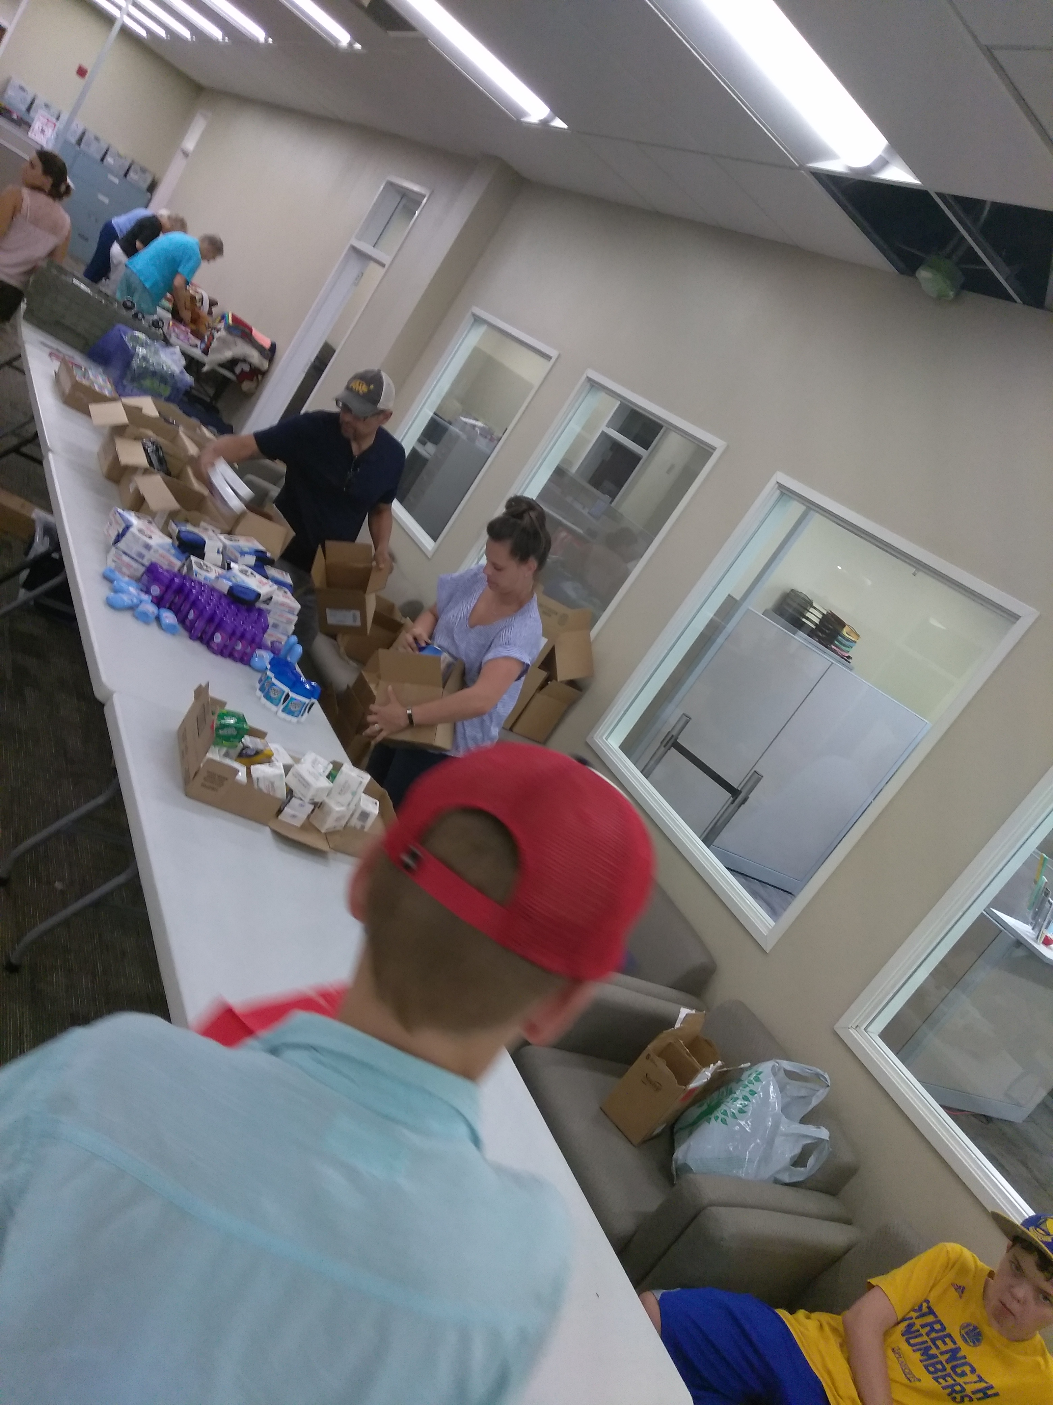
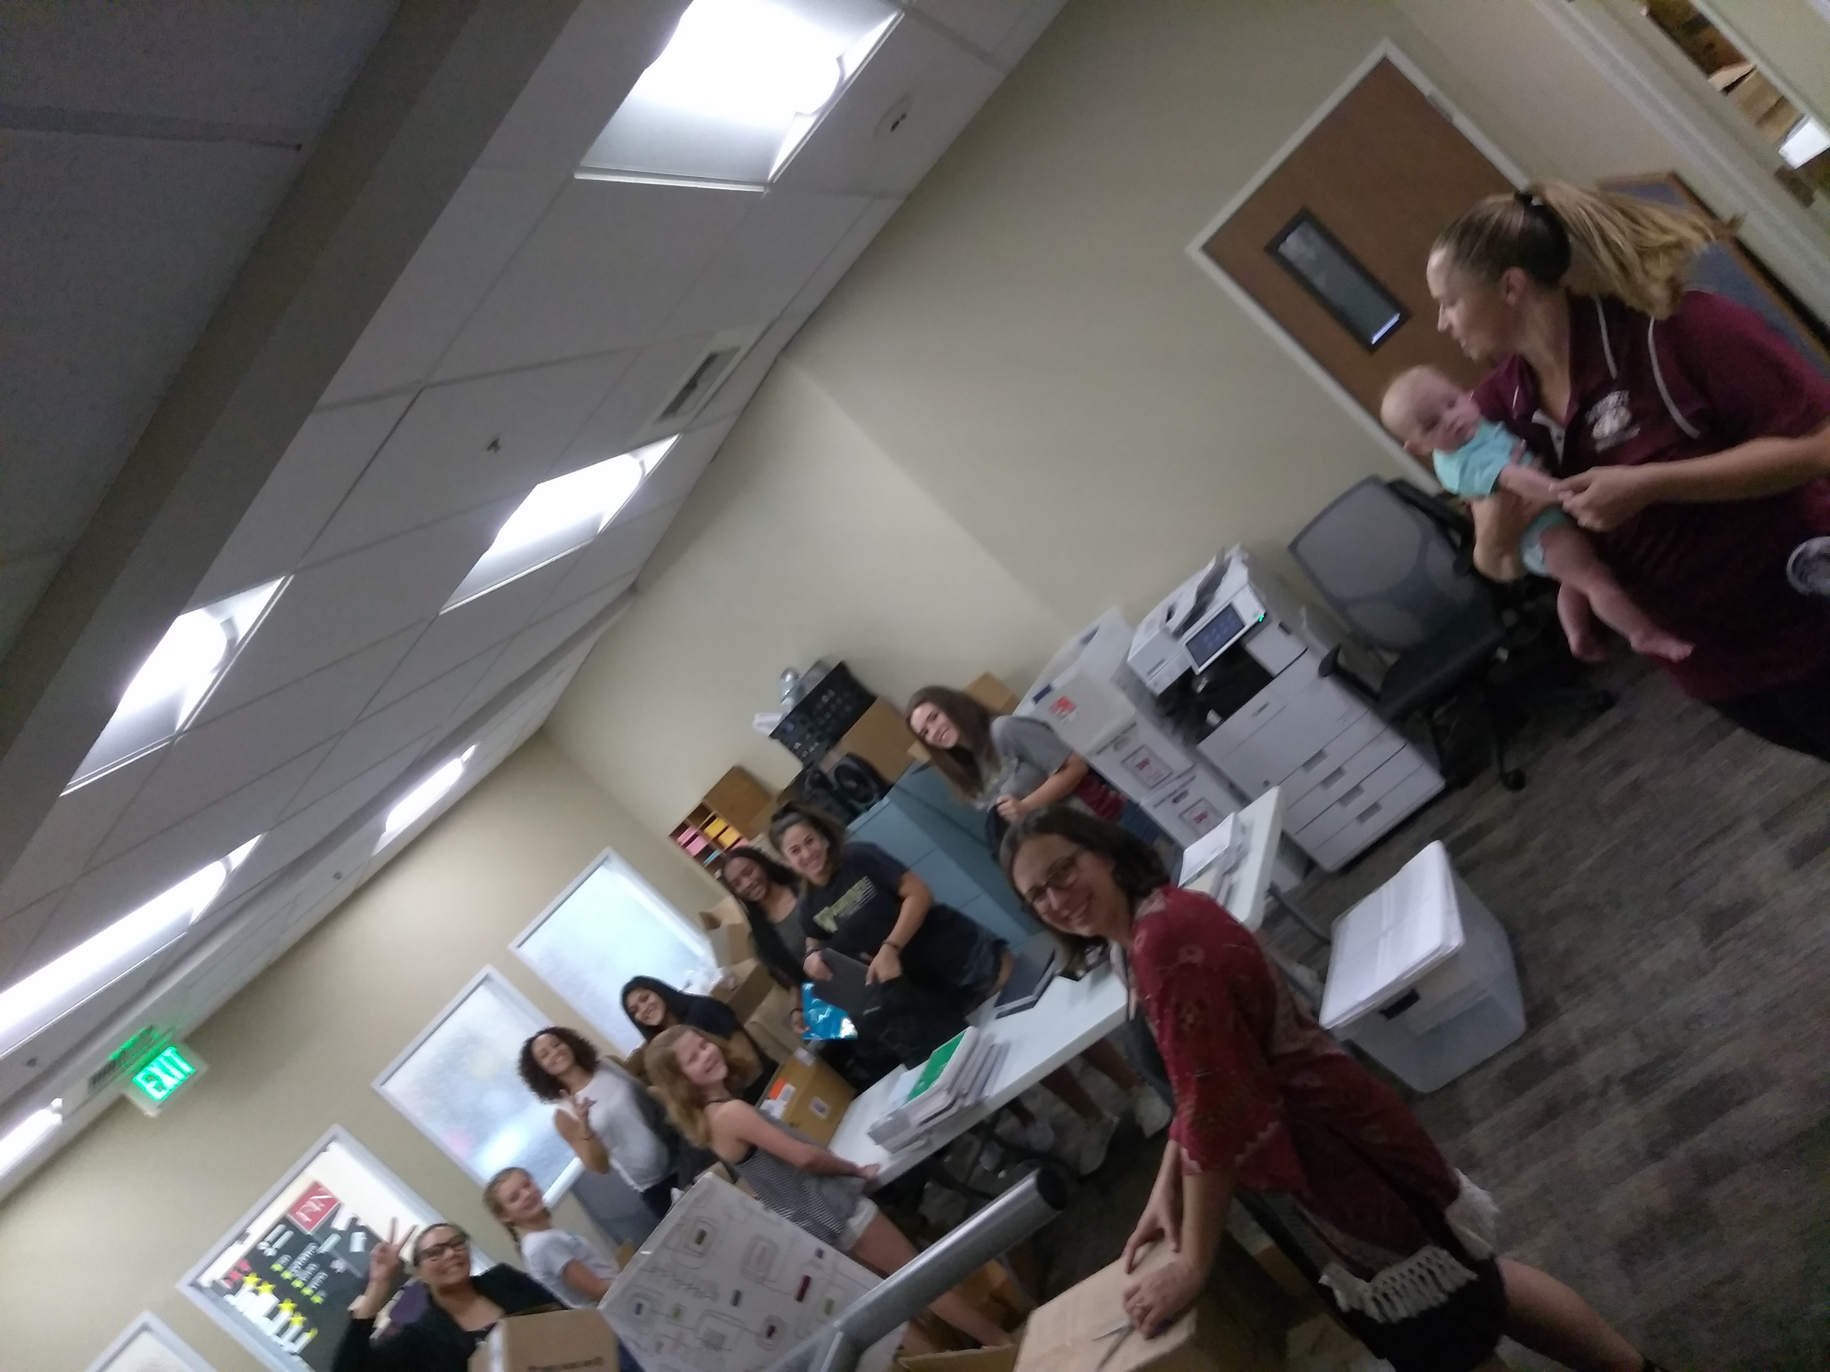
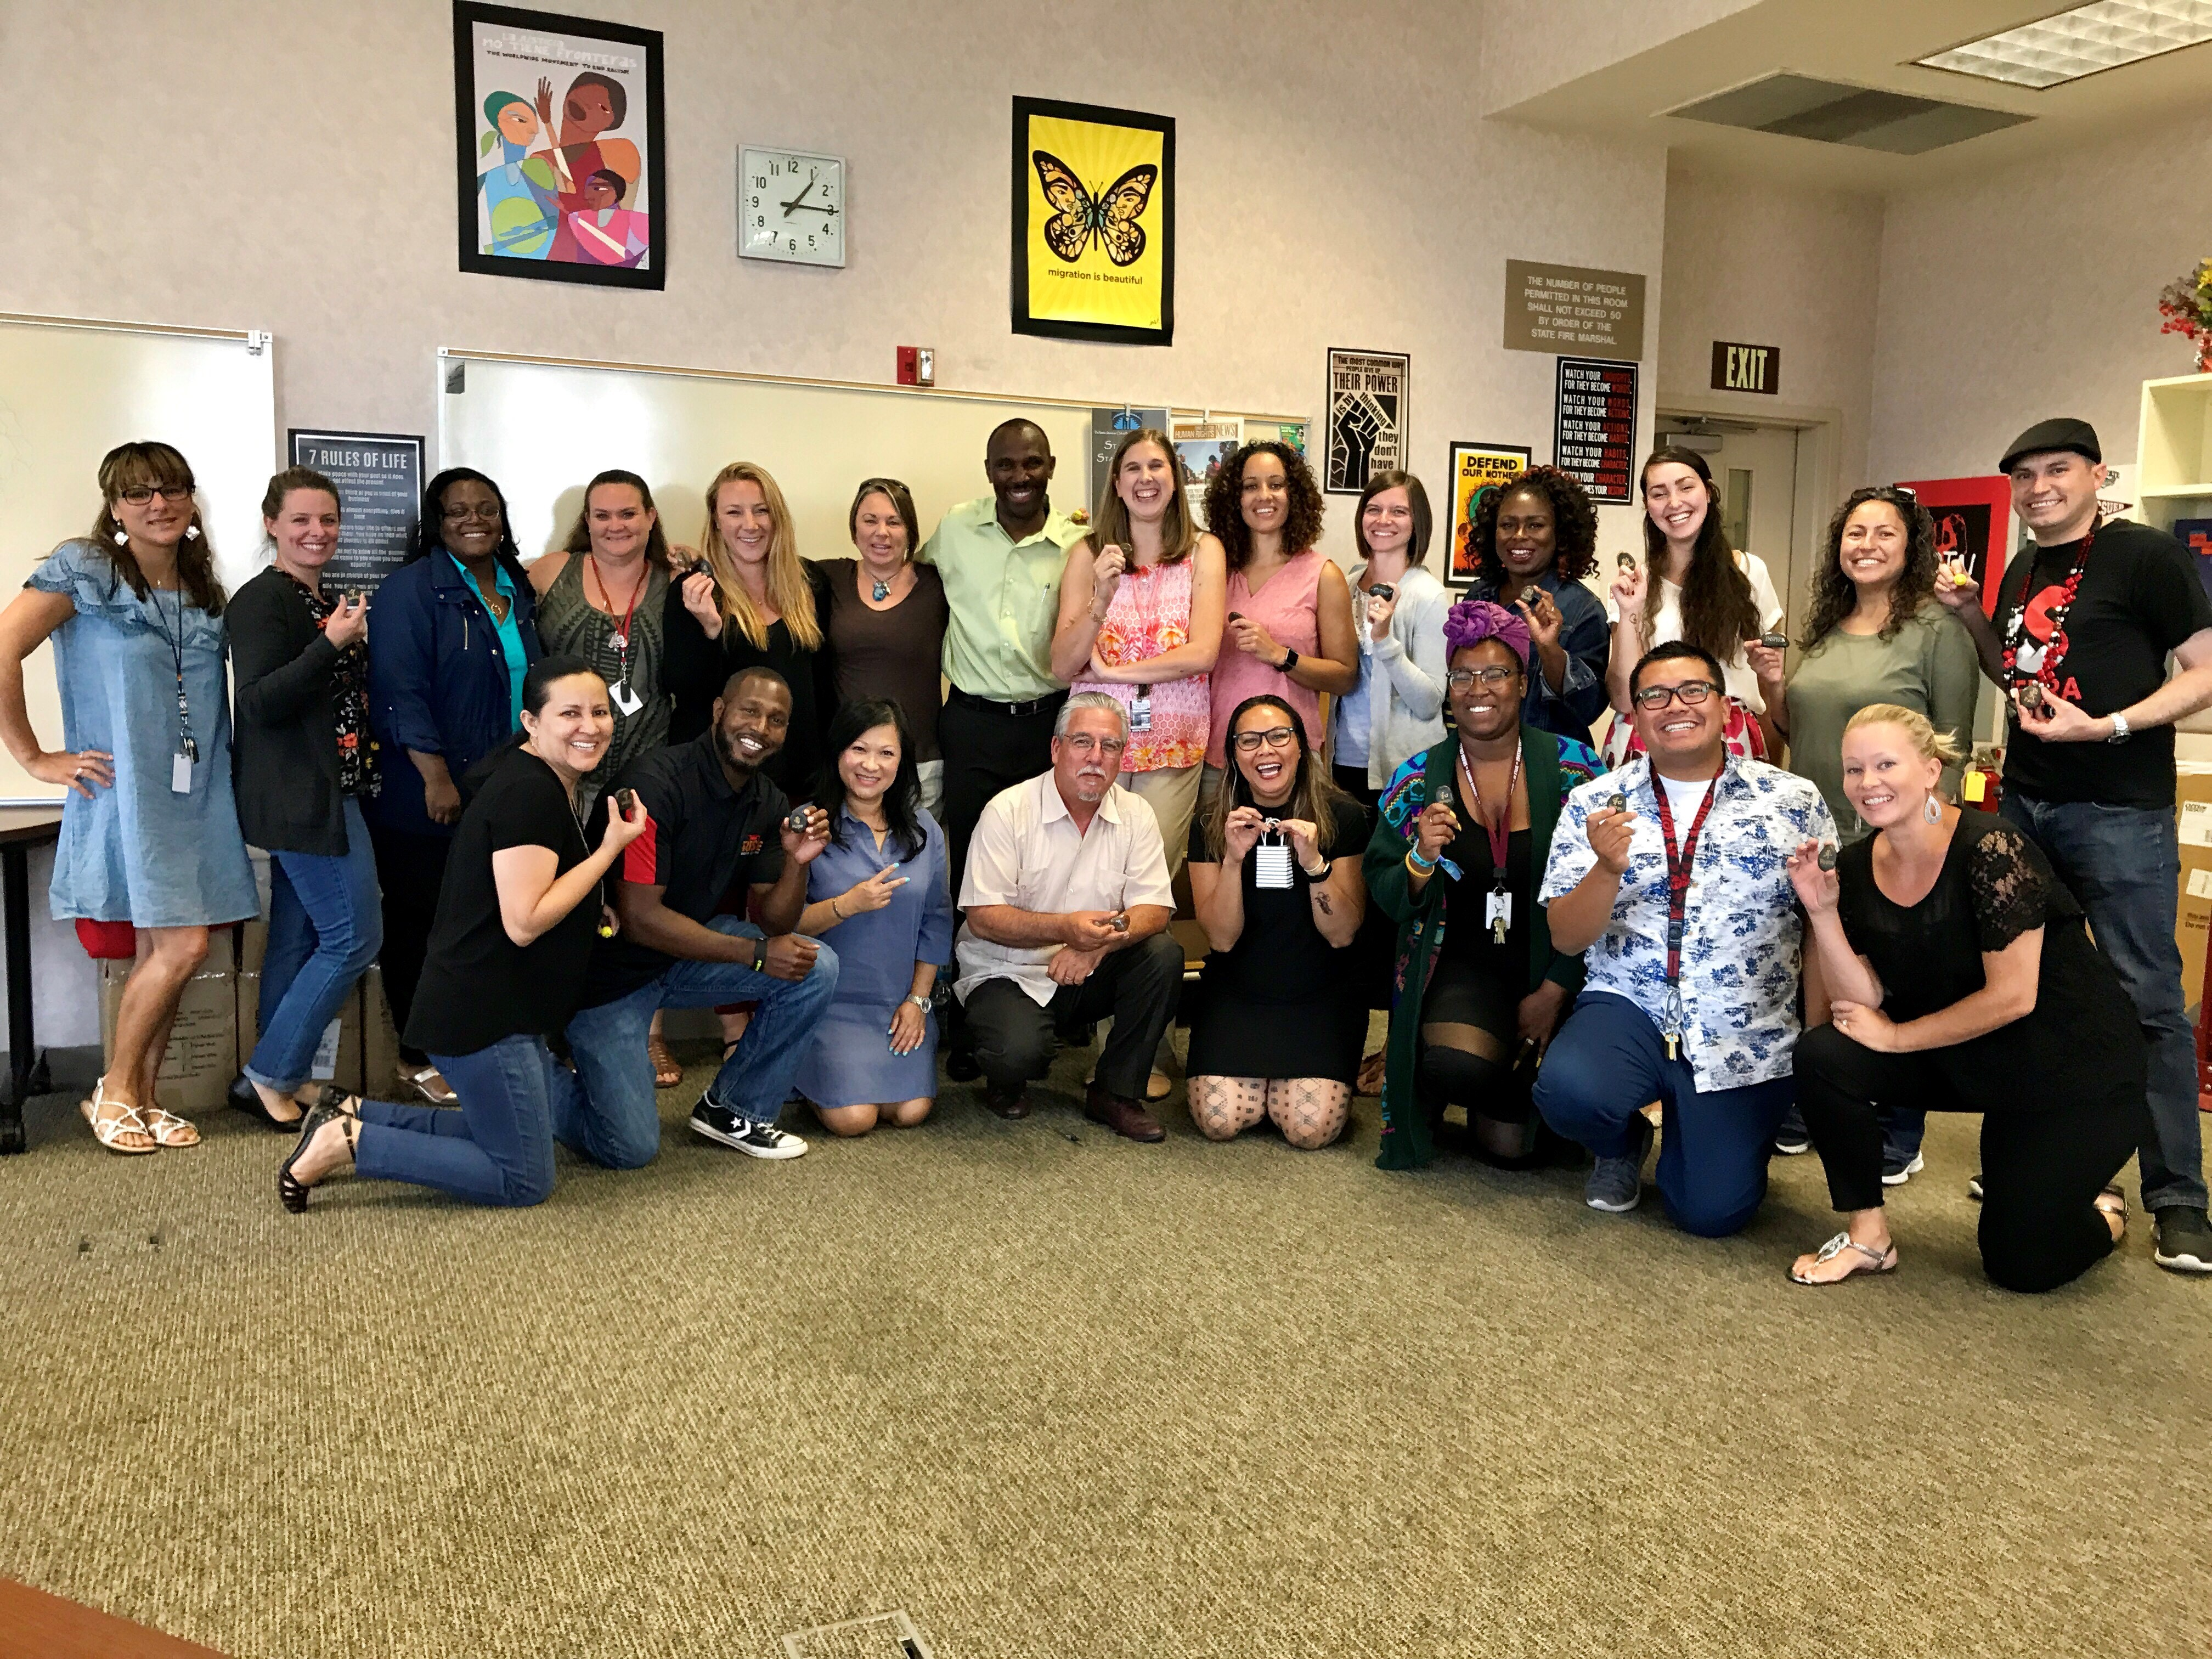
TIP #5 Build Champions On & Off Campus
List of our Donors
Sonbol from Foundation & Sierra College President @ our Welcome Event
Members of our Advisory Committee & Sierra College Community helping with Welcome Back Prep
Student Equity Team

Slide 47
Q&A

