Slide 1
Retreat Finder: Road to Personal Development
Curglin Robertson, M.A. Assistant Director, Guardian Scholars, CSU, Long Beach
Joshua Williams Coordinator, Guardian Scholars Program, CSU, Dominguez Hills
Steven Wilson, M.S., Counseling Assistant Director, EOP Guardian Scholars, Cal State LA
Danielle Chambers, M.S.E
Associate Director, Educational Opportunity Program, Cal State LA
Sara Gamez, Ed.D. Associate Director, Student Support & Equity Programs, Cal Poly Pomona
Dr. John Hamilton, Ed.D. Director, Educational Opportunity Program & Guardian Scholars, CSU, Long Beach
Notes:
Danielle
Intro all presenters (do not introduce students just yet)

Slide 2
Learning Outcomes
Understand how wellness aligns with student success
Understand the importance of providing spaces for personal growth and success; and
Identify ways to duplicate this entire program or elements of it
Notes:
Danielle

Slide 3
Why Retreat?

Slide 4
Retreat
“an act or process of withdrawing especially from what is difficult, dangerous, or disagreeable (2) : the process of receding from a position or state attained”
Miriam - Webster Dictionary
Notes:
DC: Use as a transition to discuss our approach to addressing student issues:
everyday conditions or circumstances that student face require us to move them/or “escape” in order for them to focus in on themselves.

Slide 5
Student Issues
Home Environment
Non-cognitive factors that impacts student success
Mental Health
Educational Transitions
HS to college/university
2yr to 4 yr transfer
Common barriers to retention seen by front-line staff
Notes:
Sarah:
Discuss student issues and staff challenges…????
Facilitator...Sara

Slide 6
Retreat: Then & Now
2015 - 2017
Build campus community & on-campus students networks
Create a networking pipeline across CSU
2018
Community college partnerships
Promote community across systems
Strengthen 2yr - 4yr transfer pipeline
2018 - Build community across systems (LACC)
Notes:
DC & Josh
* As a program, we felt these were the tools we wanted our students to have after attending this retreat. We knew that we couldn’t solve their problems, but we were determine to plant seeds; nuture their inner resolve to perserve, in order to help them persist (academically & personally).
2015 - DH only (est. program and on-campus community)
2016 - DH only (focus on personal development elements to address transition challenges)
2017 - DH, LA, and LB - Expand networking communities across CSU
2018 - DH, LA, LB, and CC partner(s) - Address transition challeges; seemless pipeline from 2yr - 4yr, and strengthen program relationships}

Slide 7
Retreat Framework
Budget
Participants & Staffing
Disarm the space
Establishing Trust (Vegas rules)
House Rules: Activity that allowed students to take ownership of their retreat experience
Student Development
Appreciative Advising & Strengths Quest
Workshop platforms
Use of reflection activities with students & debriefing sessions for staff
Notes:
DC & Josh
15 students per campus, demographics of ppl/volunteers
CSULA - 6 staff; DH - 4; LB 3 = 13
Creating an education networking pipeline for students
During debriefing make sure you discuss reflection with students and debriefing with staff

Slide 8
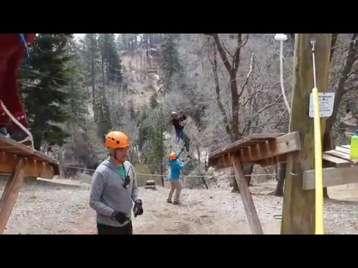
Strengths Retreat 2017

Slide 9
Workshops & Activities
Schedule - https://drive.google.com/file/d/0B6nCDywvr0WFOGRJOTJmZlQzYkU/view?usp=sharing
Notes:
JW CR
insert schedule
Important to stress everything was dialogue. Stress physical and mental challenges. Inventory of how they practice self care. Giving them space to discuss the things that mattered to them (Diversity). Discuss that we did an assessment (Have numbers ready) Don’t discuss validation and encouragement because John is doing that.

Slide 10
Engagement Indicators and Non-Cognitive Variables
Notes:
Engagement Indicators and Non-Cognitive Variables (john)

Slide 11
Engagement Factors
Outside of Class Collaborative Learning Social Experiences
Peer Group Interactions
Validating Experiences & Encouragement
Support from Faculty/Staff Mentoring Experiences Faculty Peers
Counseling/Advising Staff
Notes:
JH

Slide 12
Non-cognitive Factors
Positive Self-Concept or Confidence. Students expect to do well in academic and nonacademic areas and assume they can handle new situations or challenges
Realistic Self-Appraisal. Students understand that reinforcement is imperfect and do not overreact to positive or negative feedback. They have developed a system of using feedback to alter behavior

Slide 13
Non-cognitive Factors
Availability of Strong Support Person. Students do not rely solely on their own resources to solve problems. They are not "loners" and are willing to admit they need help when it is appropriate
Successful Leadership Experience. Students are comfortable providing advice and direction to others. They are comfortable taking action where it is called for
Notes:
JH

Slide 14
Student Panel
Notes:
Steve Wilson

Slide 15
Program Share
Cost share
create partnerships with campus or community partners
Leverage human resources
graduate school interns, volunteers, campus departments and community partners
Determine a Venue
Pali Mountain Retreat & Conference Center
Innovative
Recreate in different formats: Summit, Conference, Day Retreat
Notes:
CR
Create a day retreat, summit or conference

Slide 16
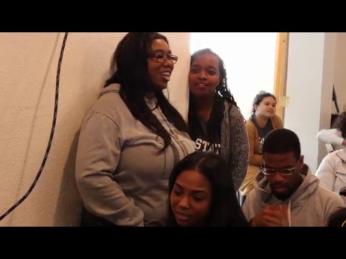
Notes:
DC

Slide 17
Thank you

