Slide 1
Sky’s the Limit: creating a foster youth support program, that fosters resiliency.
Presented by: Tia Holiday, Program Services Coordinator, GSP Linda Allen, Retention Specialist, GSP Calvonnia ”CeeCee” Kelly, GSP Student
Alfreda ”Freda” Palmer, GSP Student

Slide 2
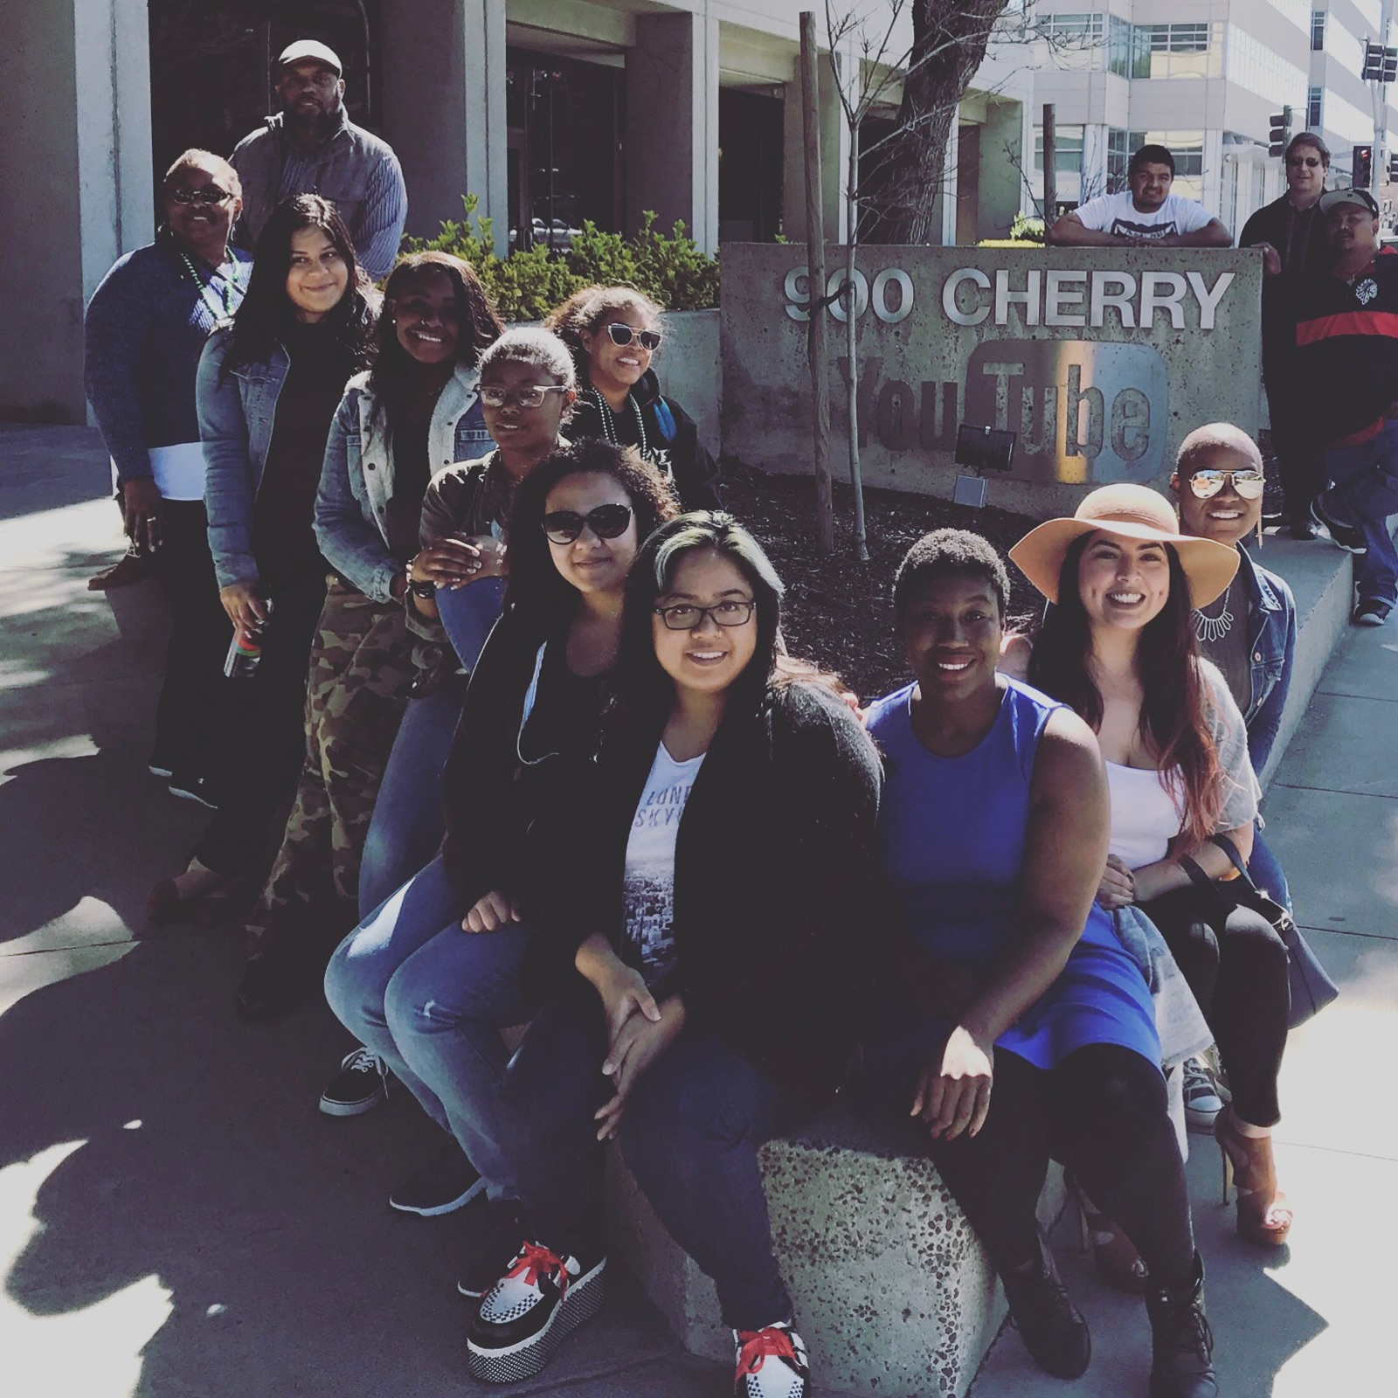
Overview
Introductions
Energizer
Start-Up GSP
Q&A – Current GSP Students

Slide 3
Staff
Tia Holiday
Program Services Coordinator
Linda Allen
Retention Specialist

Slide 4
Calvonnia “CeeCee” Kelly
Major: Administration Justice
Career goal: Law Enforcement
How has GSP helped your growth as a student or individual?
“GSP has turned me into a social butterfly. They have helped me be more involved in school and events on campus. GSP has given me opportunities with jobs and helped me through my personal life. They always push me to do my best, and don’t give up without putting up a fight. They have really helped me balance my classes so I’m not overwhelmed. GSP is my family community on campus.”

Slide 5
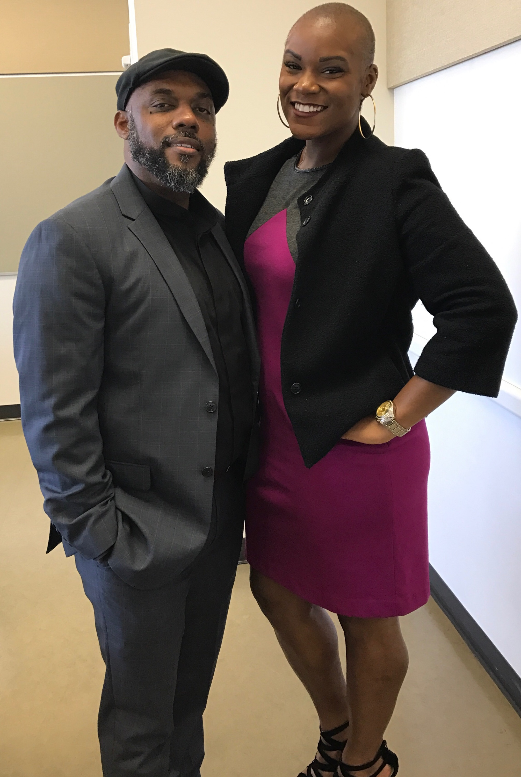
Alfreda “Freda” Palmer
Major: Kinesiology
4-Year transfer goal: “Somewhere far”
Career goal: Physical Therapist
How has GSP helped your growth as a student?
“GSP has helped me with academic and life support. They have helped me to open up to people again. GSP gives me the motivation to come to school, to talk about my problems, even when I don’t want to talk about my problems. If I didn’t have GSP I would have definitely dropped out of school by now. They have helped me grow individually as a person because of their resources and always gives me motivation to do better in and outside school."

Slide 6
Energizer

Slide 7
Guardian Scholars Program Model
Student
Career
Social
Psychological
Economic
Academic
Economic – Financial Coaching
Academic – Identify areas of growth & strength
Career – Hands on exploration
Social - Community oriented
Psychological – 1-1 Counseling

Slide 8
Start-up GSP: Year one and two
Step 1
Identify
FY at institution and/or district.
Champions on campus
Step 2
Get $$
Determine funding source
Step 3
Champions
Who are your campus allies?
Step 4
Educate
Staff & faculty
Step 5
Opportunities
Create intentional partnerships on & off campus

Slide 9
Group Activity: Identify Barriers
What are barriers to academic success for FY in community college?

Slide 10
Table activity: Identifying Champions
Directions:
Using the barriers we just identified, determine who on campus can assist in crushing that barrier for FY students.
Identify at least 5 champions on your respective campuses!
Example:
Barrier = Financial Aid Appeals 4-6 week process time
Champion = Jane Doe

Slide 11
Creating Opportunities
On-campus
Off-campus
Learning communities
Clubs
Additional support programs
Drop-in centers
CBOs
Local small businesses
Notes:
MOU templates in packet

Slide 12
Data & Iterations
Iterate, iterate, iterate…
Goal = Bring in & retain, students while creating community.
Track
Social events, workshops, appointments, end of year surveys
Survey instructors and champion staff
Quantitative AND Qualitative
Be mindful WHO wants your data. Ensure it
Why?
How?
When?
Notes:
Google Forms
Survey Monkey
Research Office

Slide 13
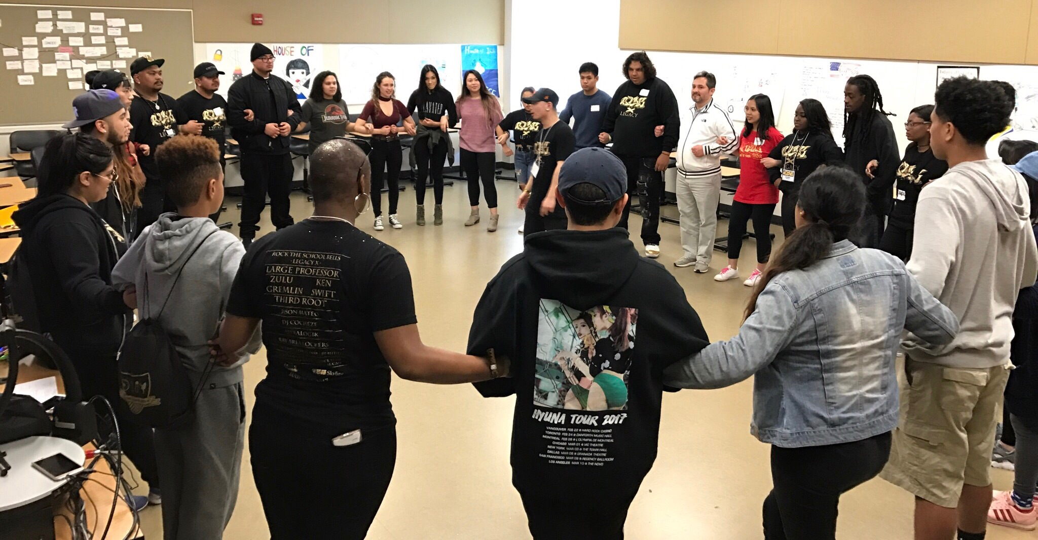
Programs created by students, for students

Slide 14
Have a question for Tia or Linda?
Write it on your notecard and we will answer them after the student Q & A, after this presentation or via e-mail.
Name:
E-mail:
Question:

Slide 15
Thank you for attending our workshop!
Contact us!
Tia Holiday
Holidayt@smccd.edu
650-738-4315
Linda Allen
allen@smccd.edu
650-738-7107

