Slide 2
Promises2Kids is a leading non-profit with a commitment to helping foster children live a brighter future.
Through our unique services and programs, we respond to the diverse needs of San Diego’s foster children of all ages, promoting positive lifelong skills they will carry through adulthood.

Slide 3
A.B. and Jessie Polinsky Children’s Center
San Diego’s emergency shelter for children who cannot remain at home as a result of abuse or neglect. Promises2Kids provides programs at the A.B. & Jessie Polinsky Center that emphasize early childhood development, recreation, health and well-being, and mentoring.
Developmental Screening and Enhancement Program
Pre-School
Pet Therapy
Youth2Youth Mentorship

Slide 4
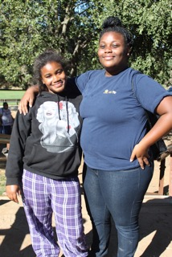
Camp Connect
Promises2Kids’ Camp Connect provides one way for family bonds to remain strong. Camp Connect unites brothers and sisters in the foster care system that do not live together to enjoy year long fun activities.
Monthly Events
Family Dinner Night
Four Day Camp

Slide 5
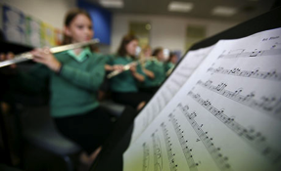
Foster Funds
This unique fund grants foster children’s wishes for basic items and special treats that most children take for granted. Children often request funds for sports fees, music lessons, graduation related fees, prom, camp, or other activities they otherwise could not afford.
Birthday Club
Something Special
Community Drives

Slide 6
Guardian Scholars
Guardian Scholars supports foster youth who wish to obtain a university, community college, or trade school education. The program provides students with the support to fulfill their career and higher education goals.

Slide 7
National Statistics
70.8% of foster youth complete high school by age 19
(Compared to 88% of the general population)
54.8% of foster youth who complete high school will attend college
After six years, the amount of time for Federal Financial Aid for a full time student, 8% will earn a 2 or 4 year degree.
300
students
212
will graduate from high school
116
will attend college
9
will earn a college degree

Slide 8
“Something is happening when foster youth exit the system. While we are supporting them in the transition, those skills are not carrying through in earning post-secondary education. ”
- Stephanie Ortega, VPO Promises2Kids

Slide 9
GUARDIAN SCHOLARS
Start early and finish strong.

Slide 10
JUNIOR GUARDIAN SCHOLARS
Take the time and you’ll be amazing. Give us a year and you’ll gain a lifetime.

Slide 11
CAREER EXPLORATION
High school students in San Diego get the opportunity learn about careers from industry professionals. Students are exposed to careers that need education and careers that they can begin directly after high school.
Students participate in
Behind the scenes tours
Hand on learning
Panel discussions
Pre-Employment Training

Slide 12
CAREER EXPLORATION
Challenge – Students were engaged but there was a lack of ability to collect long term program impact data due to students being young, moving placements, and lack of direct care.
As a result, Career Explorations was changed from a monthly program to a quarterly program that was folded within the larger Junior Guardian Scholars program.

Slide 13
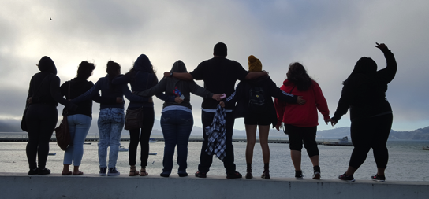
JUNIOR GUARDIAN SCHOLARS
Junior Guardian Scholars participate in unique educational program that prepare them for college and provide exposure to upcoming and advancing career fields.
Notes:
Here speak to how often they meet and the interview process.

Slide 14
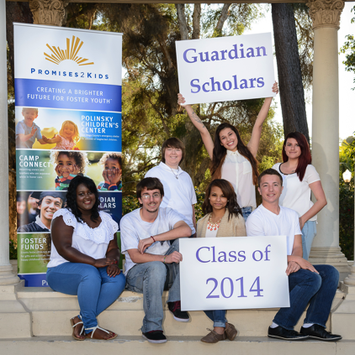
JUNIOR GUARDIAN SCHOLARS
SAT Preparation
College Application Support
Academic Connections
Exploration into STEM and STEaM fields
Career Assessments
College Campus Tours
Community Service
Notes:
Here speak to all the benefits of the program.

Slide 15
JUNIOR GUARDIAN SCHOLARS
EXPANSION
The Junior Guardian Scholars program was designed to support current foster youth as they pursued post-secondary education at a traditional college or university.
There was a lack of support for youth that chose not to attend a four-year institution.
Promises2Kids expanded the Junior Guardian Scholars program to a dual focused model that had specific support and resources for foster youth that went to community college or vocational school

Slide 16
JUNIOR GUARDIAN SCHOLARS
Community College or Vocational Education Track
Four-Year Education Track
Junior Guardian Scholars are offered the support necessary to transition to a community college or a vocational school. This includes housing, tutoring, and care that ensure they complete their two to three year journey.
Junior Guardian Scholars are offered the opportunity to explore colleges and have the comprehensive support that ensures they are eligible for both CSU and UC universities.

Slide 17
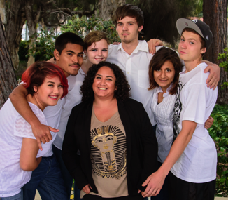
Junior Guardian Scholars Program
300
students
212
will graduate from high school
70.8%
Junior Guardian Scholars
43
students
39
graduated from high school
90%
Notes:
Speak to the success and transition into Guardian Scholars.

Slide 18
GUARDIAN SCHOLARS
Education is the most powerful weapon which you can use to change the world
- Nelson Mandela

Slide 19
GUARDIAN SCHOLARS
Guardian Scholars was established in 2001 as a support for foster youth that had aged out of care and were pursuing post secondary education.
Students were given a stipend twice a year that was based on the assumed costs of the institution they were attending.
Four-year students received slightly more than community college students.
Stipends were dispersed twice a year.

Slide 20
GUARDIAN SCHOLARS
Guardian Scholars students needed a more robust program that could adapt to their growing needs.
Program launched a community mentor program to help ground students in people outside of the professional system of care
Stipends were dispersed on a monthly basis directly to students to keep them engaged with Promises2Kids and resources in the community.

Slide 21
GUARDIAN SCHOLARS
CASE MANAGEMENT
Scholars are assigned a contact that is with them throughout their time with the Guardian Scholars Program.
SCHOLARSHIP
Students receive a $3200 to be dispersed monthly throughout the academic year.

Slide 22
GUARDIAN SCHOLARS
MENTORING
Scholars are paired with a community member that can begin assisting them with their transition to adulthood.
WORKSHOPS
Promises2Kids provides workshops and trainings for the students to learn to be successful at school and in life.
Notes:
Meet in person twice a month
Communicate once a week
Attend 2 Promises2Kids events together

Slide 23
The Promises2Kids Difference
300
students
212
will graduate from high school
116
will attend college
9
will earn a college degree
300
students
270
will graduate from high school
243
will attend college
194
will earn a college degree

Slide 24
GUARDIAN SCHOLARS
In their own words… Student Voice
2017 – 2018 Guardian Scholars

Slide 25
THANK YOU

