Slide 1

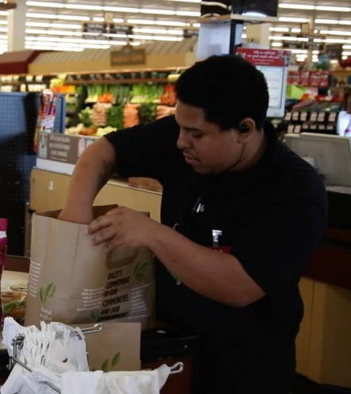


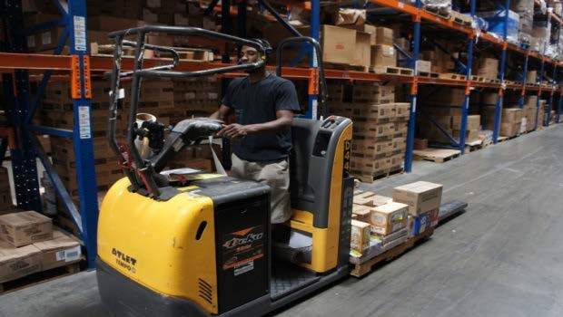

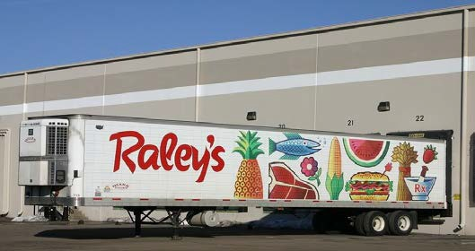
iFoster Jobs Program
Permanent Employment for Foster Youth
CO
NFIDENTIAL

Slide 2



Foster Youth need Jobs to become self-sufficient
•Within 4 years of exiting care:
50% will have no earnings and those with earnings will have an average income of only $7,500 per year.
•50% will spend time in a homeless shelter, and 70% will be on government assistance.
•Resulting in an > $1Million economic impact to society per youth who does not successfully transition to self-sufficiency
CONFIDENTIAL

Slide 3
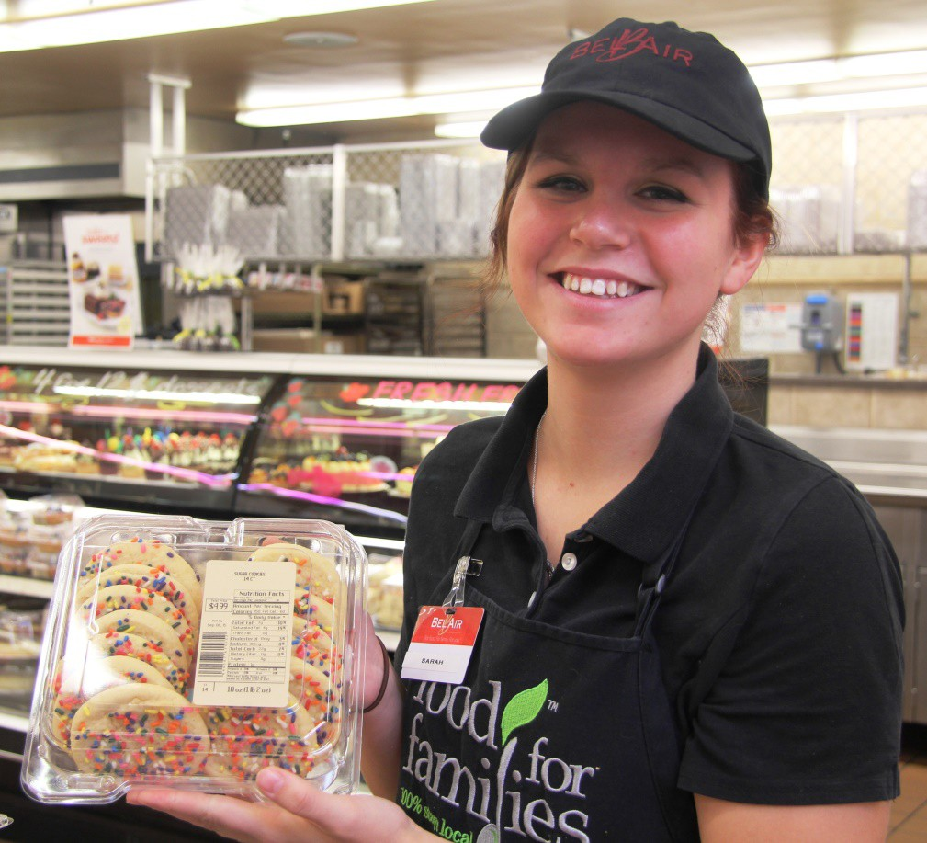

Employers need reliable,
hard working employees
More than 34 Million entry level jobs nationwide.
•Jobs offering skills development and career pathways.
•70% annual turnover rate.
•Over $3,500 cost to replace a single entry level employee. Result is 15% to 30% of an entry-level position’s annual salary is spent on filling it.
CONFIDENTIAL

Slide 4
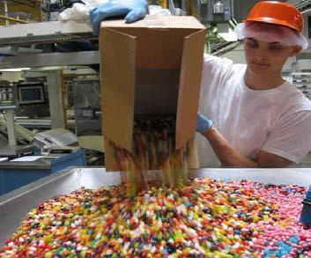


1. Provide entry-level job and management career opportunities to every eligible 16-24 year old Foster Youth in the US
An Innovative Public/Private Partnership can solve both
Problems
2. Create a pipeline of pre-qualified potential hires
3. Provide job skills training, necessary concrete resources, job coach, scholarships / tuition reimbursement, and opportunities to develop careers
CONFIDENTIAL

Slide 5





Pre-Employment Preparation
On the Job
Youth Readiness Assessment
Youth – Job Matching
Youth Readiness Assessment
Youth – Job
Employer Needs Assessment
Matching
Ongoing Coaching and Resource Support
Employer Needs
Youth Job, Soft and Life Skills Training
Assessment
Necessary Resources Provided
Application and
Interview
The iFoster Jobs Program matches Employers with entry-level positions to Foster Youth who are specifically trained, appropriately resourced, and effectively supported to gain competitive employment, succeed in their jobs, and transition to self-sufficiency.
The iFoster Jobs Program
CONFIDENTIAL

Slide 6






Support
iFoster Jobs Program is implemented locally through a collaborative of partner youth-serving organizations
Each Collaborative partner commits to providing their expertise, local knowledge, staff, existing supportive programming, concrete resources and funding
Community Collaborative includes: child welfare agencies responsible for Youth, opportunity youth job skills training organizations (WIBs), supportive housing, independent living programs, extended foster care, youth peer support, and mentors
They collectively implement a standard program (process, resources, curriculum and assessment) with standard performance metrics and goals
Resource
Train
A Community Collaborative Approach
CONFIDENTIAL
6

Slide 7
Lessons Learned after 2 years of training/placing/ supporting more than 300 foster youth in Calif.
Value to foster youth. Potential to change the trajectory of youth.
Training must go beyond resume/mock interview workshops. Must address the uniqueness of foster youth. Needs to focus on code swapping, workplace behavior, managing triggers, dealing with conflict, etc.
Requires a supportive pathway. On-going support beyond the initial training and job placement is key.
Must create partnerships with Employers. Must make the business case and ask for priority in hiring , not just invites to job fairs.
It really takes a village. Community collaboratives are a must.
CONFIDENTIAL

Slide 8

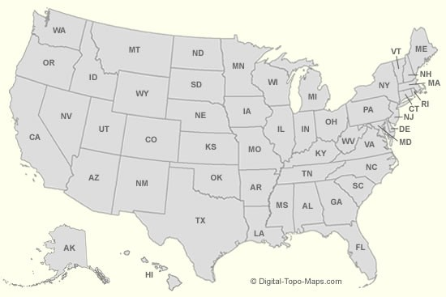


First 2 Years & Expansion Plans
Over 300 foster youth hired across LA, Riverside, San Bernardino. Sacramento and Placer counties
Expansion to NorCal, NV and NYC in 2017
Demand from Employers and Child Welfare exceeds capacity to serve
$3.9 Million earned iFoster Youth
90% retention through 6 months
Avg. 3.2 months to promotion and 1 Employee of the Year Award
iFoster working on replication nationwide by “franchising” to other agencies funded through merchandising campaigns
Program evaluation funded by Federal gov’t
20 National and Regional Employer Partners
  GOAL: 5,000 Foster Youth employed in 3 yrs
HR2060 Employer Tax Credit for Foster Youth
CONFIDENTIAL
8

Slide 9


Our Vision: A united network of employers, providers, educational institutions and community partners that create a powerful launch pad for foster youth to overcome systemic barriers to their success.

Slide 10


The OYC focuses on readiness and access to college and careers

Slide 11
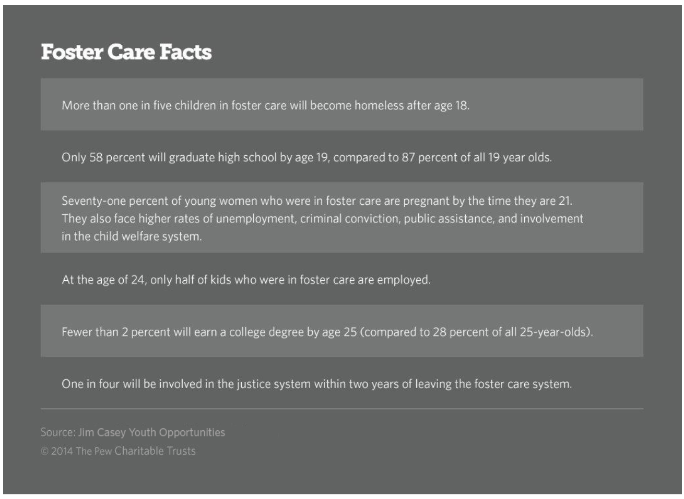

Slide 12
TInsecure: The Reality Show
Almost 3 out of 4 of former foster youth in Los Angeles Community College were housing insecure and 55% of former foster youth experience food and housing insecurity.
30 percent of former foster youth surveyed are homeless.
31% students experiencing food or housing insecurity were both working and receiving some financial aid.
The CSU system last year released a preliminary study saying 1 in every 10 of its 460,000 students was homeless, and 1 in 5 was food insecure.

Slide 13
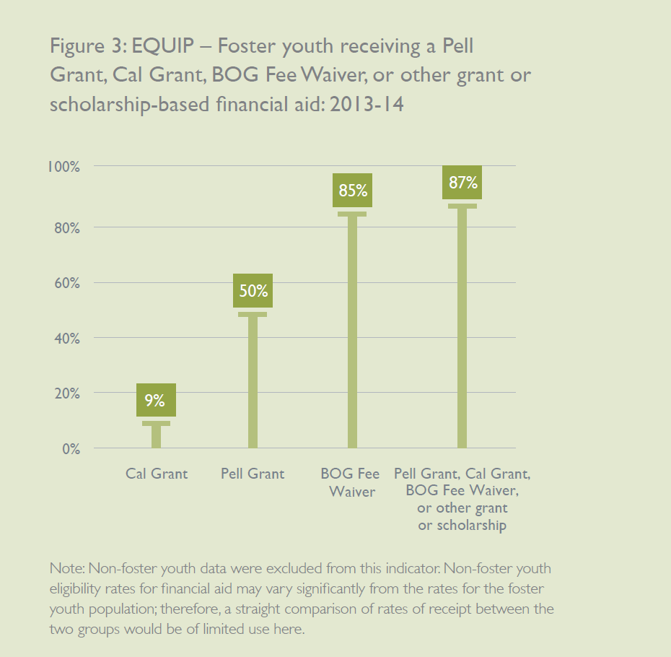
Dollars & $ense
The majority of foster youth in college received at least some form of grant-based financial aid.
More than 80 percent of foster youth are receiving the BOG fee waiver.
About half received a Pell Grant, despite the fact that most foster youth receiving a BOG Fee Waiver would likely have sufficient financial need to qualify for a Pell Grant.
Notes:
(http://kids-alliance.org/facts-stats/)

Slide 14
Greater engagement in learning –Students who work feeling more academically challenged by their coursework, are more engaged in collaborative learning, have a deeper connection with faculty members, and are involved in enriching educational experiences.
Better work skills – Evidence shows that working helps students develop time-management and other organizational skills, interpersonal skills, and work ethic.
Better college persistence –working students who work at least part-time have higher rates of persistence than students who work full- time or do not work at all.

Slide 15

WORK
IS A
NOT THE END
Notes:
This infographic is from DCFS Child Welfare Services Data Monthly Fact Sheet for April 2017
(http://www.lacdcfs.org/aboutus/fact_sheet/DRS/2017/Fact_Sheet_April2017.pdf)

