Slide 1
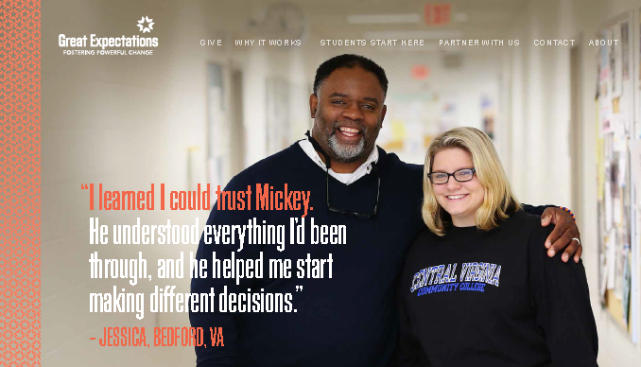
Great Expectations
An Initiative of Virginia’s Community Colleges & the
Virginia Foundation for Community College Education

Slide 2
About
Focuses on the value of a college education as the best way to gain employment and achieve independence.
Provides education that leads to employment opportunities that will improve the likelihood of success for foster youth.
Offers individual support for youth as they finish high school, leave their foster homes and transition to living on their own.

Slide 3
About
a Great Expectations coach for each student
Help with the college
admissions
Applying for financial aid
Career exploration and coaching
Job preparation
Life skills training
Mentoring
Connection to area resources

Slide 4
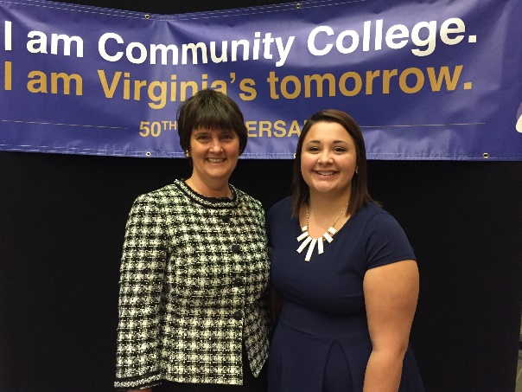
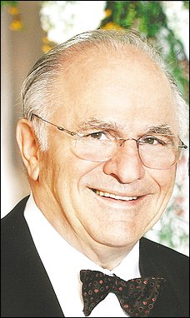
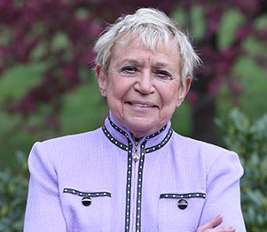
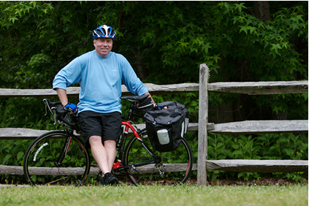
History
Began in 2008
Donor initiated challenge
5 pilot colleges
Anne Holton
Mark Fried
Barbara Fried
Chancellor Glenn Dubois

Slide 5
History
Began at 5 colleges
Expanded over 10 years, now at 21 of 23

Slide 6
Jennifer Roark- Southwest Virginia Community College,
Great Expectations Coordinator
SWCC graduate- Associate Degrees in Science, General Studies, & Education
Bachelor’s Degree in Psychology from King University
Masters from Liberty University in Counseling
Working on Doctorate in Clinical Psychology (Dec 2017) ☺
Licensed Professional Counselor
Experience in Mental Health field – 19 years. Served in the areas of Children’s services (individual and family therapy, psychological evaluations), Adult MH & SA, & Crisis Services
American Red Cross Instructor and Volunteer for 20 years
ARC Disaster Mental Health Team – Mental Health services in the event of natural or manmade disasters, House Fire assessments, etc.
PRIDE (Parent Resources for Information, Development, & Education) Trained – VA Foster Parent Training

Slide 7
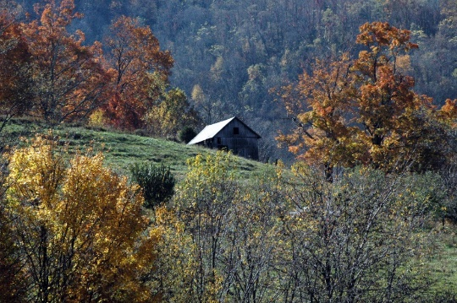
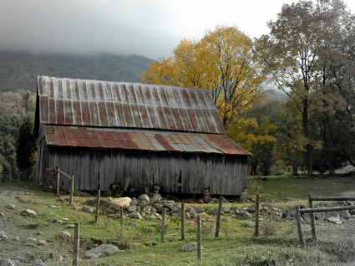
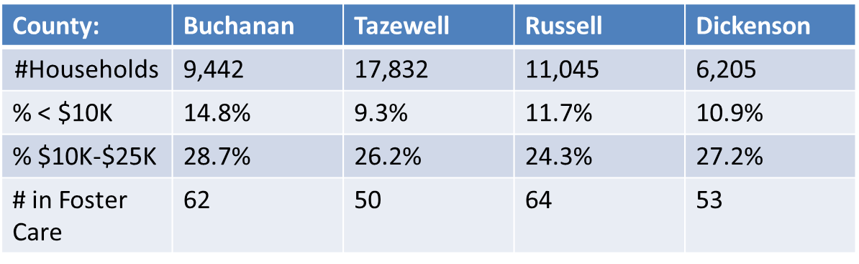
Southwest Virginia
Job Market :
Leading employer: County School Systems
Others: Medical, Construction, Call Centers, Retail, Mining
Many say the Coal industry created and sustained Southwest Virginia since the early 1900s.
Mining Industry – From 2011 to 2014 - 17,000 Mining Jobs were lost in SWVA.
Many of these Individuals were making between $60K - $125K per year
Millions of dollars lost from the region’s economy.

Slide 8

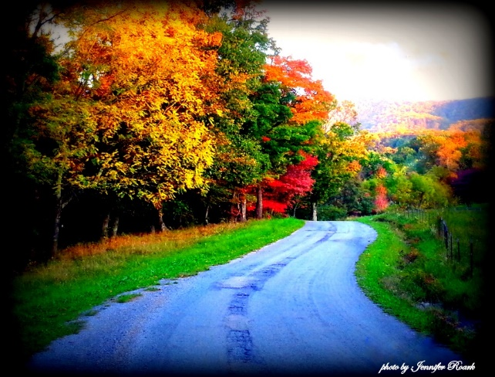
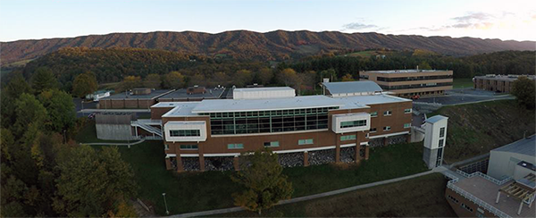
Southwest Virginia Community College
Serves 4 counties
Russell, Tazewell, Buchanan, Dickenson
About 220 foster youth in the area 16-26
Currently serving 94, 51 enrolled in classes, another 42 working towards
Reaching 42% of eligible students overall
Enrolling 23% of eligible students

Slide 9
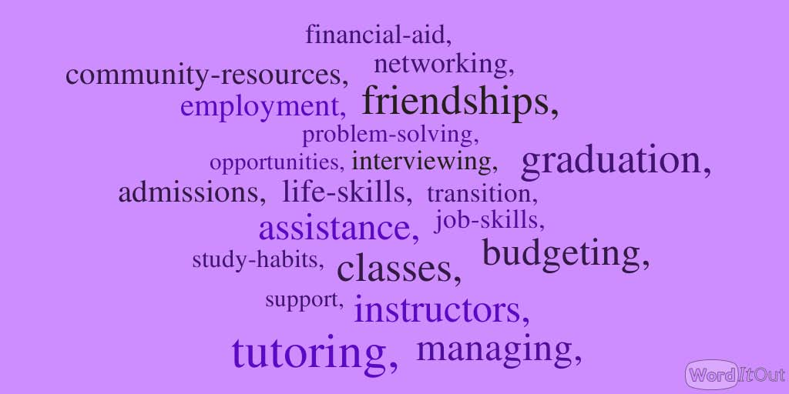
Southwest Virginia Community College
Lessons Learned: Helping Students to be Successful

Slide 10



SWCC Great Expectations:
Lessons Learned: Celebrate Successful Students
4 Bachelors Degrees
20 Associate Degrees.
32 Achieved Career Readiness Certificates
2 Registered Nurses
1 Licensed Practical Nurse
7 Certified Nursing Assistants
3 Health Science Certificates
2 Electrical / Mechatronics Certificates
1 Medical Records Certificate
1 Pharmacy Tech Certificate
1 Security Officer Certification & EMT Certificate
1 Phlebotomy Certificate
1 Software Development Certificate
1 Crime Scene Technology Certificate
1 GED and Commercial Driver’s License

Slide 11
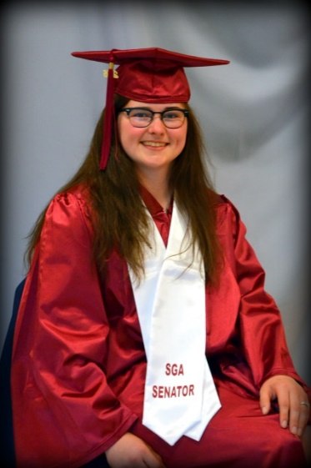
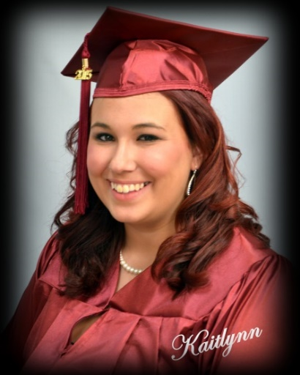
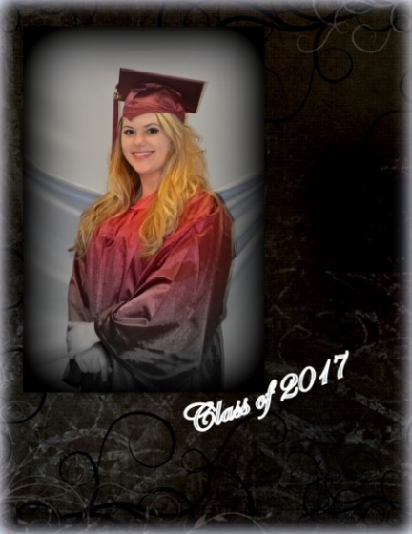
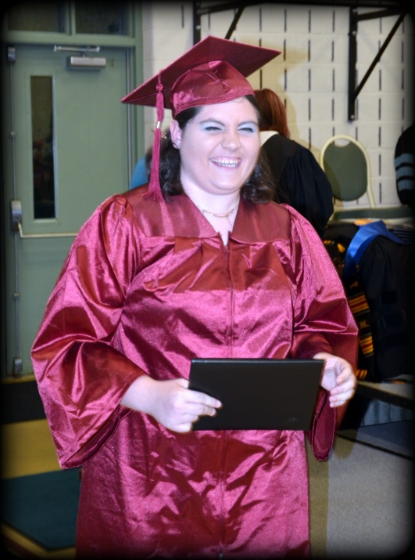
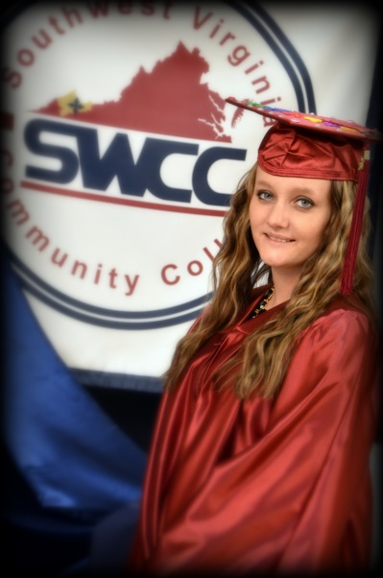
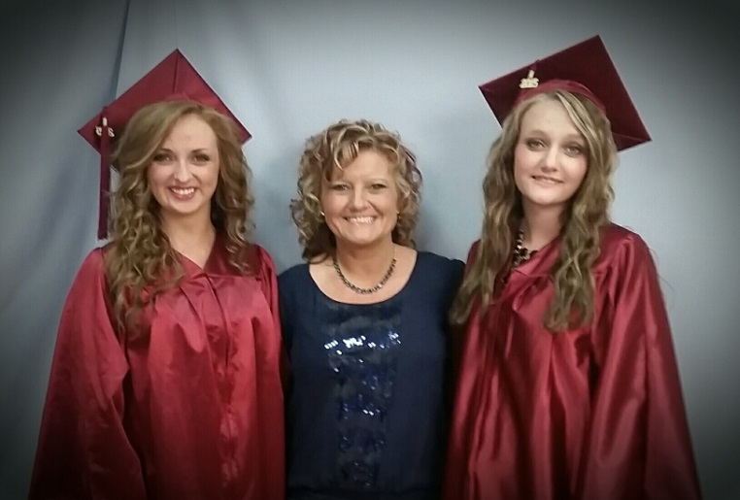
SWCC Great Expectations:
Lessons Learned: Celebrate Successful Students

Slide 12
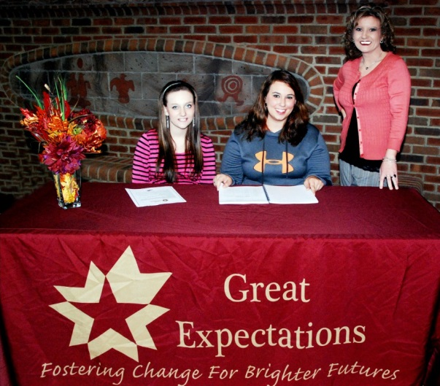
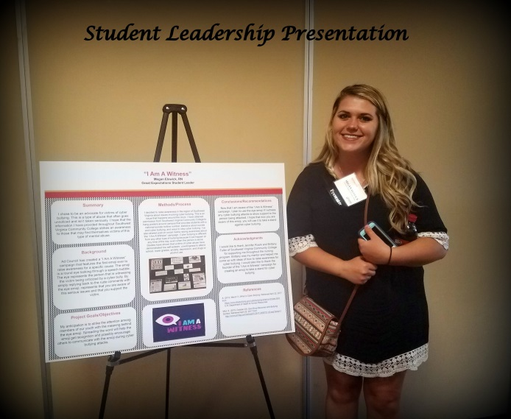
SWCC Great Expectations:
Lessons Learned: Encourage Challenges
Great Expectations Student Leaders from SWCC
Brittany Fuller & Kaitlyn Deel (2014/2015)
Jessica Larichuita (2015/2016)
Megan Elswick
(2016/2017)

Slide 13
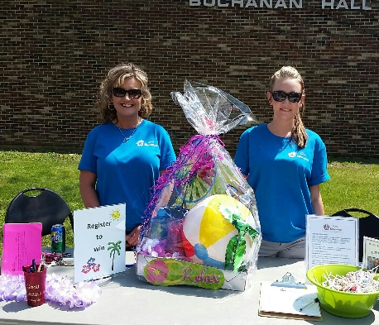

SWCC Great Expectations
Lessons Learned: Promote and Partner
Promote the program through community events
Network with other agencies
Build partnerships that benefit the students, and other members of the community

Slide 14
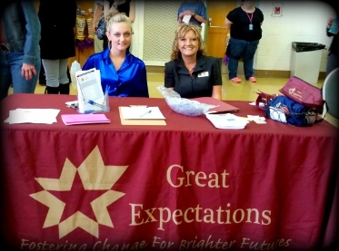
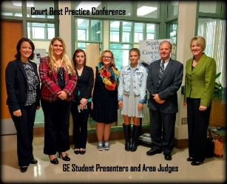
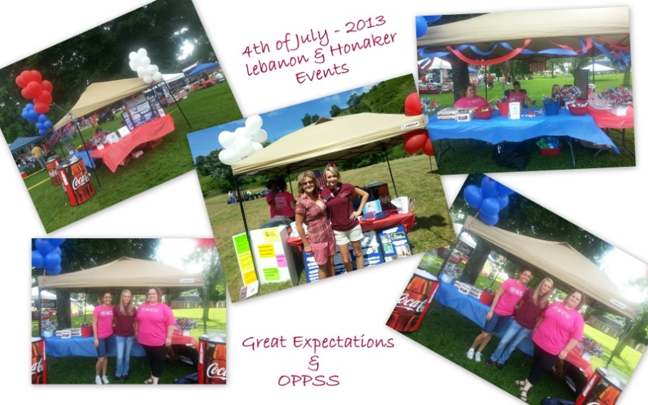
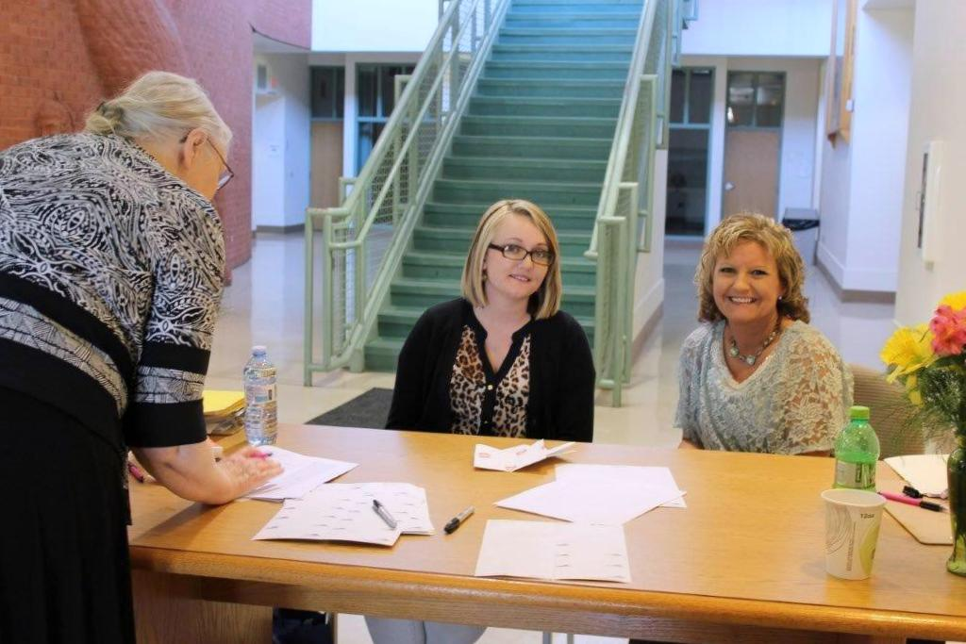
SWCC Great Expectations
Lessons Learned: Have a Presence in the Community
Promote the program through community events
Network with other agencies
Build partnerships that benefit the students, and other members of the community

Slide 15

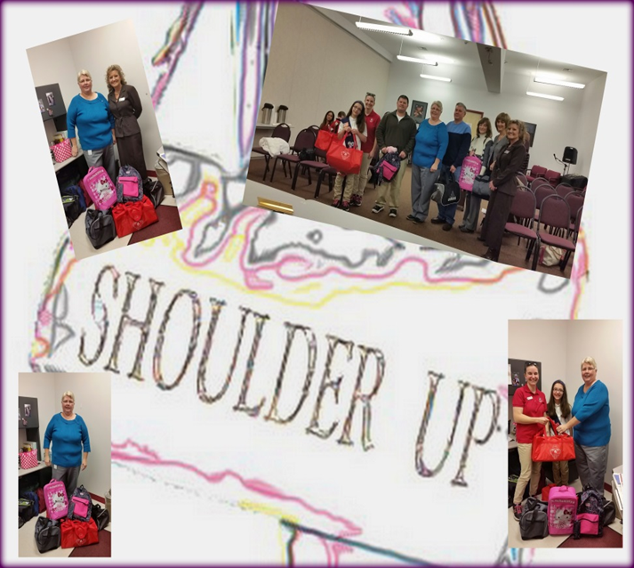
SWCC Great Expectations
Lessons Learned: Partner with Dept. of Social Services

Slide 16
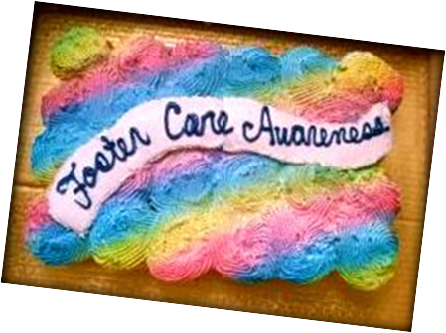
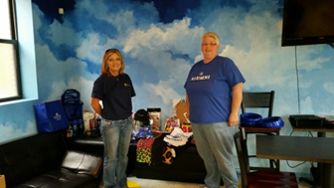

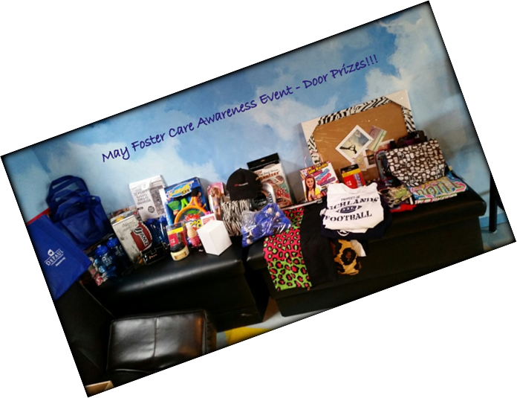
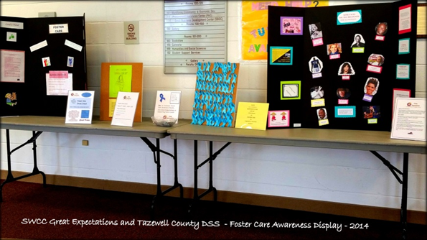
SWCC Great Expectations
Lessons Learned: Partner for Outreach and Awareness
Promote May as foster care awareness month
Paint the Campus Blue event
Event for youth who have experienced foster care at the Teen Center

Slide 17
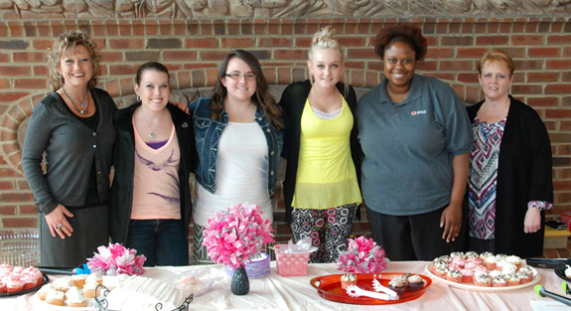
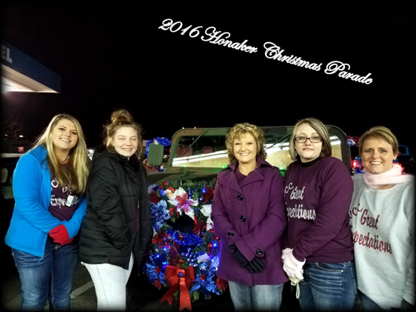
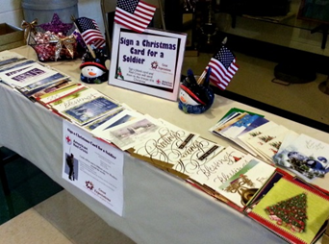
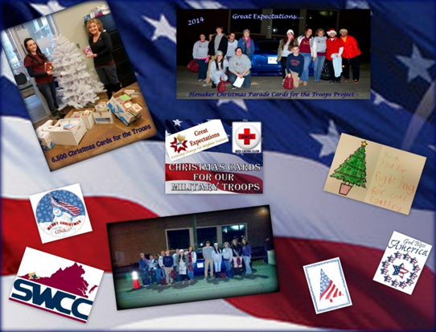
SWCC Great Expectations
Lessons Learned: Help Students Give Back
Partnership with American Red Cross
SWCC GE program was first Red Cross Club student chapter on a Virginia Community College campusStudent Chapter
Cards for military troops serving overseas
Collect care items for Comfort Kits- given to those who have lost their home to fire
Blanket collecting

Slide 18
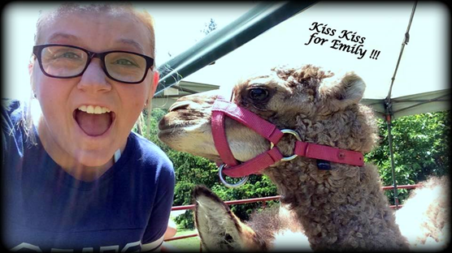
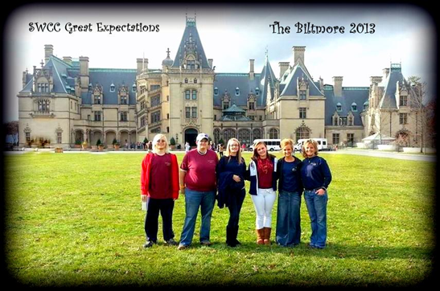
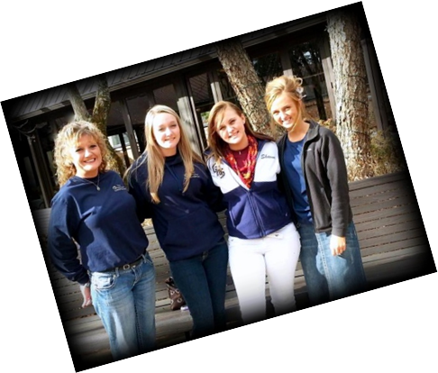
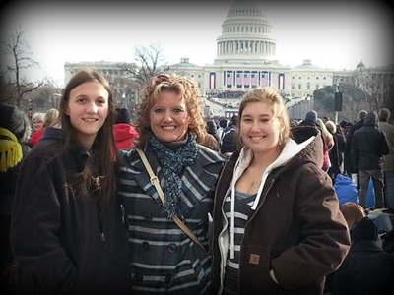
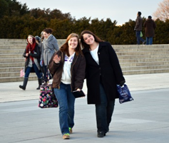
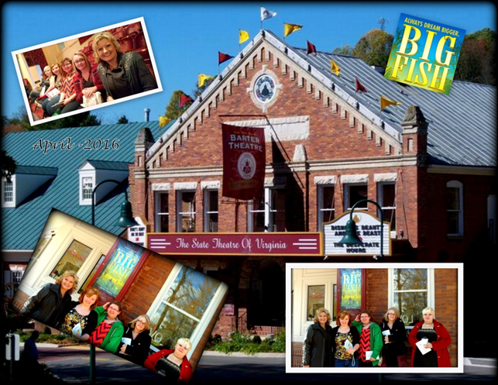
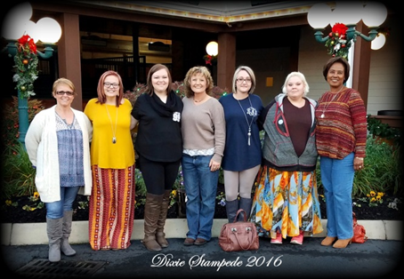
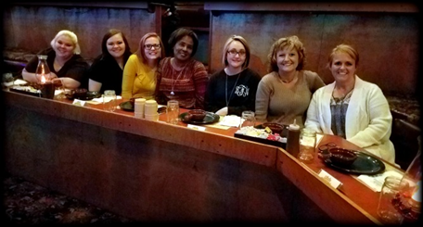
SWCC Great Expectations
Lessons Learned: Build bonds through Group Activities
Group activities facilitate feelings of belonging and support
Exposure to outside areas and ideas
Build connections with students from other colleges
Learning and fun

Slide 19
SWCC Great Expectations
Lessons Learned: Focus on Students through Initiatives
Created comprehensive resource guide for participants, other campus staff, other agencies that lists and provides contact information for all available area resources
Access Emergency funds for student needs such as:
  car repairs
  Electric bill
  Nursing uniforms and shoes
  Testing fees
  Glasses- eye exams
  Tires
  Textbooks
  Security deposits
  Mattress and basic household items

Slide 20
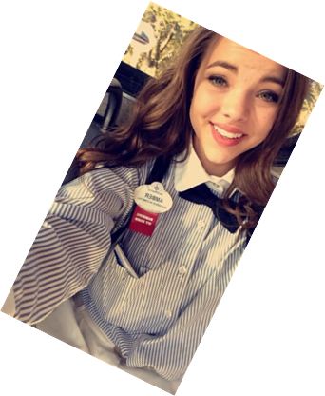
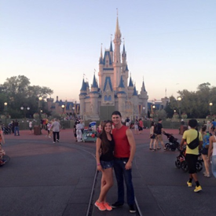
SWCC Great Expectations
Lessons Learned: Focus on Students through Initiatives
Job Shadowing Project
  Assist students with career focus
  Gain knowledge and experience
  Provide grants to assist with transportation, food, clothing, equipment
  Students shadowed at sheriff’s office, pharmacies, social services, schools, nursing homes, hospitals, Disney World

Slide 21

SWCC Great Expectations
Lessons Learned: From a Student- Brittany Fuller
Southwest Virginia Community College graduate (associate degree)
Just completed Bachelor’s degree
Work study job in Great Expectations office at SWCC

Slide 22
Performance Measures-
Persistence

Slide 23
Performance Measures
Increasing % of students graduated or retained in following term
Increasing % of students graduated or retained in following year
Increasing % of students served in potential pool
Increasing # of credentials earned each year

Slide 24
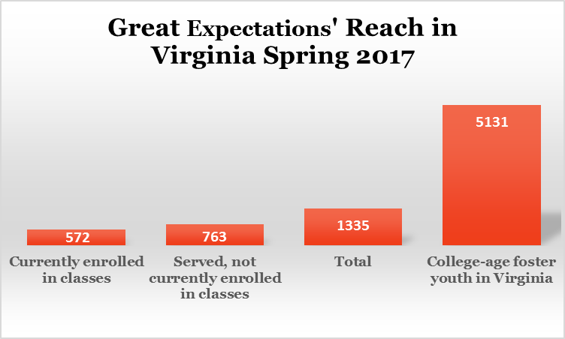
Performance Measures- Reach

Slide 25
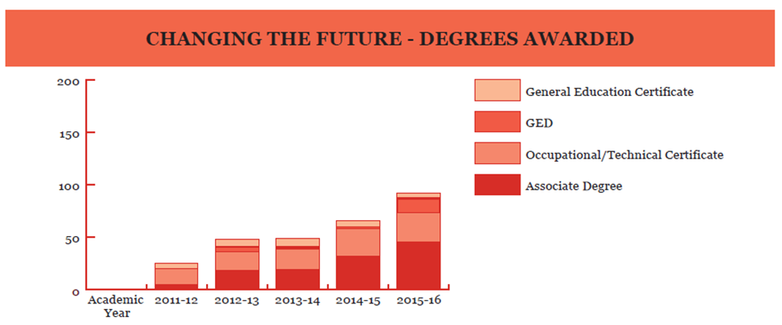
Performance Measures- Credentials

Slide 26
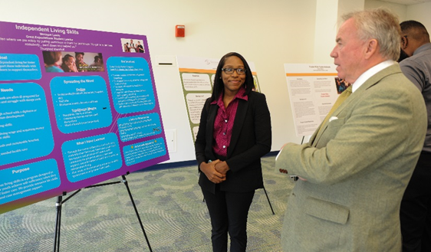
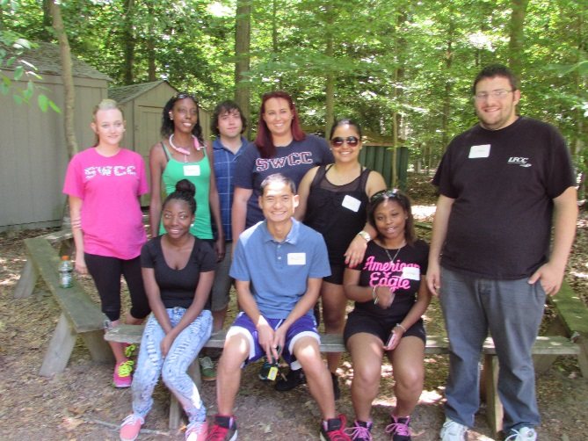
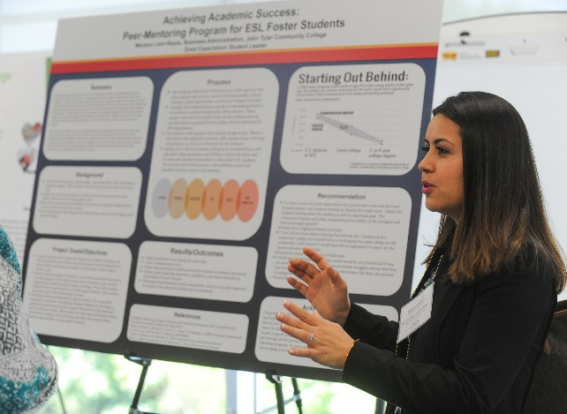
Lessons Learned: A Student Leadership Program is Beneficial
4th year
Hybrid online/in person leadership training
12 student leaders
Based on Kouzes & Posner’s Student Leadership Challenge
Advocacy
Alumni network

Slide 27
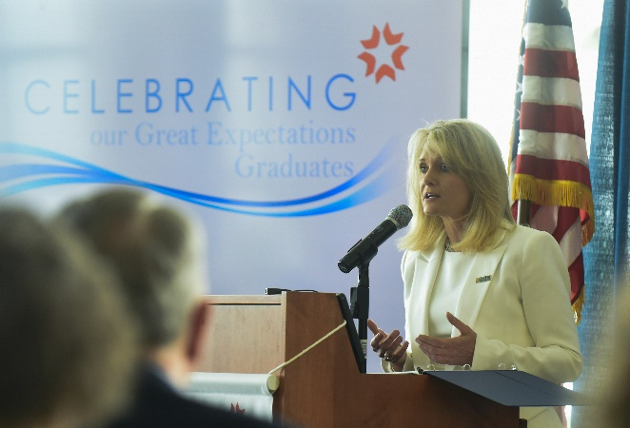
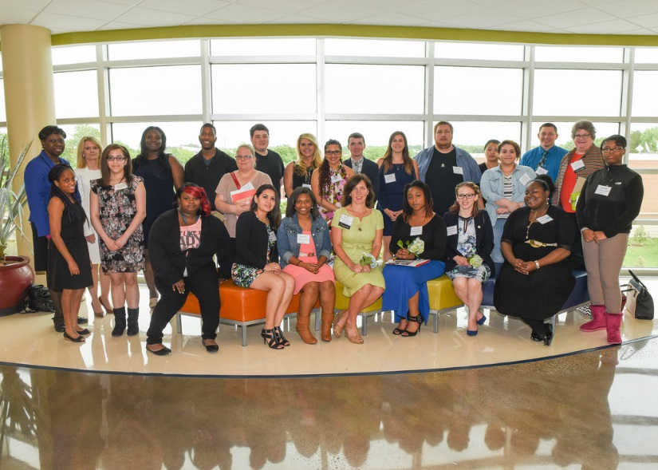

Lessons Learned: Celebrations Important
Honors graduates, inspires others
Chance to invite donors
Concurrent sessions
Advocacy Poster project presentations

Slide 28
Questions?
Rachel Mayes Strawn, Ph.D.
Great Expectations Program Director
804-819-4690
rstrawn@vccs.edu

