Slide 1
It’s Not Drama, It’s Trauma
Blueprint Conference October 17, 2017
Theresa Reed, M.Ed

Slide 2
2013 CA Foster Care Placements
Notes:
Data from 2013
Only most severe cases end up in the foster care system

Slide 3
Foster Care Statistics
By 3rd grad, 83% repeat a grade
Less than ½ graduate from high school
1
In the first 18 months in care, they average 4 placements
1

Slide 4
Foster Care Statistics
50% will be unemployed
Within 2 years of aging out:
25% will be incarcerated
20% will be homeless

Slide 5
Trauma Basics
Trauma affects a person’s behavior, feelings, relationship and view of the world in profound ways.
Types of Trauma
PTSD - A person experiences hyperarousal, re-experiencing, and withdrawal/avoidance for a long period of time and reactions get in the way of living a normal life
Acute
Chronic
Complex

Slide 6
toxic stress video: https://www.youtube.com/watch?v=rVwFkcOZHJw

Slide 7
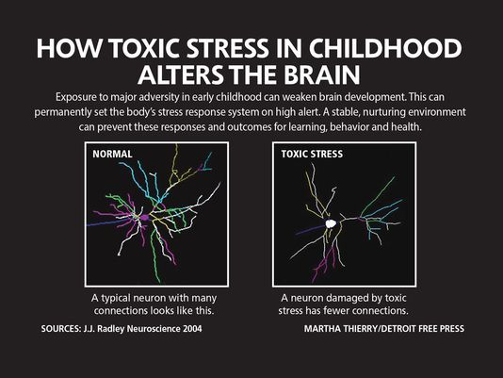

Slide 8
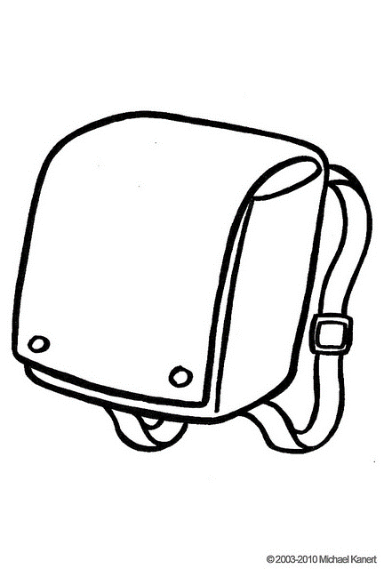
The Invisible Backpack
Trauma shapes children’s beliefs and expectations about themselves, the adults who care for them, and the world in general
Therapy doesn’t help
Its all my fault
I can’t trust anyone
What’s wrong
with me
I am stupid
No one understands me or what I have been through
No one loves me

Slide 9
Focus
concentration
Taking in new information
Going to sleep
Staying asleep
Feeling moody
Becoming angry
Showing aggression
Not acting
their age
DIFFICULTIES
WITH:

Slide 10
Why Trauma-informed Engagement
Communities that provide a context of understanding and self-determination may facilitate the healing and recovery process for the individual. Alternately, communities that avoid, overlook, or misunderstand the impact of trauma may often be re-traumatizing and interfere with the healing process. Individuals can be re-traumatized by the very people whose intent is to be helpful.

Slide 11
How You Can Be Supportive
Communicate and demonstrate to foster youth that you care about their success
Ensure students understand course material
Respect foster youths’ privacy
Offer direct and tangible academic support
Adopting trauma-informed interventions
Notes:
Presenter’s Notes
Display each bullet point one by one.
Pay special attention to the academic progress of foster youth and intervene if problems arise. Students consistently express that they want to receive ongoing feedback rather than find out at the end of a course that they did not do well.
Provide some additional support to foster youth if you see them struggling. They may be reluctant to ask for help, so make a point of offering it. As faculty within the context of higher education you may have the expectation that it’s the duty of the student to ask for help. Foster youth, however, have often been conditioned to not ask for help. For instance, asking for help in a foster home can result in being moved or punished, or asking for anything at all could be a set-up for being let down by yet another adult.
Let foster youth know that you are there for them and invested in their success. Not only do you WANT them to succeed but you KNOW that they CAN. As you have learned, it is rare for foster youth to have positive adult role models in their life, so you all have a very special and important role to uphold. Often what a foster youth needs in order to be successful is simply someone who believes in them. That someone can be you.
Foster youth should NEVER be publicly "outted" in class. But rather a note in the syllabus should be included so foster youth can connect with appropriate foster youth resources/programs on campus. Like students with a disability -- foster youth status is a private identity that can be accompanied by stigma and faculty should be respectful of this. A student who has been in foster care must be allowed to make their own choices as to when and with whom they choose to share this information. While one may be comfortable sharing this information, another may not want anyone to know.

Slide 12
Understanding the Trauma Cycle
Cognitions
Youth – “I’m bad, unlovable, damaged”
Adult – “I’m ineffective” “Child is rejecting me”
Behavior/ Coping strategies
Adult – overreacting, controlling, shutting down, being overly permissive
Youth – avoidance, aggression preemptive rejection
The Cycle
Youth – “I’m being controlled; I have to fight harder”
Adult – “He keeps fighting me; I better dig in my heels”

Slide 13
Responding to Students
Not So Helpful
Assuming the student is being rebellious
Tell the student he/she is being dramatic or over-reacting
Ask why they were in foster care
Force them to face the reminder
Expressing anger or impatience

Slide 14
Responding to Students
Helpful
Avoid re-traumatization
Differentiate yourself
Provide an inclusive environment
Teach social and executive skills
Catch your students doing good
Establish relationships with program staff
Encourage RESILIENCY

Slide 15
Resiliency is…
… speedy recovery from problems: the ability to recover from setbacks
… ability of Individuals to rebuild their lives even after devastating tragedies.
… capabilities of humans to adapt and over-come risk and adversity.

Slide 16
Resiliency is…
… not something that you’re either born with or not.
… developed as people grow up and gain better thinking and self-management skills and more knowledge.
… also comes from supportive relationships

Slide 17
How to Help Build Resiliency
Acknowledge we have been
Affirm ourselves
Acquire a support network.
Attain our goals.
Notes:
1. Acknowledge we have been hurt but use the hurt as a catalyst to move ahead instead of a reason to stay down
2. Affirm ourselves, we are not our circumstances and to speak positive affirmations. I know I am worthwhile. It is safe for me to succeed. I love and approve of myself. I am loving and lovable.
3. Acquire a support network. Find someone who is doing something positive and spend time with them.
4. Attain our goals. Setting goals gives us something to look forward to and rejoice in completing them. I now go beyond other people’s fears and limitations. I create my life.

Slide 18
How Do You Plan to Use the Knowledge?

