Slide 1
ACCELERATING SUCCESS:
Turning Insights into Action for Foster Youth at
California Community Colleges – October 16, 2017
April Allen, Ph.D.
Vice President of Innovation and Strategy
Ken Sorey
Executive Vice President

Slide 2
ACKNOWLEDGEMENTS
Funders:
John Burton Advocates for Youth - Debbie Raucher
Stuart Foundation - Alexia Everett
May and Stanley Smith Charitable Trust - Elisabeth Cutler
Marcled Foundation
Walter S. Johnson Foundation
Pritzker Foster Care Initiative
Consulting Partners:
Mark Courtney - Chapin Hall
Nathanael Okpych - University of Connecticut School of Social Work
A special thanks to the California Community College Chancellor’s Office

Slide 3
ACKNOWLEDGEMENTS
Bright Spot Campuses:
College of the Canyons
De Anza College
Evergreen Valley College
Fresno City College
Los Medanos College
Reedley College

Slide 4
CALIFORNIA COLLEGE PATHWAYS POLICY MILESTONES
Early 2000’s, Guardian Scholars, foster youth success initiative
In 2006, the Community College Chancellors Office launched the Foster Youth Success Initiative
In 2015, Senate Bill 1023 created CAFYES, a dedicated source of state funds for supporting foster youth at up to 10 community college districts

Slide 5
BUILDING ON WHAT WE LEARNED
Charting the Course (2015)
Notes:
This current report builds on the foundation established by Charting the Course by providing:
Updated descriptive outcomes reflecting data two years after the initial report, using many of the same metrics
A deeper analysis using several statistical methods to pinpoint milestones and momentum points
Analysis of specific program practices
A qualitative investigation and description of promising practices identified at “bright spot” colleges

Slide 6
METHODOLOGY
Quantitative data from Cal-PASS Plus
A survey of institutional policies and foster youth programs
A multi-method analysis to identify bright spot colleges through data
Qualitative interviews to uncover promising practices
Notes:
Quantitative data from Cal-PASS Plus
A Survey of institutional policies and foster youth programs at 69 of the 114 California Community Colleges
A multi-method analysis that used quantitative data to identify colleges that had better than expected outcomes for foster youth (“bright spots”) and incorporated qualitative interviews to uncover promising practices

Slide 7
EQUIP

Slide 8
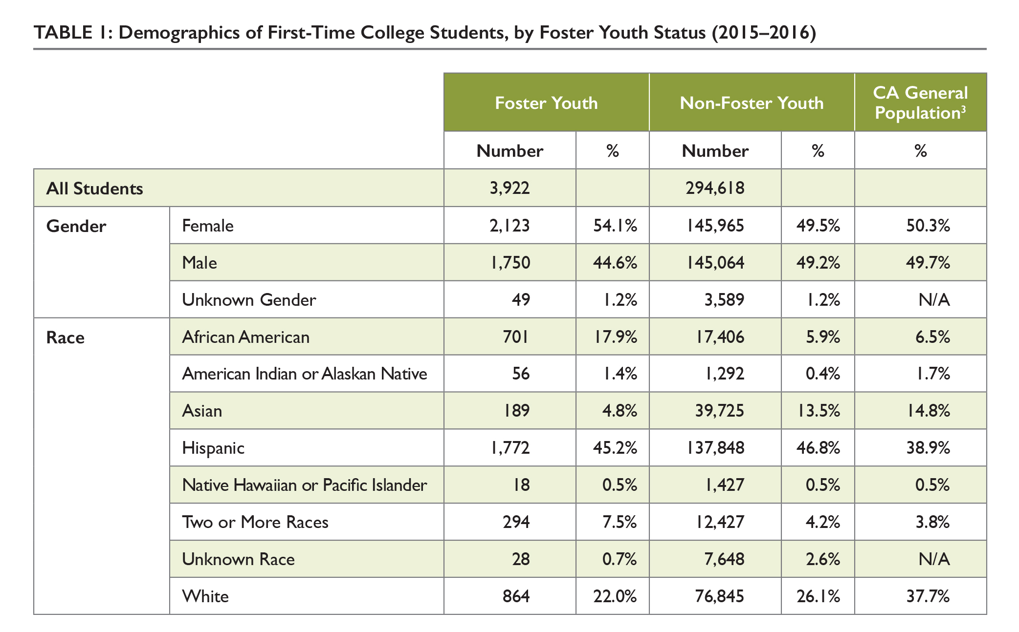
FOSTER YOUTH DEMOGRAPHICS
Notes:
23,500 identified foster youth
2 cohorts of foster youth: 2012-2013 and 2015-2016
54% female, 45% male
African American students make up almost 1/5 of the foster youth student population but only 6% of non-foster youth population
Asian students make up less than 5% of foster youth student population and 14% of non-foster youth students
White foster youth are under-represented in community college population

Slide 9
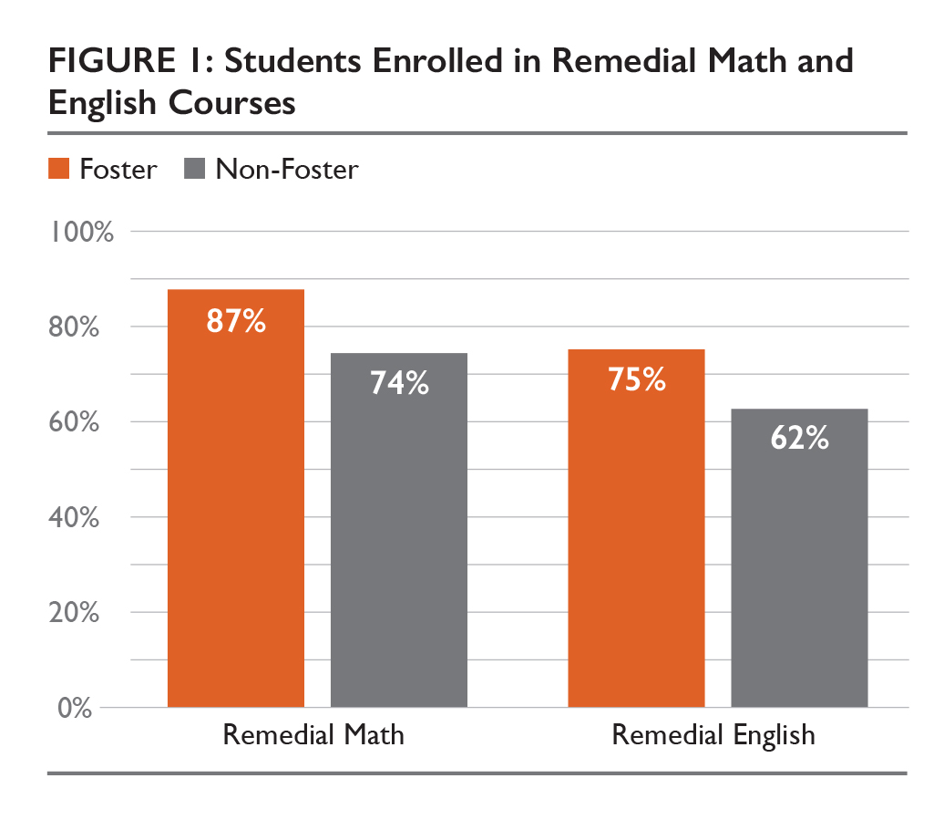
STUDENTS WHO START IN DEVELOPMENTAL ED.
Notes:
Foster youth are more likely to enroll in remedial math, English or ESL courses instead of transfer-level courses (speaker notes)
Note that this is only for students who take math or English

Slide 10
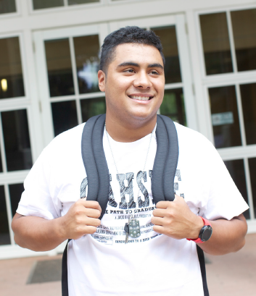
PREPARING FOSTER YOUTH FOR COLLEGE
Staff assist students with paperwork and questions regarding financial aid
Evergreen Valley College -- accompany students to the financial aid office
Reedley College -- on-campus housing, foster youth have priority status
Fresno City College -- collaborates with community partners for foster youth housing
Notes:
At bright spot colleges, staff assisted students with completing paperwork and answered questions regarding financial aid
Evergreen Valley College has a foster youth program staff member accompany students to the financial aid office
Reedley College has on-campus housing, foster youth have priority status
Fresno City College collaborates with community partners to address housing needs for foster youth– providing limited funds for emergency hotel stays and linkage to outreach workers

Slide 11
EQUIPPING FACULTY AND STAFF
College of the Canyons and Los Medanos provide training for faculty to understand the needs of foster youth and other vulnerable populations
General training on trauma and behavior intervention and integration of social-emotional learning in the classroom
Informing instructors about the needs of foster youth enhances academic experience and educational success
Notes:
College of the Canyons provide a 54 hour training for faculty to understand the needs of foster youth and other vulnerable populations at the college
Other novel approaches included general training on trauma and behavior intervention and integration of social-emotional learning in the classroom
College leaders are in consensus that informing instructors about the needs of foster youth enhances academic experience and educational success

Slide 12
ENROLL

Slide 13
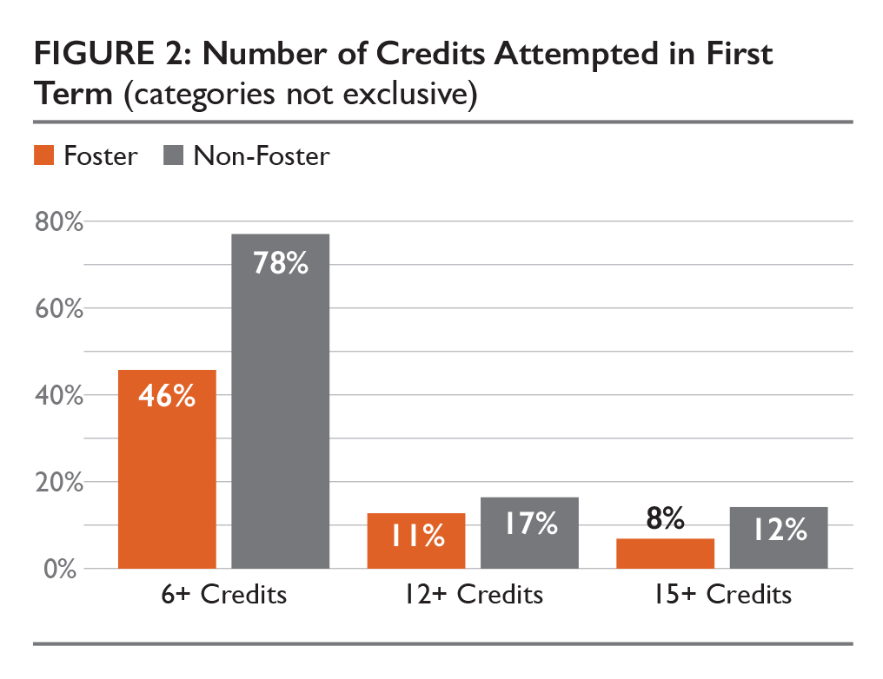
COURSE ATTEMPTS
FY on average attempt few credits at all levels than non-foster youth
FY enroll full-time at comparable rates as other students – yet low percentages
Notes:
Foster youth attempt 6 or more credits in the first term at lower rates than non-foster youth
This pattern also holds true for attempting 12-15 units
Foster youth and non-foster youth had comparable proportions or students who attend full-time, 32% and 36%, respectively
Milestones for credits attempted did not show large difference among ethnic groups of foster youth, all had relatively low completion rates

Slide 14
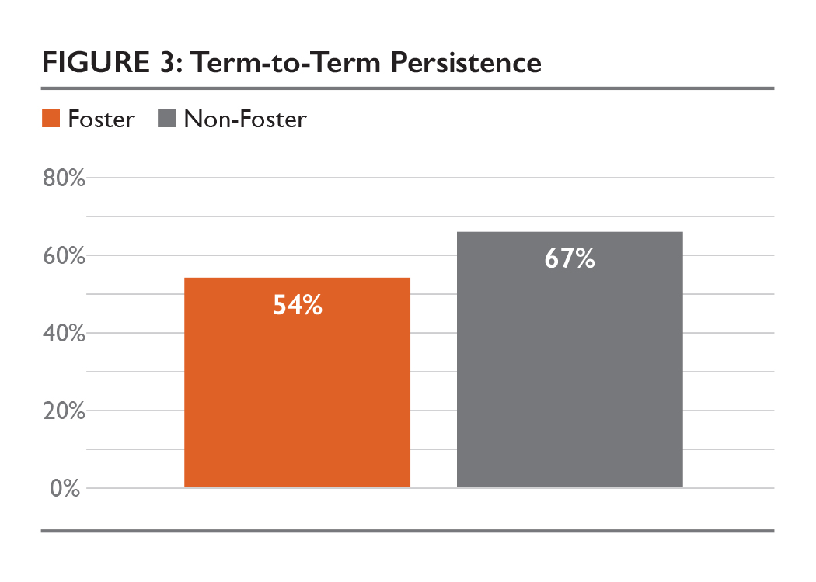
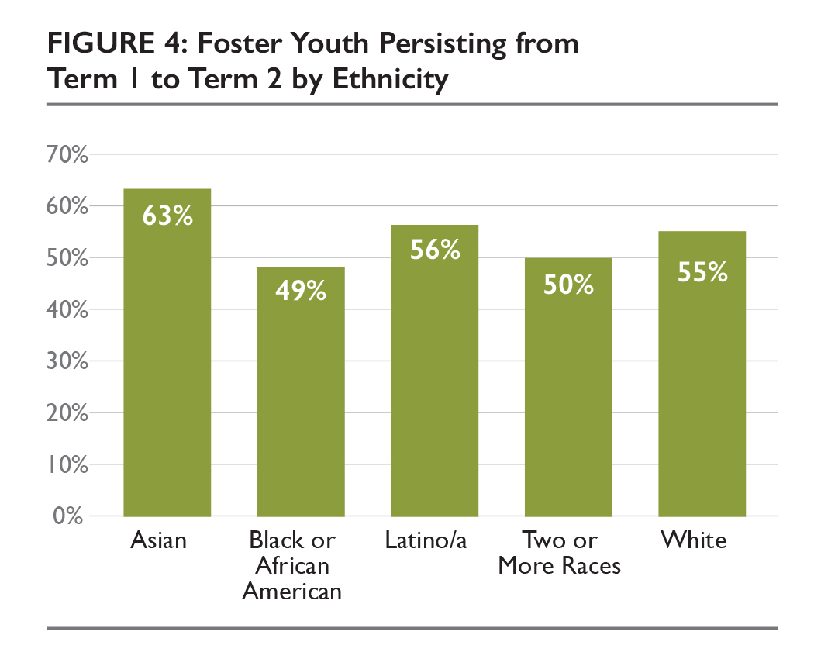
TERM-TO-TERM PERSISTENCE
Notes:
Persistence between the first and second terms for foster youth was 54% compared to 67% of non-foster youth
Asian foster youth persist at higher rates than other ethnic groups
Black or African American students persist at lower rates than other ethnic groups

Slide 15
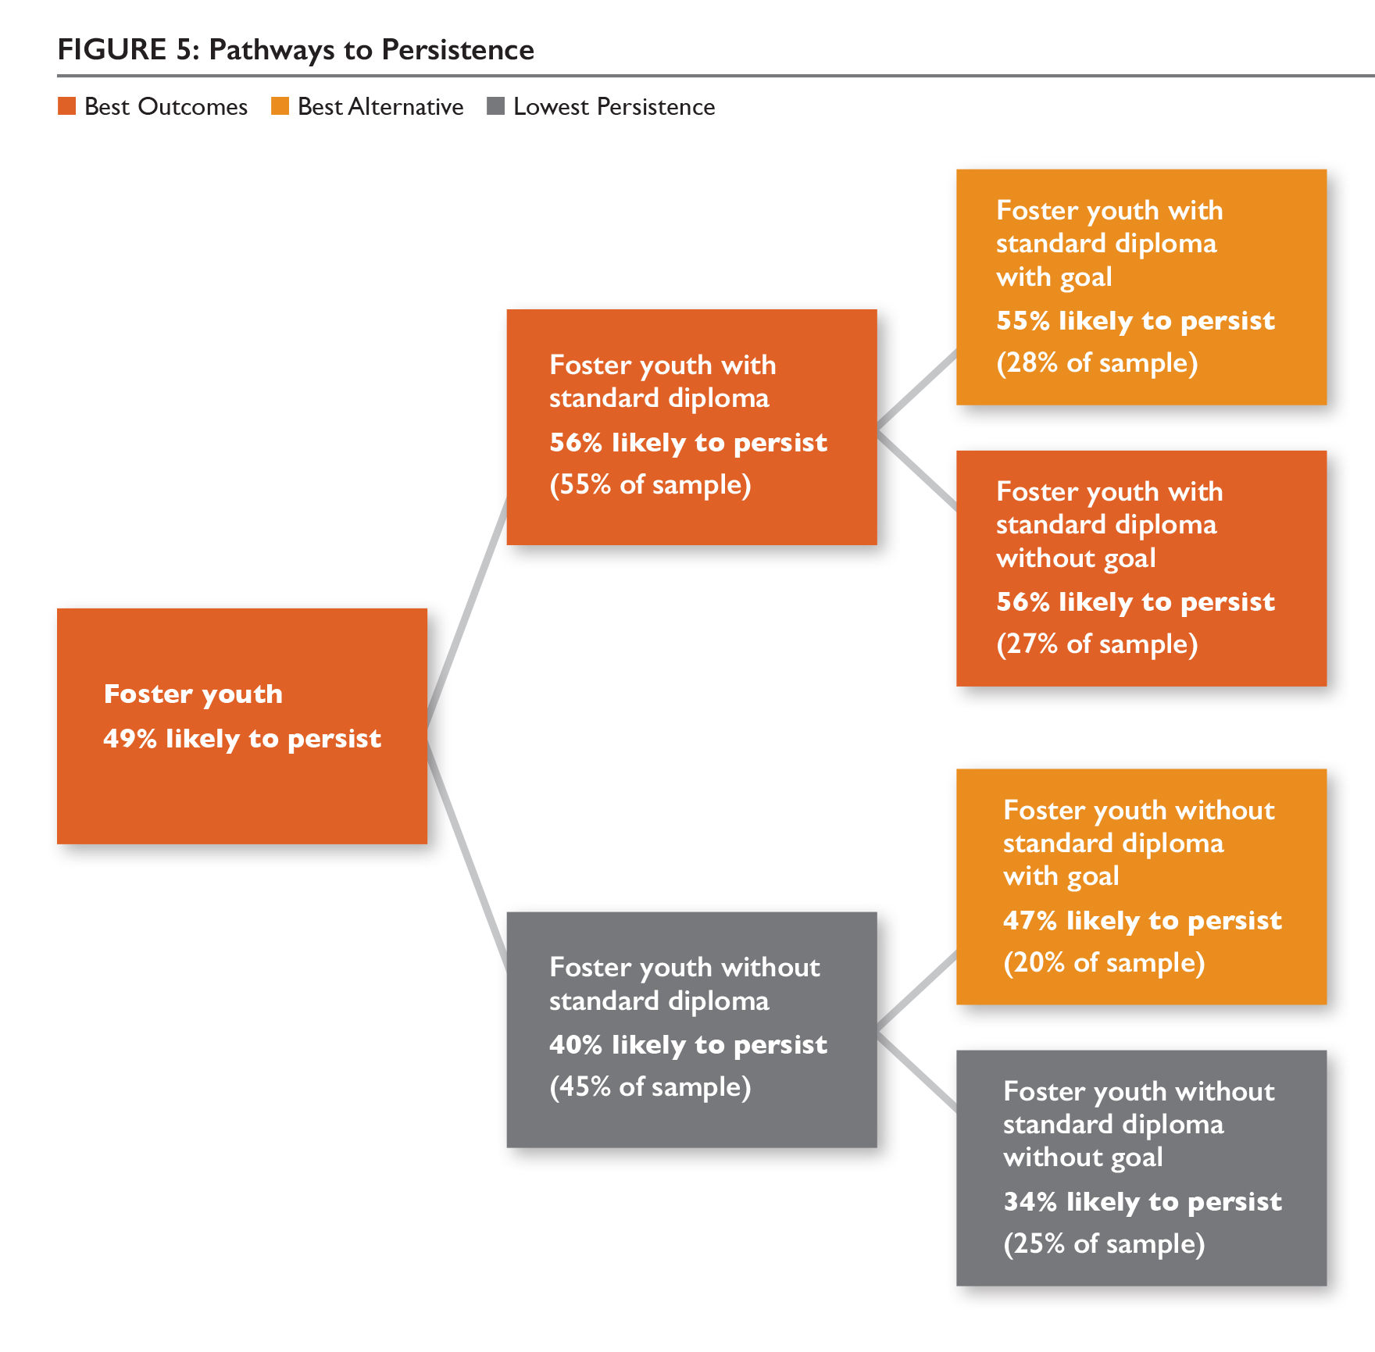
PATHWAYS TO FOSTER YOUTH PERSISTENCE
Standard high school diploma was the most important factor for term-to-term persistence
For foster youth without a standard diploma, declaring an academic goal was associated with a 13% increase in persistence
Notes:
Receiving a standard high school diploma (rather an a GED or no diploma) was the most important element in persisting from the first term to the second – a 16% increase in persistence
For foster youth without a standard diploma, declaring an academic goal upon matriculation was associated with a 13% increase in persistence
Very little difference in persistence for foster youth with a standard diploma based on this variable

Slide 16
FACILITATING PERSISTENCE WITH SOCIAL SUPPORTS
Ensure uninterrupted contact with foster youth
Reedley College – sends text messages to foster youth about workshops, deadlines or to just stay connected
Mental health counseling, peer support groups, and life skills workshops have proven to be beneficial
Bright spot colleges described a higher intensity or greater availability of these services
Notes:
Bright spot colleges ensure uninterrupted contact with foster youth
Reedley College utilizes the ReMind app to send text messages to foster youth students about workshops, deadlines or other pertinent information
Mental health counseling, peer support groups, and life skills workshops have proven to be beneficial
Bright spot colleges have a higher intensity and availability of services

Slide 17
EARN

Slide 18
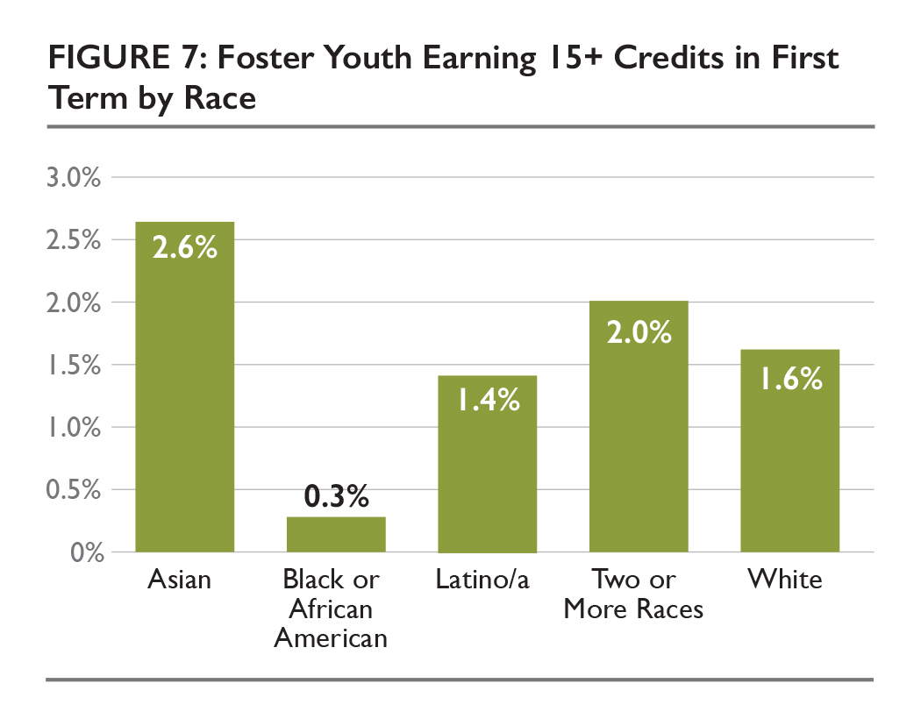
CREDITS EARNED
Notes:
In 2015-2016, 28% of foster youth earned 6 credits or more in the first term, compared to 45% of non-foster youth
1% of foster youth earned 15 more credits in the first term, compared to 4% of non-foster youth
3% of Asian youth completed 15 units in the first semester
0.3 percent of African American/Black students completed 15 units in the first term

Slide 19
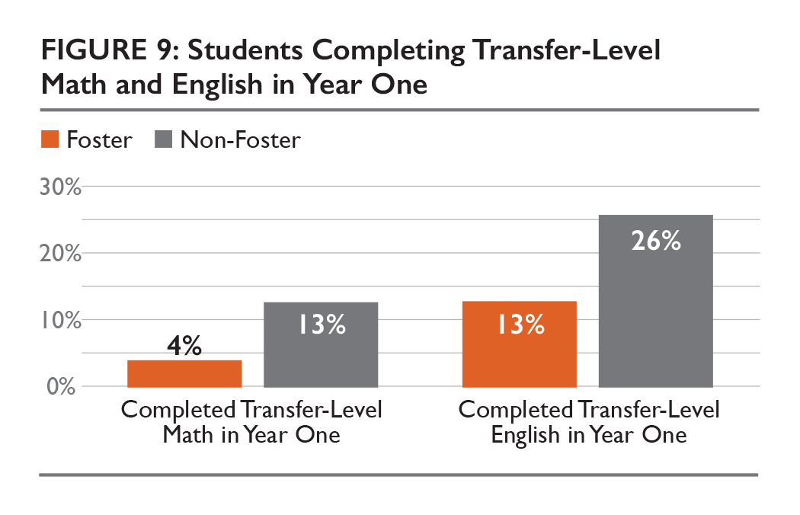
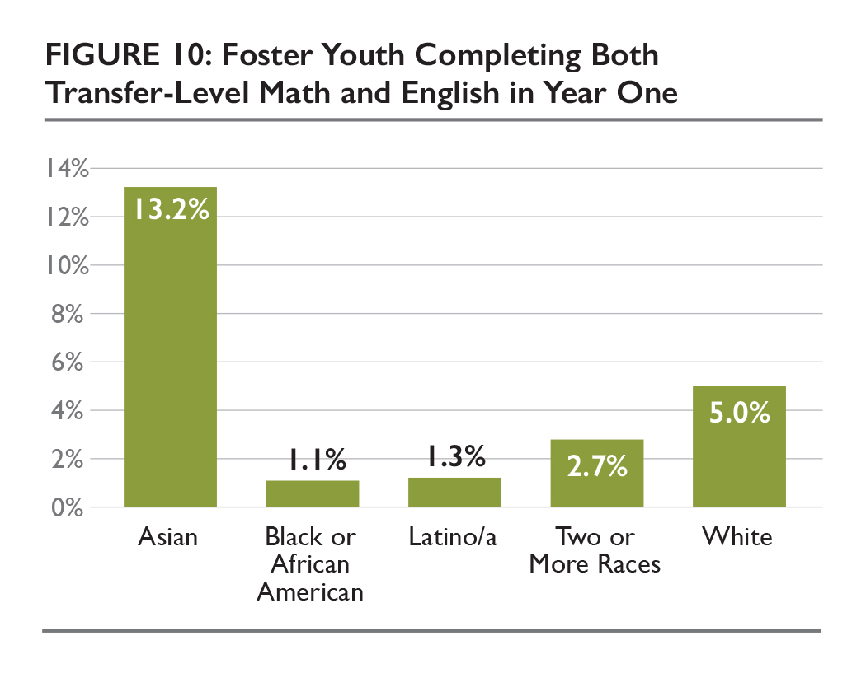
MATH AND ENGLISH COMPLETION

Slide 20
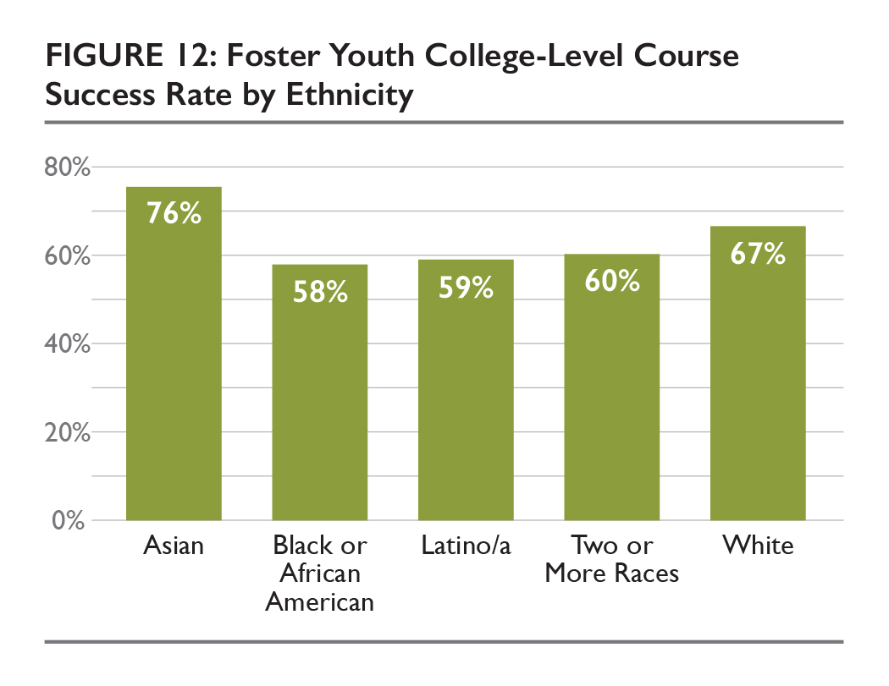
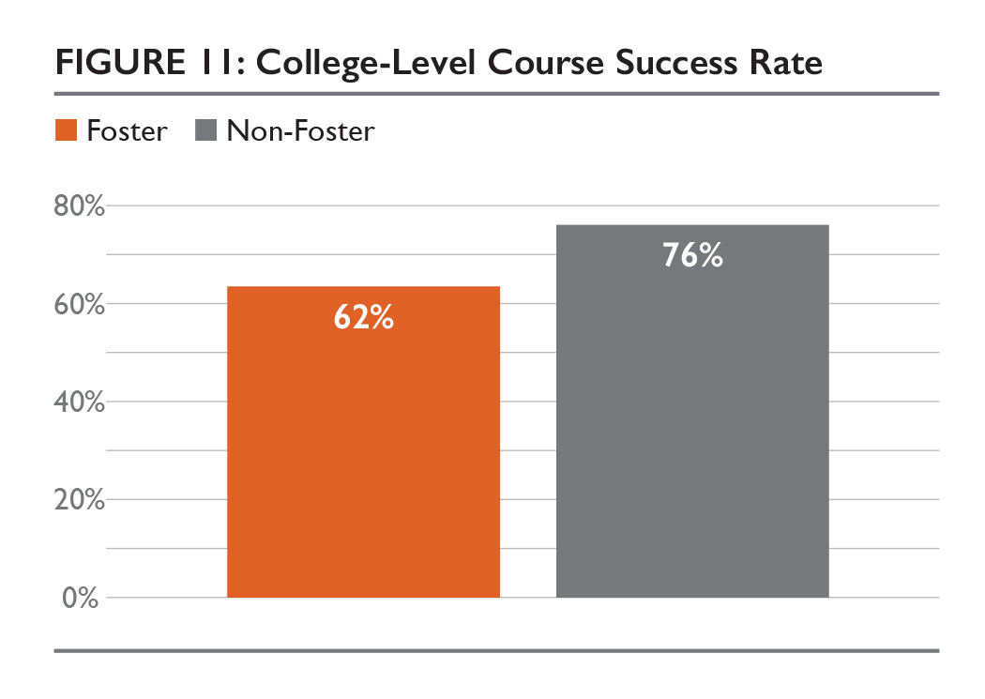
MATH AND ENGLISH COMPLETION

Slide 21
MATH AND ENGLISH COMPLETION
Foster youth complete transfer level English in their first year at substantially lower rates than non-foster youth
Large disparities exist for certain groups of foster youth

Slide 22
MATH AND ENGLISH COMPLETION
Noticeable differences in course success rates among different ethnic groups

Slide 23
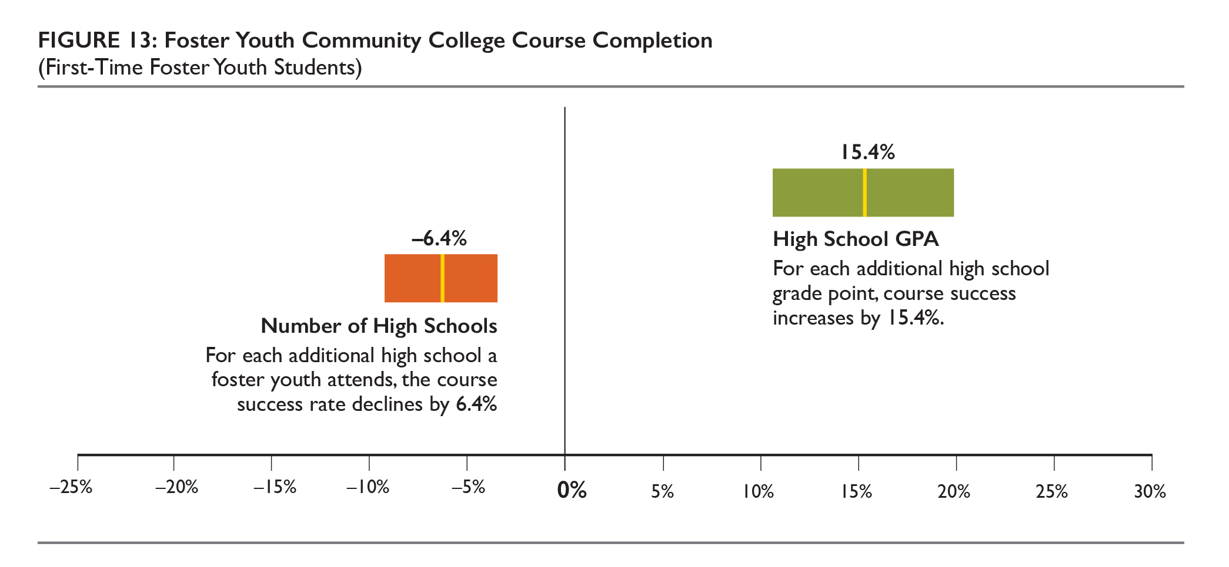
PROMISING PRACTICES TO SUPPORT 30-CREDIT COMPLETION

Slide 24
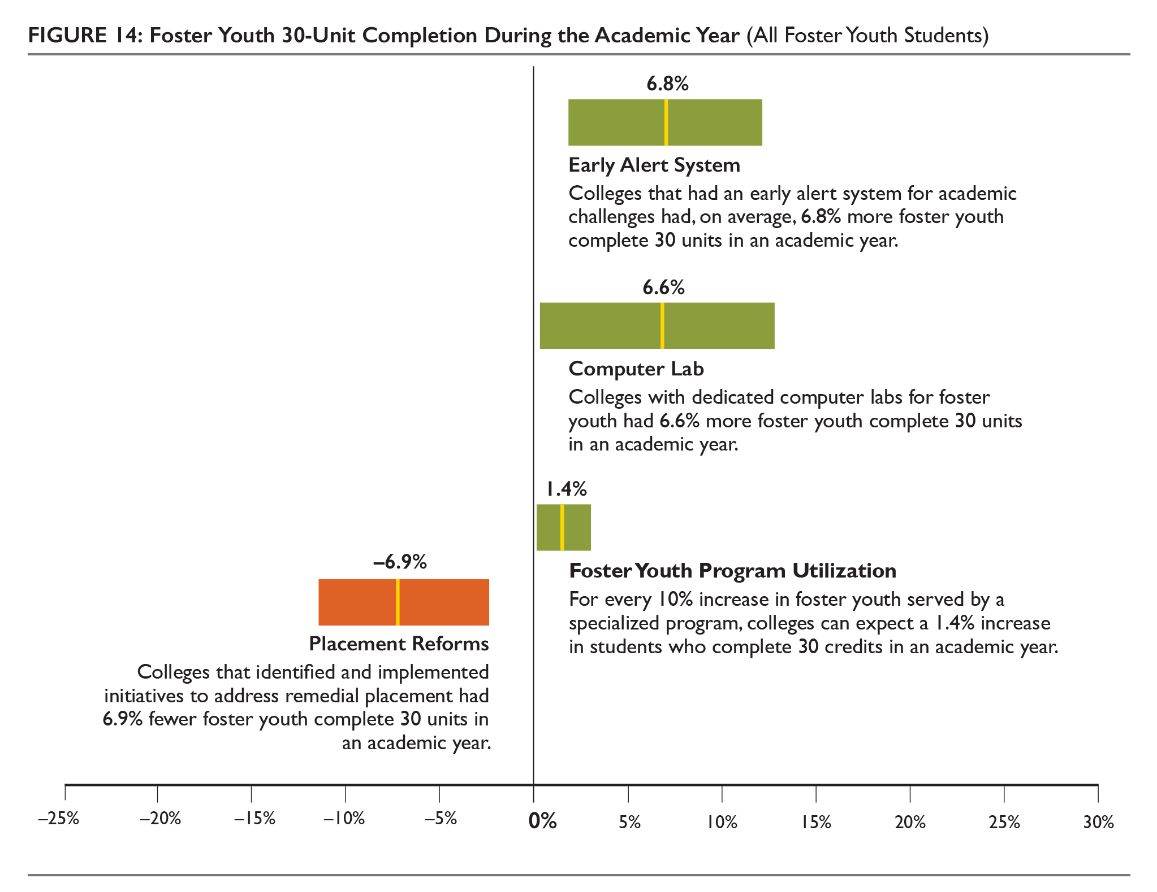
INSTITUTIONAL AND PROGRAM FACTORS THAT PREDICT 30-CREDIT COMPLETION
Notes:
Note about placement reforms like Multiple Measures may not have been in place at the time of the data pull. But, it may indicate more that the colleges identified the need to reform and/or that foster youth may not be impacted as much by using high school transcripts

Slide 25
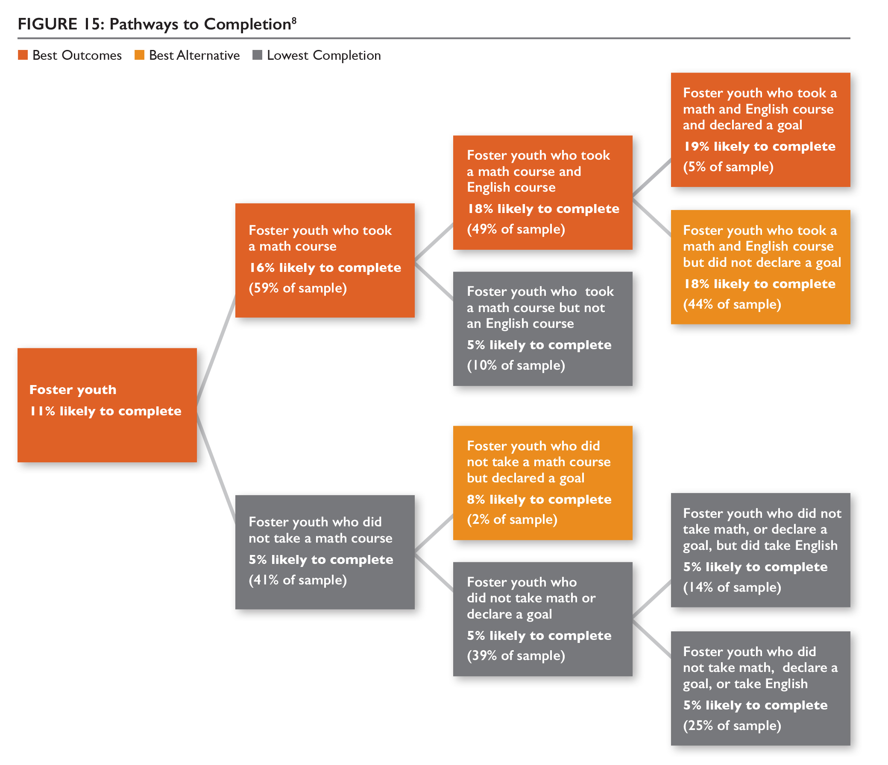
PATHWAYS TO COMPLETION
Foster Youth who took a math and English course in the first two years increased their likelihood of completing college by 7%
Declaring an Ed. Goal in addition to math and English only slightly increased completion

Slide 26
DISCUSSION
The educational experience of racial minority foster youth gives cause for concern
Further exploration of differentiated Asian-American groups should be explored
Persistence after the first year of college was influenced by receiving a standard high school diploma
Number of high schools attended by foster youth influenced their academic outcomes
Taking a math or English course in the first year was the strongest predictor of student success
Multiple measures on many colleges is beginning to reduce under-placement of students into courses.
Notes:
If foster youth in aggregate, underperform all other disadvantaged groups, the educational experience of racial minority foster youth gives cause for grave concern
Further exploration of differentiated Asian-American groups would provide more information regarding achievement discrepancies
Persistence after the first year of college was influenced by whether or not a student had a standard high school diploma
Number of high schools attended by foster youth influenced their academic outcome
Taking a math or English course in the first year was the strongest predictor of student success
Multiple measures is beginning to reduce remedial course placement – but probably not at the time of the study and may need to be explored further as to whether it is benefitting foster youth in particular.

Slide 27
LIMITATIONS
Foster youth were identified via self-identification and financial aid application
The analyses presented do not control for length or intensity of a students experience in foster care
This report does not evaluate the causal relationship between specific foster youth programs and student outcomes
This analysis was limited to foster youth in California

Slide 28
NEXT STEPS
Further data matching and analysis are needed between K-12 school districts and community colleges
Future work should cross-reference community college and child welfare
Triangulated findings from quantitative analysis and qualitative interviews warranted highlighting promising practices of higher-performing programs
Listening directly to foster youth regarding their experiences would bolster identification of challenges and promising practices
Analyzing the fourth “E” (Embark) when enough time has lapsed will illuminate the connection between post-secondary education and the labor market/economic well-being

