Slide 1
Orange County Network: Collaborating to Support Foster Youth Success
Orange Coast College, Golden West College,
CSU Fullerton
2017 Blueprint Conference for Success
October 16-17
Los Angeles, CA

Slide 2
Purpose
Orange County Network: Collaborating to Support Foster Youth Success
This network was established in partnership with the Stuart Foundation to develop an admissions pipeline for foster youth from community colleges to the four year institution.
Share how we worked within a community of practice (CoP) to develop High Impact Practices and other support services that focused on identifying the gaps that foster youth face within the education pipeline from community college to a four year institution.
Notes:
The presentation will emphasize the importance of inclusive education: A perspective that acknowledges and respects the knowledge and strengths all students bring from their communities and recognizes this an integral component of curricular and co-curricular development a means to support them in developing tools to fully participate in university life. The presenters will and share their cycle of inquiry, the key principles of Just, Equitable and Inclusive Education, and its impact on the Abrego Future Scholars Program.

Slide 3
Agenda
Orange County Network: Collaborating to Support Foster Youth Success
Institutional Context
Community of Practice
Challenge, Barriers and Successes
Campus based foster youth advocacy programs
Story Sharing
Tools and Strategies to Implement
Notes:
The presentation will emphasize the importance of inclusive education: A perspective that acknowledges and respects the knowledge and strengths all students bring from their communities and recognizes this an integral component of curricular and co-curricular development a means to support them in developing tools to fully participate in university life. The presenters will and share their cycle of inquiry, the key principles of Just, Equitable and Inclusive Education, and its impact on the Abrego Future Scholars Program.

Slide 4
Institutional Context
Orange County Network: Collaborating to Support Foster Youth Success
Name: Orange Coast College
Type: Community College
Enrollment: 16,744
Foster Youth Population: 375 self-identified/80 active in program
Name: Golden West College
Type: Community College
Enrollment: 9,536
Foster Youth Population: xx self-identified/xx active in program
Name: CSU Fullerton
Type: 4 year public, one of the 23 CSU Campuses
Enrollment: 40,325
Foster Youth Population: 100 self-identified/80 active in program, 46 of the 80 are receiving full scholarships

Slide 5
Community of Practice
Orange County Network: Collaborating to Support Foster Youth Success
Monthly Network Meetings
Attended the following meetings together:
Southern California Higher Education Foster Youth Consortium Meetings
Foster Youth Outcomes Committee Meeting
Meeting with Orange County Department of Education representatives
Presented at EOPS and FYSI Region 8 meeting
Building Bridges for College Success Committee

Slide 6
Community of Practice
Orange County Network: Collaborating to Support Foster Youth Success
Results:
Share how foster youth were being provided services and resources on respective campuses
Identified gaps and challenges/barriers foster youth were facing
Reviewed current law and policy that affects foster youth (priority registration, Chafee, etc…)

Slide 7
Challenges and Barriers of Pipeline
Orange County Network: Collaborating to Support Foster Youth Success
Admissions
Foster youth not completing CSU Mentor-- now CSU Apply application
Difficulty finding EOP application within CSU application
Application a barrier in itself
Deadlines not clear (multiple deadlines) ex: orientation, transcripts,admission, FAFSA, major advising
FAFSA
Need more education on completing FAFSA application
Determining EFC for students if student is working
Notes:
A just, equitable, and inclusive education requires an awareness of and willingness to interrupt and change policies and practices that have historically institutionalized the privileging of one group of students over others.

Slide 8
Challenges and Barriers of Pipeline
Orange County Network: Collaborating to Support Foster Youth Success
Navigating Campus Environment
Where does student go for foster youth support services?
If not accepted in EOP what are additional options for them?
Who is their support and point of contact when they transfer from the community college?
Verifying foster youth at the community college and four year
Notes:
A just, equitable, and inclusive education requires an awareness of and willingness to interrupt and change policies and practices that have historically institutionalized the privileging of one group of students over others.

Slide 9
Successes and Implication for Practice
Orange County Network: Collaborating to Support Foster Youth Success
Admissions
Checklists
OCC and Golden West will be reviewing their checklist to make sure it aligns with CSU checklist.
CSUF will create an individual checklist specific for transfer to CSUF.
Workshops
Developing application workshops with OCC and GWC to assist students interested in transferring to CSUF
FAFSA
EFC
CSUF has created a policy with Admissions and Records to provide all incoming foster youth a service indicator to protect the student, regardless of EFC, from any fees associated with orientation and accepting admission to the University.
Developing FAFSA application workshops with OCC and GWC to assist students interested in transferring to CSUF
Notes:
Political context - this focus needed ,more than ever
A just, equitable, and inclusive education requires an awareness of and willingness to interrupt and change policies and practices that have historically institutionalized the privileging of one group of students over others.

Slide 10
Successes and Implication for Practice
Orange County Network: Collaborating to Support Foster Youth Success
Navigating Campus Environment
Fostering Success Coach: Facilitated and participated in the Fostering Success Coach Training from Western Michigan’s Center for Fostering Success as a result:
Warm Transition: OC Network will be developing a purposeful intervention in assisting students transferring from the community college to CSUF.
Inclusive Services
Realizing the need to support all foster youth on campus, CSUF in consultation with OC Network partners has developed inclusive services for all foster youth attending CSUF. This included non-scholarship services.
Bridge Building
Leveraging connections as a result of the OC Network to assist staff and students in navigating both the community college and CSUF environments.
Community College CSUF
CSUF Community College
Notes:
A just, equitable, and inclusive education requires an awareness of and willingness to interrupt and change policies and practices that have historically institutionalized the privileging of one group of students over others.

Slide 11
Successes and Implication for Practice
Orange County Network: Collaborating to Support Foster Youth Success
Navigating Campus Environment
Bridge Building
Leveraging connections as a result of the OC Network to assist staff and students in navigating both the community college and CSUF environments.
Community College CSUF
CSUF Community College
Notes:
A just, equitable, and inclusive education requires an awareness of and willingness to interrupt and change policies and practices that have historically institutionalized the privileging of one group of students over others.

Slide 12
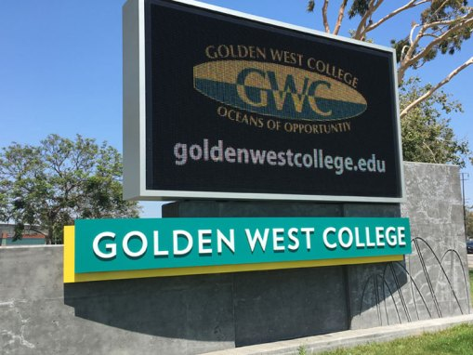
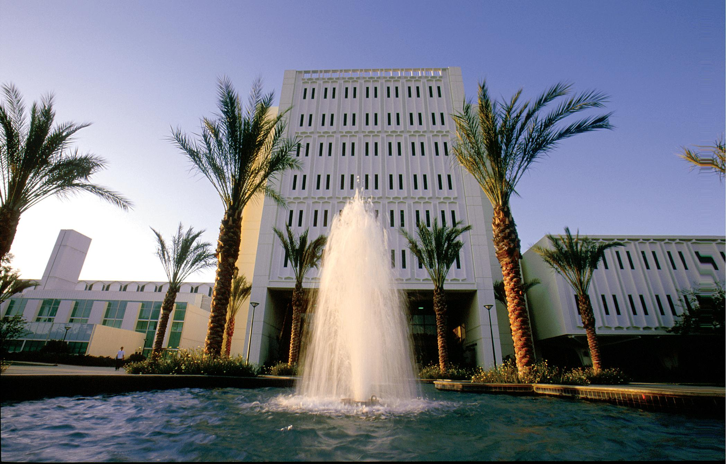
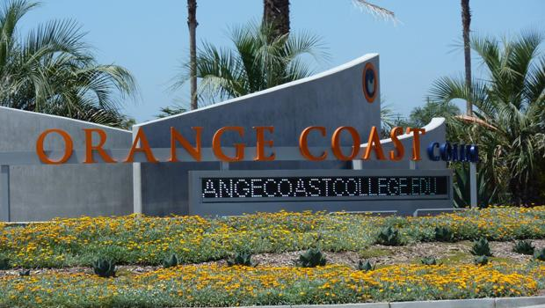
Campus Based Foster Youth Advocacy Programs
Orange County Network: Collaborating to Support Foster Youth Success
Orange Coast College
Golden West College
CSU, Fullerton

Slide 13
Tools and Strategies to Implement
Orange County Network: Collaborating to Support Foster Youth Success
Educate Your Base
Community Development
Continuous Improvement

Slide 14
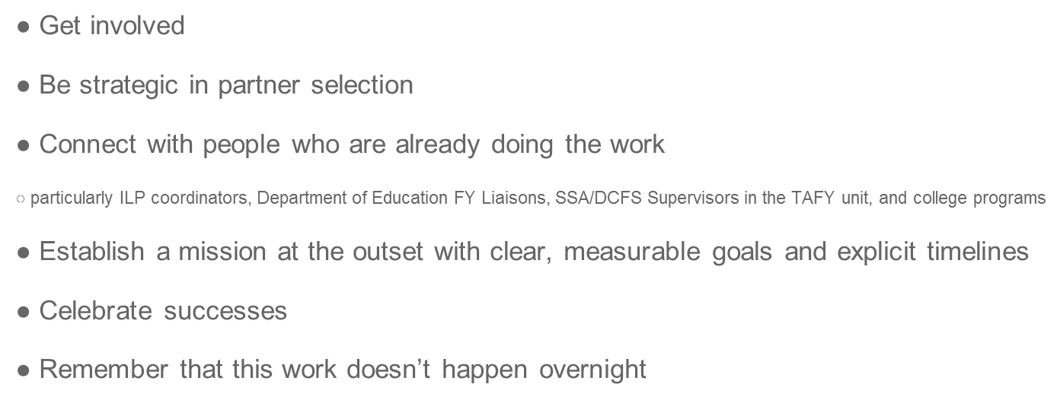
Advice
Orange County Network: Collaborating to Support Foster Youth Success

Slide 15
Orange County Network: Collaborating to Support Foster Youth Success

Slide 16
Campus Contacts
Orange County Network: Collaborating to Support Foster Youth Success
CSUF: Center for Scholars
scholars@fullerton.edu
657-278-3458
OCC: Guardian Scholars Program
guardianscholars@occ.cccd.edu
714-432-6877
GWC: EOPS/CARE/Guardian Scholars
714-895-8768

Slide 17
Questions?
Orange County Network: Collaborating to Support Foster Youth Success

