Slide 1
CalYOUTH: Communications Breaks and Bridges for Higher Education
October 16, 2017
Blueprint for Success Conference

Slide 2
Today’s Session
Findings from the CalYOUTH Study
With focus on findings related to Education
Presented by:
Nate Okpych Adrianna Torres-García
University of Connecticut University of Chicago
Results from CalYOUTH in the Loop Project
With focus on findings related to methods and messaging
Presented by:
Laurie Kappe and Lilia Granillo
i.e. communications
Group Discussion
Kamari Wells

Slide 3
California Youth Transitions to Adulthood Study (CalYOUTH)
Nathanael Okpych, PhD
CalYOUTH Project Director
University of Connecticut
Adrianna Torres-García, BA
CalYOUTH Research Assistant
University of Chicago

Slide 4
Background
Evaluation of the impact of California Fostering Connections to Success Act (AB 12) on outcomes for foster youth
Public/private funders
Study includes:
Collection of data from transition-age foster youth
(3 interview waves)
Collection of data from child welfare workers (2 surveys)
Analysis of administrative program data
Notes:
ACKNOWLEDGE FUNDERS

Slide 5
What We’re Sharing Today
Foster youth’s and child welfare workers’ perceptions of youth’s readiness to go to college
Social support and other predictors of college entry
Foster youths’ experiences and activities while in college

Slide 6
CalYOUTH Longitudinal Study of Foster Youth
Eligible youth between 16^{3/4} and 17^{3/4} years of age
In care at least 6 months
Sample
Drawn from CDSS administrative data records
Stratified by county based on number of eligible youth in each county
Includes youth from 51 CA counties
Notes:
Note that this included FC supervised (not probation-supervised) youth at time sample was drawn

Slide 7
Longitudinal Study Interviews
 | Interview Year | Age of Respondents | Eligible Youth | Respondents | Response Rate
Wave 1 | 2013 | 17 | 763 | 727 | 95%
Wave 2 | 2015 | 19 | 724 | 611 | 84%
Wave 3 | In Progress | 21 | 721 | -- | --

Slide 8
Second Child Welfare Worker Survey
516 foster youth in the longitudinal study were still in foster care in June 2015
Asked 306 child welfare workers of these 516 youth to complete online survey
Questions about the youth
Questions about services in worker’s county
By October 2015, 295 workers completed surveys about 493 youth (95% response rate)

Slide 9
PART 1: Foster youth’s and child welfare worker’s perceptions of youth’s readiness to go to college

Slide 10
Purpose
Examine agreement between youth and their caseworker on youth’s preparedness to pursue higher education
Explore whether perceptions of preparedness (youth’s and caseworker’s) is related to youth’s likelihood of enrolling in college

Slide 11
Data Used for this Analysis
Second child welfare worker’s survey
Second wave of longitudinal study
Both took place in summer/fall 2015
Youth participants were about 19 years old
Only includes participants who were still in foster care

Slide 12
Survey Questions Used in Analysis
Youth Survey
Worker Survey
“How prepared do you feel to continue and achieve your education or job training goals? This may include goals like earning your high school diploma or G.E.D., completing a vocational training program, or going to college.”
Very prepared
Prepared
Somewhat prepared
Not prepared
Don’t know
Refused
“How prepared is this youth to continue his/her education goals?”
Not prepared
Somewhat prepared
Prepared
Very prepared
This youth does not plan on completing additional education
Don’t know

Slide 13
Foster youth tended to give higher ratings than caseworkers on perceptions of youth’s preparedness
Youths’ perceptions of their education preparedness (n=423)
Workers’ perceptions of youth’s education preparedness (n=492)

Slide 14
Youth and caseworker agreement on perceptions of education preparedness (n=461)

Slide 15
Regression Analysis: Predicting the Odds of Enrolling in College
Associations between Youth’s and Caseworker’s Perceptions of Youth’s Education Preparedness and College Enrollment (n=461)
 | No controls | Controls
Predictors | Odds Ratio | Odds Ratio
Youth’s perceptions (ref: Not prepared)
Somewhat prepared | 1.10 | 0.82
Prepared | 1.30 | 0.54
Very prepared | 1.09 | 0.54
Caseworker’s perceptions (ref: Not prepared)
Somewhat prepared | 1.40 | 1.21
Prepared | 2.51* | 2.05
Very prepared | 14.3*** | 8.24***
*p<.05 ***p<.001

Slide 16
Regression Analysis: Summary of Findings
Youth’s perceptions were not associated with their odds of enrolling in college
Caseworker’s perceptions of youth’s preparedness significantly related to youth’s likelihood of going to college
In the final model with all controls, only youth rated as “very prepared” were significantly more likely than youth rated as “not prepared” to enter college
Caveat: Some youth may have already enrolled in college when worker’s were asked about youth’s preparedness to continue education

Slide 17
PART 2: Social support and other predictors of college entry

Slide 18
Purpose
Investigate link between background characteristics (age 17) and college entry:
Academic performance and aspirations
Foster care history
Health and mental health
Other risk and protective factors
Okpych & Courtney (2017). Predictors of high school completion and college entry at age 19/20. Chapin Hall webpage.
Examine which types of social capital are linked to going to college
Okpych & Courtney (in press). Who goes to college? Social capital and other predictors of college entry for youth in foster care. Journal of the Society for Social Work and Research

Slide 19
Data for this Analysis
Sample
711 youths who completed CalYOUTH interview at age 17 and who consented to administrative data access
Outcome
National Student Clearinghouse records
Obtained in February 2016 (average age of participants 20.2 years)
Youth enroll in two-year or four-year college
Predictors in Logistic Regression Analyses
State child welfare records for foster care history characteristics
Longitudinal youth survey (age 17) for all other predictors

Slide 20
More than half of foster youth enrolled in college by age 19/20, most attended two-year colleges

Slide 21
Summary of Significant Findings: Predictors of College Entry¹
Predictor | Odds Ratio
Highest completed grade at age 17 (ref: 9th or lower)
10th grade | 1.22
11th grade | 1.74
12th grade | 2.65^
Reading score | 1.43**
Ever repeated a grade | 0.52**
Educational aspirations (ref: high school credential or less)
Some college | 1.14
Earn a college degree | 2.21*
More than a college degree | 2.70**
Foster care placement change rate | 0.83*
Months in care past age 18 | 1.06***
Parent at age 17 | 0.34*
¹ See handout for other controls
^p<.10 *p<.05 **p<.01 ***p<.001

Slide 22
Social Capital and College Entry
Social capital includes resources embedded in social ties
Different types of social capital useful for different goals
Our main hypothesis: Foster youth who have institutional agents to rely on for advice and tangible support would be more likely to enter college than youth without these supports
Institutional agents are adults familiar with college that can serve as motivators, guides, advocates, links to resources to college aspirants (Stanton-Salazar, 2011)
We expected other types of social capital to play lesser or nonsignificant roles in predicting college enrollment

Slide 23
About 46% of the 711 youth nominated 1 or more institutional agents

Slide 24
Main Findings of Social Capital Analysis
Each additional institutional agent youths nominated increased the probability of entering college, after controlling for wide range of factors
Example students with no institutional agents
Probability of persisting:
55%
Example students with 1 institutional agent
Probability of persisting:
63%
Relationship was partially mediated (explained) by:
the amount of college application/preparation help youth said they received during age 19 interviews,
The amount of time they spent in care past age 18
Other types of social capital did not significantly predict college entry

Slide 25
PART 3: Foster youths’ experiences and activities while in college

Slide 26
Purpose
Examine how foster youth were managing the transition to college
Examine differences by foster care status
Data Used for this Analysis
Second (age 19) interviews of longitudinal youth study (n=611)

Slide 27
How Youth are Paying for College (n=268)
 | Overall (%) | In Care (%) | Out of Care (%) | p
Paying for College (can select more than 1)
ETV grant | 54.3 | 55.1 | 49.9 | n.s.
Other scholarships, fellowships, or grants | 71.0 | 73.0 | 58.6 | n.s.
Student loans | 9.2 | 8.2 | 15.2 | n.s.
Own earnings from employment or savings | 31.9 | 30.0 | 43.0 | n.s.
Money from a relative, friend, other | 8.4 | 5.7 | 25.1 | <.001
Money from another source | 11.0 | 12.5 | 1.7 | .016
Among youth at age 19 who had finished high school (n=448), 36% said they did not know what an ETV grant is
¹ Includes both youth who were enrolled at W2 and youth who were enrolled since W1.
Notes:
**Note: Add a bullet for the % of students who did not know what an ETV was

Slide 28
Participation in Campus Activities to Support Academics (n=268)
 | Overall (%) | In Care (%) | Out of Care (%) | p
Involvement in campus support for F.Y. | 50.3 | 55.1 | 21.9 | .002
Involvement in other college activities
Tutoring | 35.2 | 34.5 | 39.4 | n.s.
TRIO/EOP student support services | 19.3 | 20.6 | 11.4 | n.s.
Academic advising | 51.6 | 53.4 | 40.6 | n.s.
Meeting with professors outside class | 54.8 | 57.0 | 41.9 | n.s.
Among youth in college (n=268), 29% said they were not sure if their college offered a campus-based program for foster care youth
¹ Includes both youth who were enrolled at W2 and youth who were enrolled since W1.
Notes:
**Note: Remember to add a bullet point for the % of college students who said they didn’t know if their college has a campus-support program

Slide 29
Difficulties with the Transition to College (n=268)
 | Overall (%)
Paying for College (can select more than 1)
Classes harder than youth was used to | 44
Difficult organizing time to finish all responsibilities | 62
Hard making friends | 19
Did not know how youth was going to afford college | 23
Youth did not know if he/she would have transportation to and from college | 31
Had to balance school and work | 53
Had to balance school and being a parent (n=33) | 73
Notes:
Note: there were no differences by in-care status

Slide 30
Summary & Implications
Child welfare workers appear to be a good gauge of youths readiness, but youth’s perceptions not as much.
Workers are in a good position to assist youth in making realistic plans for the future according to youth’s resources (e.g. academic achievement, economic resources).
Some youth expected to have a difficult time enrolling in college (e.g., young parents, youth with academic difficulties)
Connections to institutional agents important predictor of going to college
Supports in college: about half said they were in FC program. About half said they received ETV

Slide 31
Stay Tuned…What’s to Come with CalYOUTH
Analysis of impact on college entry and college persistence using administrative data (20,000 foster youth)
Identification of colleges in California foster youth most commonly attend
Findings from third interview wave, when participants are 21 years old

Slide 32
CalYOUTH in the Loop
Research
Share with foundations/ policymakers/ advocates
Improve programs and services
Outreach to youth
Who:
Chapin Hall and i.e. communications
What:
Create a feedback loop between young people
in foster care and those working with them
How:
Share selected findings of the California Youth Transitions to Adulthood Study (CalYOUTH) and incorporate youth feedback/input
Why?
Incorporate input to create policies and practices that best meet their needs
Increase engagement with young people
Identify best methods of communication for continuous feedback

Slide 33
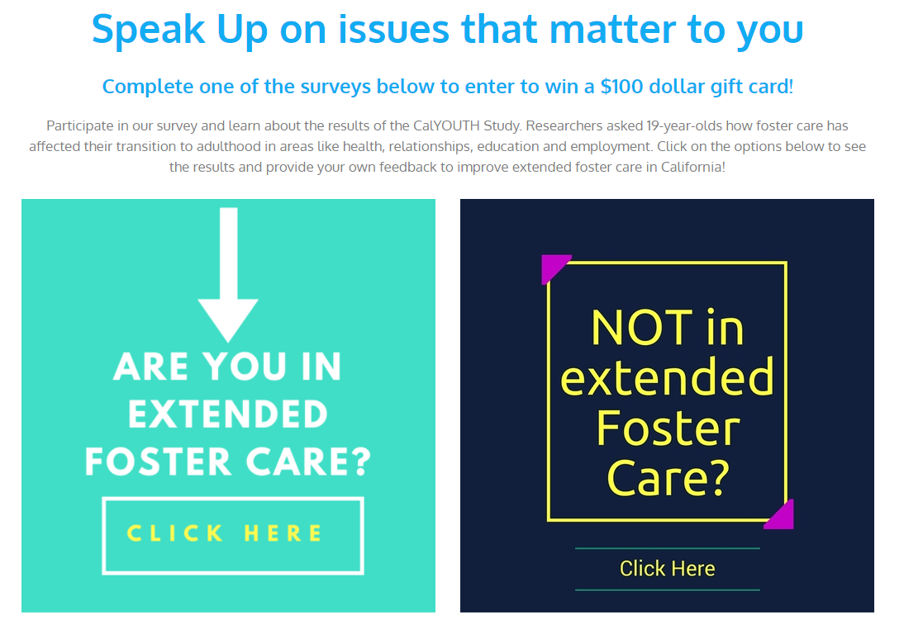
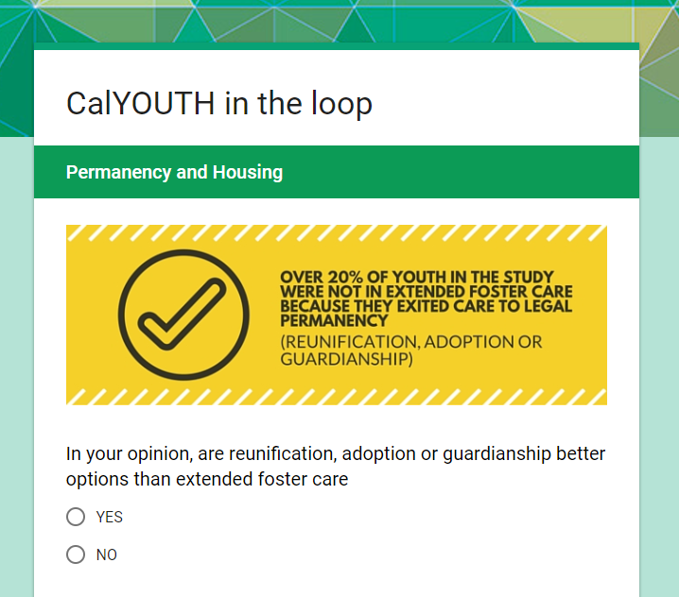
How do we collect feedback?
CalYOUTH in the Loop Website
CalYOUTH in the Loop Survey

Slide 34
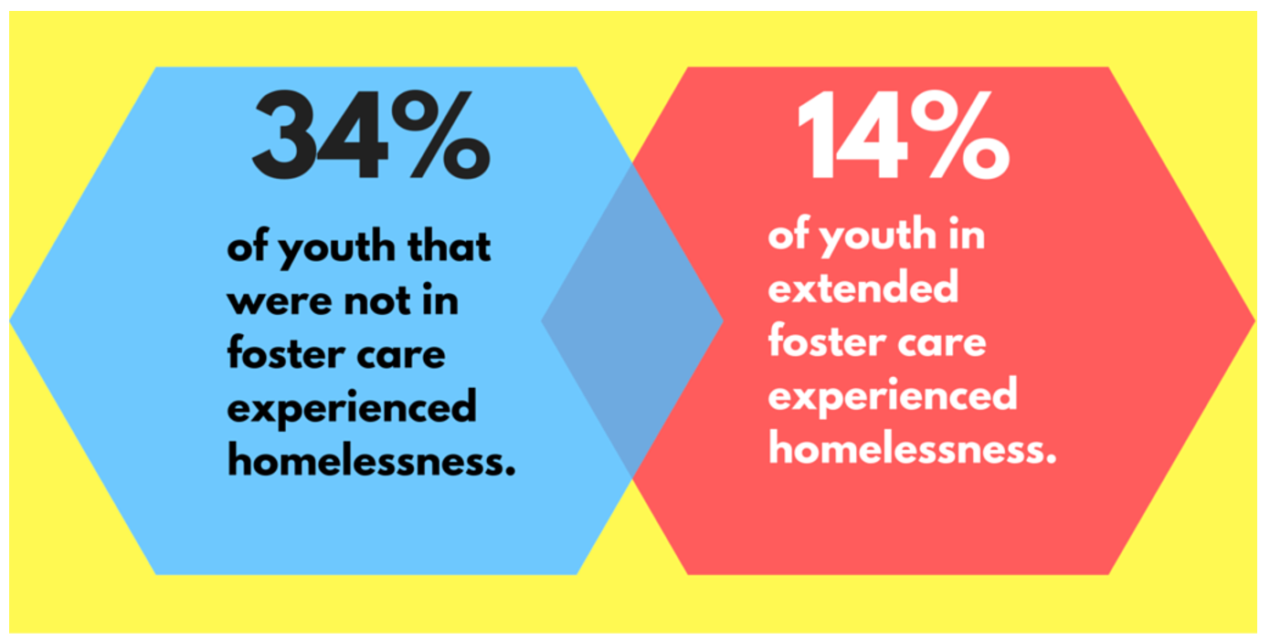
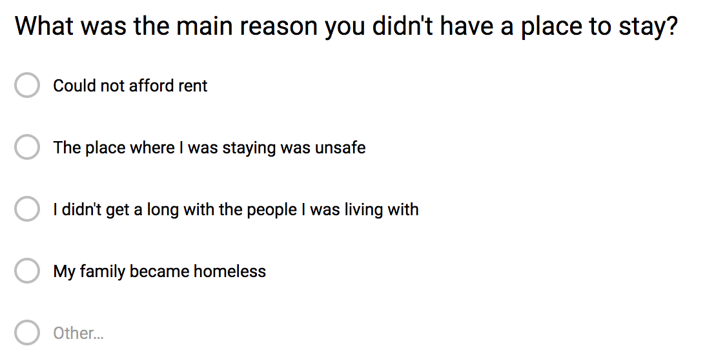
What we are trying to learn
The CalYOUTH Study tells us outcomes – CalYOUTH in the Loop wants to learn more in the youth’s own words and learn how to better listen to youth voice

Slide 35
Feedback Methods
Direct emails to youth
Direct emails to service providers
Personal Calls and emails with service providers
In-Person contact with service providers
Peer-to-peer outreach (Youth Perspective Recruiters)

Slide 36
Youth Perspective Recruiters
Peer to Peer Outreach Strategies
To encourage youth to share survey with their peers, CalYOUTH in the Loop created a Youth Perspective Recruiter (YPR) position
YPRs had to participate in a short orientation where they learned more about the CalYOUTH Transitions to Adulthood Study.
Youth who participated in this activity were compensated with a stipend for recruiting at least 5 of their peers to take the survey

Slide 37
Feedback Loop Challenges
Survey fatigue
Youth and intermediaries are asked to respond to surveys or requests for feedback by many different parties for different purposes beyond their immediate self-interest (i.e. “long term policy change,” vs. immediate changes in their personal situation)
Social media limitations
Youth interact with the social media profiles that their social networks also interact with
Popular brands
Original creative content pages
Our relatively small digital project struggled to gain traction on social media. Peer-to-peer outreach strategies and intermediary relationships were more effective.

Slide 38
Highlight and Insights
College support organizations are trustworthy, tight-knit communities that encourage youth to provide feedback
Youth Perspective Recruiters were previously involved in other advocacy organizations and were enthusiastic to develop skills related to elevating youth voice.
Communicating with other peers about foster care was personally enriching for YPRs.
YPR position created opportunities to develop youth agency and leadership.
After orientation, YPRs could share information from the CalYOUTH study in a more informal way, and spread knowledge of its results and effects, leading to greater familiarity with youth advocacy efforts and resources.
Feedback loops in these contexts were not just “another survey” into the “feedback void.”

Slide 39
Bridging the Information Gap on Higher Ed Opportunities
College Success Foundation
Sought to inform more foster youth about Washington State program and scholarship that paid for former foster youth’s college credits at most Washington State Colleges.
Led focus groups in Seattle and Spokane to gather insights to create new materials (e.g., video) to increase awareness and enrollment

Slide 40
Focus Group Insights
In your opinion, what barriers face alumni of foster care to enroll in college?
Not knowing about scholarships
Swayed by peers into thinking college is not important/financial aid is not possible
“I aged out before I knew it (college support funds) existed…”
“Didn’t know how much money is out there”
Being a first generation college student: no family history, no role models
Understanding what degree to pursue - how to pick a major, what to do in college
Difficult to find resources and support

Slide 41
Video and Materials
Link: https://youtu.be/gcmK5PR1Ea8

Slide 42
Discussion
What are some actionable steps that can be taken to close the information and communications gap identified by the CalYOUTH study?
What role should child welfare workers play? College campus professionals?
What are biggest barriers you see?
Are there new insights on methods, materials or messages from the CalYOUTH in the Loop findings that can be incorporated?

