Slide 1
Empowering TAY in Mental Health Advocacy Efforts
Presented by:
Kathleen Casela, MHAC
Ashley Flores, Project Return
Notes:
Welcome to the first day of Blueprint Conference! Thank you for choosing our workshop. This is the “Empowering TAY in Mental Health Advocacy Efforts”

Slide 2
Introductions
Kathleen Casela
CAYEN Program Director
Ashley Flores
Project Return
CAYEN Board Member
Notes:
My name is Kathleen Casela and I am the Program Director for the CAYEN. Our focus is to empower young people who have been affected by mental health and involve them in policy efforts. I have been an advocate for over 16 years. A little bit about myself, I was in the foster care system for a couple of years and used my own personal stories to affect policy changes. I have also done a lot of direct service, primarily in SF working at several youth homeless shelters, group homes and transitional living programs. I’m really passionate about young people, higher education and making sure young people have access to mental health resources.
With me, I would like to introduce you to…..
Name
Number of years as a CAYEN board member
One thing member has learned from CAYEN
What is member doing now? (Peer, school, etc.)

Slide 3
California Youth Empowerment Network (CAYEN)

Slide 4
California Youth Empowerment Network
CAYEN’s mission is to empower Transitional Age Youth (TAY) to be leaders in community and mental health system transformation and to create positive change through the promotion of culturally appropriate supports, services and approaches that improve and maintain the mental health of California’s TAY.
Notes:
We are from the California Youth Empowerment Network, pronounce like cayenne pepper. CAYEN is a project of Mental Health America of California. MHA has various affiliates throughout the state you may have hard of, such as MHALA or MHA Orange County, which are closer to LA.
CAYEN, is MHAC’s youth component of the organization. Our mission is to empower Transition Age Youth or TAY to be leaders in community and mental health system transformation. We believe that young people’s voices and experience are extremely valuable and have the ability to impact policy legislation, not just statewide but also local impact.

Slide 5
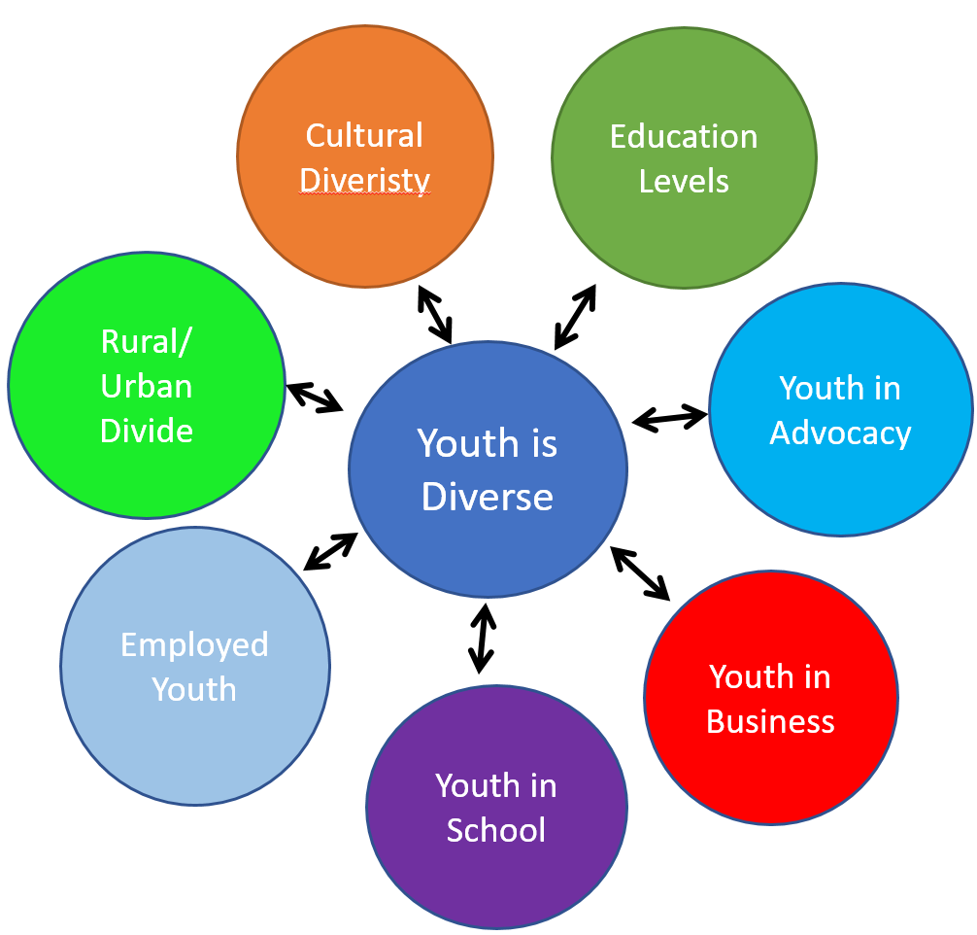
Vision
We envision a community in which Transition Age Youth in need of mental health services have access to resources and supports so they can lead fulfilling lives and be contributing members of society.
Notes:
What we envision is for all young people seeking mental health services have access to resources so they are able to get their needs met, get treatment that best fits them and are able to lead their best lives.

Slide 6
Who are Transition Age Youth (TAY)?
TAY -Transitional Age Youth
Young people 16 to 26
Unique demographic
Not children, not adults
Distinct supportive needs
Require customized services and supports
Involved in a system
Notes:
I’m sure most of you are familiar with the term, TAY or transition age youth. There are various definitions of TAY and different age.
For CAYEN:
We work with TAY between the ages of 16-26
Young people in this age group are very unique, in that they require a specific set of needs.
Need customized and additional supports-young people within this age group are not quite adults but not children.
Young people we work with have been involved in some system- foster care, mental health and or have been homeless

Slide 7
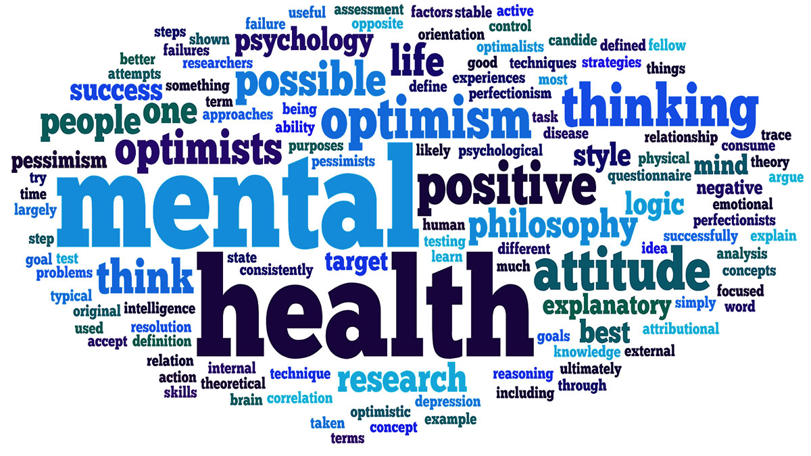
Mental Health Definition
Mental health includes our emotional, psychological, and social well-being. It affects how we think, feel, and act. It also helps determine how we handle stress, relate to others, and make choices. Many factors contribute to mental health, including:
Biological factors, such as genes or brain chemistry
Life experiences, such as trauma or abuse
Family history of mental health problems
Mental health problems are common but help is available.
*MentalHealth.Gov
Notes:
Question to the group: “how do you define mental health? When I say, mental health, what comes up for you?”
“Mental health includes our emotional, psychological, and social well-being. It affects how we think, feel, and act. It also helps determine how we handle stress, relate to others, and make choices.
Many factors contribute to mental health, including:
Biological factors, such as genes or brain chemistry
Life experiences, such as trauma or abuse
Family history of mental health problems
Mental health problems are common but help is available.
So the way that I describe mental health is, there are days that you feel really great about your life, your relationships, you just scored a really high school on an exam. Then there are days where one thing after another, things just take a turn for the worse. You got in a disagreement with your best friend, or partner, or you may not have done that well on your finals, or you may have gotten in an accident. So mental health, is learning to understand the way you work, learning what happens when you are stressed out and what positive things you can do for yourself to feel better. For me, I love playing with my dog and my cat. They are positive to my mental health because they accept me through it all.
What about you? How do you know when you feel stressed out? What are ways that you get yourself to feel better?
https://www.mentalhealth.gov/basics/what-is-mental-health/index.html

Slide 8
Mental Health Statistics
1 in 5 adults have a mental health condition
The onset for 50% of adult mental health disorders occurs by age 14, and for 75% of adults by age 24
Individuals living with serious mental illness face an increased risk of having chronic medical conditions
Mood disorders, including major depression and bipolar disorder, are the third most common cause of hospitalization in the U.S. for both youth and adults aged 18–44
Notes:
So let’s look at some general mental health statisics
1 in 5 adults have a mental health condition (we can count off as an activity)
The onset for 50 percent of adult mental health disorders occurs by age 14, and for 75 percent of adults by age 24.⁴
https://youth.gov/youth-topics/youth-mental-health/prevalance-mental-health-disorders-among-youth
Individuals living with serious mental illness face an increased risk of having chronic medical conditions.
Mood disorders, including major depression, dysthymic disorder and bipolar disorder, are the third most common cause of hospitalization in the U.S. for both youth and adults aged 18–44

Slide 9
Mental Health and Young Adults
Foster Youth- Up to 80% of children in foster care have significant mental health issues, compared to approximately 18-22% of the general population
LGBTQ Youth- Suicide is the third leading cause of death among youth ages 15 to 24, and are more likely to attempt suicide than their peers
Homeless Youth-45% of homeless youth reported mental health problems in the past year.
Notes:
Foster Youth- Up to 80% of children in foster care have significant mental health issues, compared to approximately 18-22% of the general population
A lot of contributing factors- actors contributing to the mental and behavioral health of children and youth in foster care includes the history of complex trauma, frequently changing situations and transitions, broken family relationships, inconsistent and inadequate access to mental health services and the over-prescription of psychotropic medications.
/www.ncsl.org/research/human-services/mental-health-and-foster-care.aspx
LGBTQ Youth- Suicide is the third leading cause of death among youth ages 15 to 24, and are more likely to attempt suicide than their peers. This can be contributed by stigma, bullying and lack of resources.
Homeless Youth-45% of homeless youth reported mental health problems in the past year.
---TAY who are involved in multiple systems, more than likely will have a mental health challenege.

Slide 10
Challenges Facing TAY:
Stigma
Lack of representation
Lack of TAY specific services
Criminalization of mental illness
Culturally inappropriate/ineffective services and referrals
Disempowerment
Misunderstanding of TAY culture
Accessing Services: housing, education, services
Any others?
Notes:
The increasing amount of challenges young people experience with accessing mental health is one of the main reasons why CAYEN exists. This is by no means a comprehensive list but hopefully it’ll shed some light on some of the more pressing issues, and what we advocate for.
Listed below are some of the challenges facing Transition Age Youth (TAY) in California.
Stigma:
Stigma and discrimination is still one of the primary reasons TAY do not seek help for mental health challenges.
Lack of Representation:
Transition Age Youth are underrepresented, they often do not have a voice in local or state government policy discussion and all too often the needs of TAY are defined without stakeholder involvement.
Lack of TAY Specific Services:
Transition Age Youth do not have their own mental health system of care. They fall in the children’s or adult systems of care and these structures are inadequate in addressing the needs of TAY.
Criminalization of Mental Illness:
Many TAY that exhibit serious mental health challenges end up in the juvenile justice system instead of linked with appropriate, community defined, services and supports.
Culturally Inappropriate/ineffective Services and Referrals:
Many existing programs and services are not appropriate or effective in some diverse communities.
Disempowerment:
Youth feeling less than an equal partners in system planning, meetings, committees, and boards.
Misunderstanding of TAY Culture:
There is lack of understanding and a prevalence of misunderstanding of the culture of today’s youth, which furthers stigma and discrimination.
Accessing services:
Even when a youth is able to overcome stigma, many youth still do not know where to go, or who to turn to when they need help.
Housing:
California has one of the highest rates in the country of homeless youth. In order for youth to achieve success, they need a stable place to live!
Education:
The cost of education is astronomical and for some, it is a challenge to enter into the educational system for a variety of reasons. Youth need opportunities and guidance to support them on their educational journey.

Slide 11
Mental Health Stigma
Mental health stigma is discrimination and prejudice behaviors against someone who has a mental health condition.
Self
Public
Structural
Stigma a person feels towards themselves
Stigma that comes from the general public
Stigma in the design of public and private institutions/ systems
Notes:
One of the major challenges with mental health, is the stigma associated with it. Social media, tv and movies often portray people who have mental health challenges as violent, irrational or dangerous. These one sided conversations often perpetuate those living with mental health and continues to stigmatize people. Every now and then, there are movies that show a more positive light. Often, stigma is a big barrier on seeking for treatment.
We define stigma as a label that someone puts on you and I’m sure we are all familiar with labels …..some negative labels that can impact how they feel about themselves. When we talk about mental health stigma- we talk about how these labels affect someone who has a mental health condition.
Some people with serious mental health challenges, appear to be different because of their symptoms or side effects of their medication. People may notice these differences, fail to understand them, feel uncomfortable, and thus act in a negative way toward them.
For foster youth, they have double the stigma of being a foster youth!
There are 3 types of stigma: self, public and structural stigma.
Stigma is not just the use of the wrong. Stigma is often an unspoken feeling, uncomfortabled or action. Stigma can be about disrespect or misunderstanding that can lead to fear or discrimination.. Mental health stigma is used to put someone down living with a mental illness.
Self Stigma is stigma a person feels towards themselves. It can affect self image and self esteem, and prevent people from seeking help and support.
What were some examples of Self Stigma included in the activity?
Ex 1 Felt down on yourself
Ex 2 Avoided seeking help because you did not want to receive a label or diagnosis
Public Stigma includes attitudes and prejudices from the general public. It is learned early in life and results in ignorance, prejudice, and discrimination. Social rejection and inaccurate stereotypes in the media are forms of public stigma.
What were some examples of Public Stigma included in the activity?
Ex 1 Felt that people have been afraid that you were dangerous because of your mental illness
Ex 2 Felt that people thought you were incompetent or unable to work
Structural stigma exists in the design of public and private institutions such as the legal system, the educational system, or the housing system. Structural stigma restricts people’s opportunities and rights. What were some examples of Structural Stigma included in the activity?
Ex 1 Denied housing, loans, health insurance, educational opportunities or jobs
Ex 2 Denied the right to make choices about your own medical care

Slide 12
Effects of Stigma
Stigma
Unwillingness to seek help
Social isolation
Difficulty in forming relationships
Denial of housing, jobs, loans, health insurance, etc.
Family rejection or isolation
Damage to self-esteem and self-confidence
Negative effect on the mental health condition
Notes:
Stigma is often a barrier and discourages individuals and their families from getting the help they need.
Stigma can affect people in many ways. As we observed, it has affected all of us in this room in some way. The effects of stigma can interfere with recovery and overall wellbeing, and actually make mental health conditions worse. Fighting stigma is an important job for mental health advocates…
Basically, finding different ways to fight stigma is what we are doing here today. This list includes a variety of ways advocates can change people’s minds and attitudes about mental health and mental illness, and fight self and public stigma. Legislation on the rights of consumers and families will create structural changes. The advocacy tools you will learn today can all be used to fight stigma in different ways.
Unwillingness to seek help
Social isolation
Difficulty in forming relationships
Denial of housing, jobs, loans, health insurance, etc.
Family rejection or isolation
Damage to self-esteem and self-confidence
Negative effect on the mental health condition

Slide 13
What CAYEN Does
CAYEN Board
Training and Education
TAY Center Directory
Policy and Advocacy
Notes:
As we stated earlier, we envision we envision all young people seeking mental health services have access to resources so they are able to get their needs met, get treatment that best fits them and are able to lead their best lives.
We do this in 4 ways:
Through our leadership focus with the CAYEN Board
Our policy and advocacy efforts
Our leadership and training currirulum
And TAY Center Directory

Slide 14
CAYEN Board
CAYEN Board is responsible for providing guidance and direction of the program
Composed of young people between the ages of 16-25
Have been involved by the mental health, juvenile justice and foster care systems
Personal lived mental health experience
Aspiring leaders committed to developing, improving and strengthening the voice of TAY
Notes:
We have a CAYEN Board, which is responsible for providing guidance and direction of the program.
Our CAYEN Board made up of a diverse group of TAY between the ages of 16 to 26, who have all been touched in some way by the mental health, juvenile justice, or foster care systems. They are youth with lived experience of a mental health challenge, family members, and friends of people living with a mental illness. Our Board Members are proven and aspiring leaders who are committed to developing, improving, and strengthening the voice of TAY. Many members work or volunteer in the mental health field as Peer Mentors or Youth Advocates, and represent a variety of counties throughout the state, giving them a unique perspective on the issues affecting their local communities. Through CAYEN, they receive many opportunities for leadership, and the support, training, and skills necessary to bring their voices and perspectives to policy and program discussions.
Maintain a social media presence-and as we all know, young people are glued to their phones- so we make sure we meet them where they are. We are consistent with updating our website and our social media sites, so if you are ever interested to learn what we are doing, please follow us

Slide 15
Policy and Advocacy
Young people’s experiences are central in our policy efforts.
During our retreat, we identify our policy priorities for the coming year with their input
Throughout the legislative year, we keep our board members up to date and provide opportunities to join us for leg visits, sharing their stories or writing support letters
Notes:
Another focus through the CAYEN is policy and advocacy:
Our CAYEN Board helps us to develop our policy priorities. Mention retreat, you will see priority and goals next slide
Develop and communicate policy ideas from the TAY perspective. Empower youth to be involved in policy discussion and activities- For example, if we have leg visits, we often invite any of our board members to come join us so they are able to talk about their personal experience. It allows them take part in the legislative process and really get a feel for what it’s like.
Participate in the stakeholder processes- an example of this would be being part of the stakeholder process in their local county with MHSA
Include examples from this current fiscal year…

Slide 16
CAYEN’S Priorities and Goals
Mental health education within school curriculum
2. One mental health professional on all school campuses
3. Continuity of care between children’s system and adult system
4. No wrong door to receive mental health services and supports
5. Abolition of the use of seclusion and restraint on juveniles
6. Support the mental health of immigrant and undocumented youth.
Notes:
One of the way we advocate on behalf of young people is through creating our policy priorities with young people.
In February, we had our youth retreat and we came up with our policy priorities for the year, with young people leading the conversation. This is what we came up
Advocate for there to be mental health education included in the school curriculum every year in every school.
Advocate for there to be at least one mental health professional on all school campuses.
Advocate for continuity of care between children’s system and adult system.
Advocate for there to be no wrong door to receive mental health services and supports.
Advocate for the abolition of the use of seclusion and restraint on juveniles.
Advocate for policies that support the mental health of immigrant and undocumented youth.

Slide 17
Training and Education
TAY Local and State Advocacy Training:
CAYEN developed training to teach youth how to tell their story
CAYEN Board Members receive training and become lead facilitators with support from staff
Participants learn how to become informed advocates to greatly influence local and statewide policy efforts.
Notes:
TAY Local and State Advocacy Training
Train youth to become informed advocates to greatly influence local and statewide policy efforts.
This training is for any youth who would like to become an advocate. It’s a full day of training where participants will learn:
Importance of youth perspective and experience
Introduction to the legislative process
Effects of mental health stigma
Empowered and inspired to become involved
This training is facilitated by a CAYEN Board member. They learn the curriculum and also lead the training. We do this so young people gain facilitation skills, curriculum development and we found that it’s best for young people to connect with other youth. This year, Ashley and I trained two groups. One was for high school foster youth in Elk Grove Unified School district and the other, Mental Health America LA.
After the training, youth will also have access to a statewide network including other youth advocates, provide input on upcoming projects, mentoring and ability to gain leadership experience.

Slide 18
6 Steps for Telling Your Story:
1.) Who You are and why you’re here
2.) What is your experience with mental health?
3.) Your journey to recovery!
4.) Where are you now?
5.) What worked & what didn’t!
6.) Put forth a Recommendation!
Notes:
We have a sample curriculum….
Telling your story is one of the most meaningful ways to advocate for policy change. The prompt for this exercise is you are in an elevator with an elected official and you have 30 seconds before he gets off. What do you say to him?
The following 6 steps is a guide to use in gathering your thoughts, making your point in a very short and succinct way. The steps are as follows:
1.) Who You are and why you’re here
2.) What is your experience with mental health?
3.) Your journey to recovery!
4.) Where are you now?
5.) What worked & what didn’t!
6.) Put forth a Recommendation!

Slide 19
TAY Center Directory
Compilation of statewide database of drop-in centers serving transition-age youth.
Currently updating directory
Expected completion 1/2018
Notes:
We also have a TAY Center Directory. Couple of years ago, we compiled a statewide list of drop-in centers serving TAY. It included a link to the organization, a brief description, ages served, hours of operation, if they employ TAY peer workers and what kind of services provided- from completing SSI, to bus pass, housing, showers, etc.
We are in the process of editing our directory to make sure we have the most up to date information and hope to have completion by 2018.

Slide 20
How Can You Get Involved?
CAYEN Youth Board
TAY between the ages of 16-26 who are committed to developing, improving, and strengthening the voice of TAY
CAYEN Advisory Committee
Advise CAYEN staff and board on programmatic goals, priorities and activities
CAYEN Action Network
Stay up-to-date on all things CAYEN including state-level policies and legislation impacting TAY, upcoming events such as conference/trainings and advocacy activities
Notes:
So…. we have various ways for you to get involved with us:
CAYEN Youth Board
TAY between the ages of 16-26 who are committed to developing, improving, and strengthening the voice of TAY
CAYEN Advisory Committee
Advise CAYEN staff and board on programmatic goals, priorities and activities
The California Youth Empowerment Network has established a new Advisory Committee to advise the CAYEN staff and board on programmatic goals, priorities and activities. The Advisory Committee will help grow programmatic reach and will provide input to support sustainability. The Committee will provide project guidance from a stakeholder/advocate perspective. CAYEN is proud to be home to an all TAY board. This Advisory Committee will allow CAYEN to include others, regardless of age, in the program’s activities in a meaningful way.
CAYEN Action Network
Stay up-to-date on all things CAYEN including state-level policies and legislation impacting TAY, upcoming events such as conference/trainings and advocacy activities
Stay up-to-date on state-level policies and legislation impacting California’s TAY
Learn about successful TAY programs throughout the State
Hear about conference events
Engage in advocacy activities
Learn of opportunities for youth engagement

Slide 21
CAYEN Board 2016-2017
Notes:
This years retreat..

Slide 22
THANK YOU
Kathleen Casela
kcasela@mhac.org
(916)557-1167 x 118
www.ca-yen.org
www.mhac.org

