Slide 1
Youth Voice: Top Down & Bottom Up
October 16,
2017
Incorporating Constituent Voice
Silicon Valley Children’s Fund & TeenForce

Slide 2
Today’s Objectives
UNDERSTAND the importance of incorporating youth voice throughout your agency
IDENTIFY strength & growth areas within your organization
LEARN how to implement effective strategies to elevate youth input
Why is youth voice important?
Genuine
Inclusive
Culturally responsive
Keeps your agency grounded

Slide 3
Youth Voice in Program
Youth-led coaching
Student-led activities
Feedback loops
Surveys
Focus groups

Slide 4
Youth Engagement
Youth Advisory Board
Volunteering
Speaking opportunities
Internships

Slide 5
Staff Development
Onboarding
Training
Supervision
Performance evaluation

Slide 6
Youth Voice Post-Program
Board of Trustees
Alumni engagement opportunities
Alumni network
Alumni hiring

Slide 7
Environmental Cues
Inviting space – safe, clean, bright
Room for students to work and rest
Being pleasantly greeted by name by most staff
Consistently stocked snacks & drinks
Unconditional acceptance
Pictures of youth in the office
Child friendly environment for parenting students
Meeting students in their preferred environment (community, home, etc.)
Culturally responsive
Accessible – location, transportation, parking
Verbal & non-verbal communication

Slide 8
Let’s hear from the experts!
Notes:
Panel (25 minutes)

Slide 9
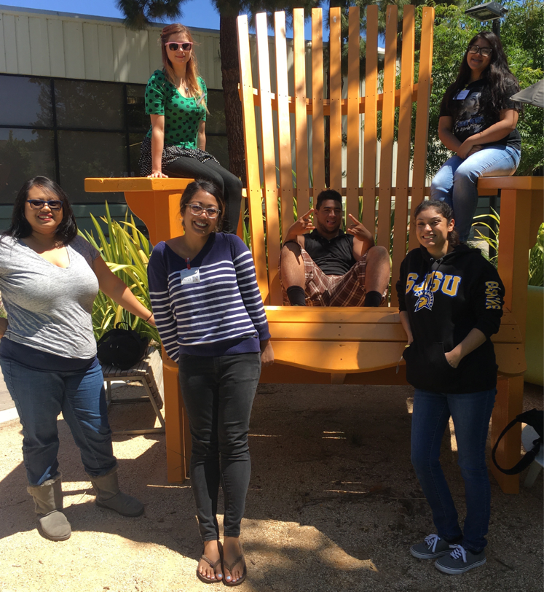
Let’s rate ourselves & get moving!

Slide 10
Don’t forget to pick up a copy of our “How to Guide”
THANK YOU FOR JOINING US TODAY!

